Slide 1
WILEY
IFRS EDITION
Prepared by
Coby Harmon
University of California, Santa Barbara
Westmont College

Slide 2
PREVIEW OF CHAPTER 5
Financial Accounting
IFRS 3rd Edition
Weygandt ● Kimmel ● Kieso

Slide 3
CHAPTER
5
Accounting for Merchandising Operations
LEARNING OBJECTIVES
After studying this chapter, you should be able to:
Identify the differences between service and merchandising companies.
Explain the recording of purchases under a perpetual inventory system.
Explain the recording of sales revenues under a perpetual inventory system.
Explain the steps in the accounting cycle for a merchandising company.
Prepare an income statement for a merchandiser.

Slide 4
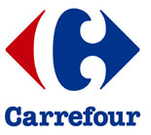
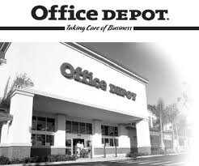
Merchandising Operations
Learning Objective 1
Identify the differences between service and merchandising companies.
Merchandising Companies
Buy and Sell Goods
Retailer
Wholesaler
Consumer
The primary source of revenues is referred to as sales revenue or sales.
LO 1

Slide 5
Merchandising Operations
Income Measurement
Sales
Revenue
Not used in a Service business.
Less
Illustration 5-1
Income measurement process for a merchandising company
Cost of
Goods Sold
Equals
Gross
Profit
Less
Operating
Expenses
Net
Income
(Loss)
Cost of goods sold is the total cost of merchandise sold during the period.
Equals
LO 1

Slide 6
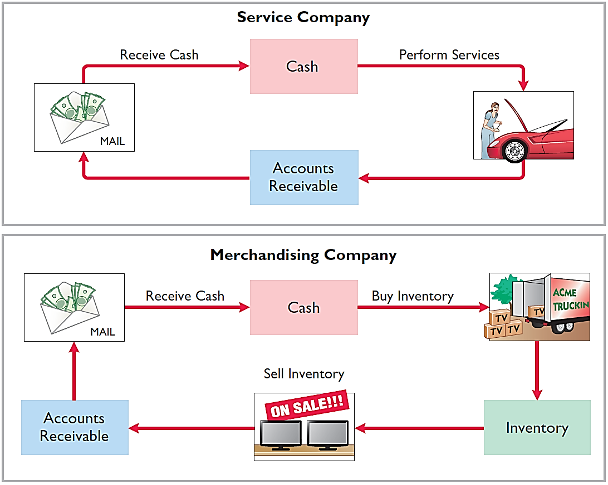
Operating Cycles
The operating cycle of a merchandising company ordinarily is longer than that of a service company.
Illustration 5-2
Illustration 5-3
LO 1

Slide 7
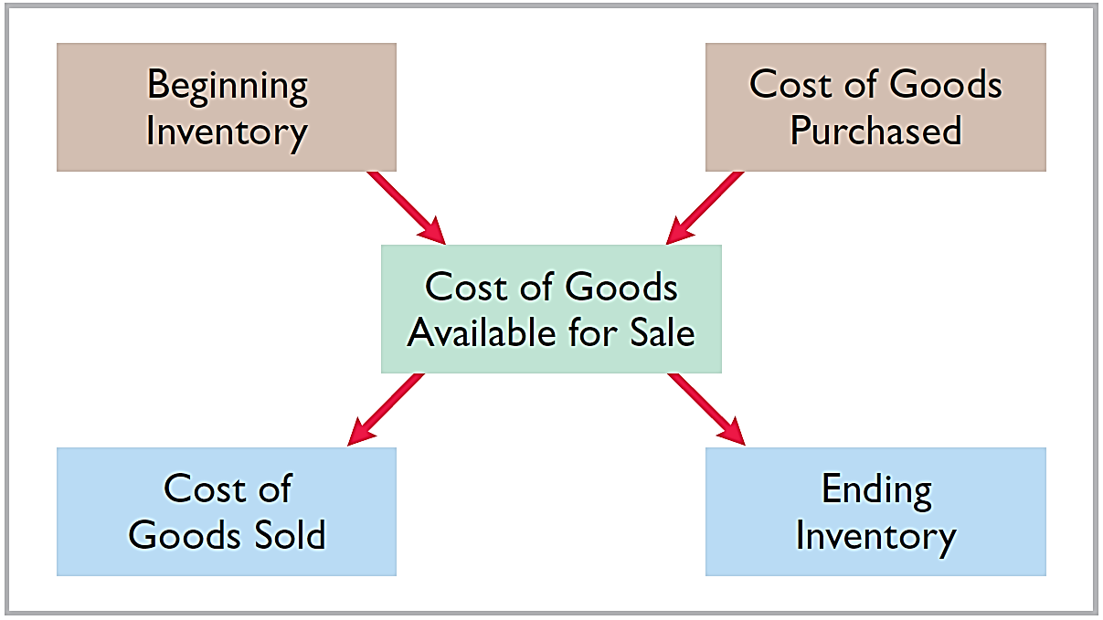
Flow of Costs
Illustration 5-4
Companies use either a perpetual inventory system or a periodic inventory system to account for inventory.
LO 1

Slide 8
Flow of Costs
PERPETUAL SYSTEM
Maintain detailed records of the cost of each inventory purchase and sale.
Records continuously show inventory that should be on hand for every item.
Company determines cost of goods sold each time a sale occurs.
LO 1

Slide 9
Flow of Costs
PERIODIC SYSTEM
Do not keep detailed records of the goods on hand.
Cost of goods sold determined by count at the end of the accounting period.
Calculation of Cost of Goods Sold:
Beginning inventory € 100,000
Add: Purchases, net 800,000
Goods available for sale 900,000
Less: Ending inventory 125,000
Cost of goods sold € 775,000
LO 1

Slide 10
Flow of Costs
ADVANTAGES OF THE PERPETUAL SYSTEM
Traditionally used for merchandise with high unit values.
Shows the quantity and cost of the inventory that should be on hand at any time.
Provides better control over inventories than a periodic system.
LO 1

Slide 11
INVESTOR INSIGHT
Snowboard Company Improves Its Share Appeal
Investors are often eager to invest in a company that has a hot new product. However, when a fast-growing snowboard-maker issued ordinary shares to the public for the first time, some investors expressed reluctance to invest in it because of a number of accounting control problems. To reduce investor concerns, the company implemented a perpetual inventory system to improve its control over inventory. In addition, the company stated that it would perform a physical inventory count every quarter until it felt that its perpetual inventory system was reliable.
LO 1

Slide 12
>
DO IT!
Indicate whether the following statements are true or false.
The primary source of revenue for a merchandising company results from performing services for customers.
The operating cycle of a service company is usually shorter than that of a merchandising company.
Sales revenue less cost of goods sold equals gross profit.
Ending inventory plus the cost of goods purchased equals cost of goods available for sale.
False
True
True
False
LO 1

Slide 13
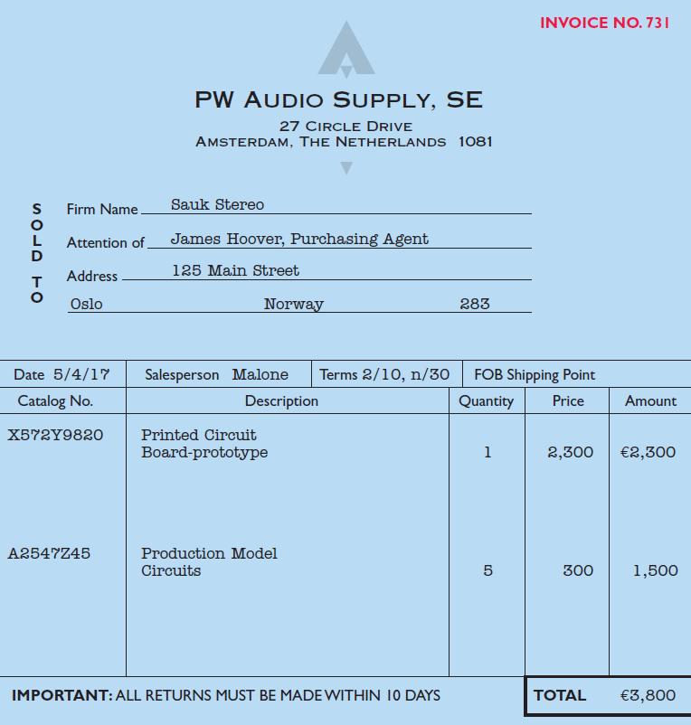
Recording Purchases of Merchandise
Learning Objective 2
Explain the recording of purchases under a perpetual inventory system.
Made using cash or credit (on account).
Normally record when goods are received from the seller.
Purchase invoice should support each credit purchase.
Illustration 5-6
Sales invoice used as purchase
invoice by Sauk Stereo

Slide 14
Recording Purchases of Merchandise
Illustration: Sauk Stereo (the buyer) uses as a purchase invoice the sales invoice prepared by PW Audio Supply, Inc. (the seller). Prepare the journal entry for Sauk Stereo for the invoice from PW Audio Supply.
Illustration 5-6
May 4
Inventory 3,800
Accounts Payable 3,800
LO 2

Slide 15
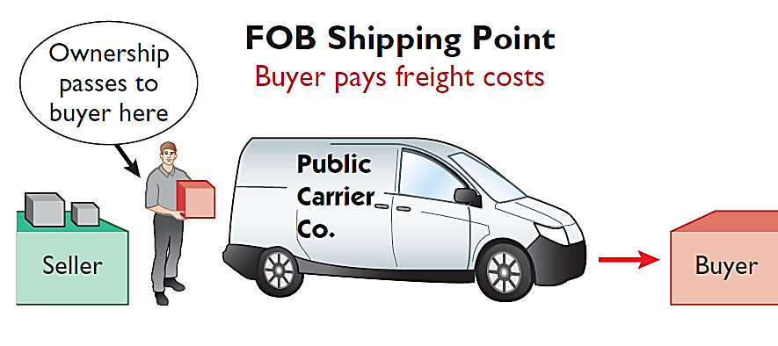
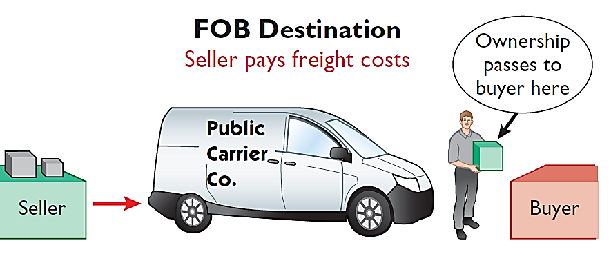
Freight Costs
Ownership of the goods passes to the buyer when the public carrier accepts the goods from the seller.
Ownership of the goods remains with the seller until the goods reach the buyer.
Illustration 5-7 Shipping terms
Freight costs incurred by the seller are an operating expense.
LO 2

Slide 16
Freight Costs
Illustration: Assume upon delivery of the goods on May 6, Sauk Stereo pays Public Freight Company €150 for freight charges, the entry on Sauk Stereo’s books is:
May 6
Inventory 150
Cash 150
Assume the freight terms on the invoice in Illustration 5-6 had required PW Audio Supply to pay the freight charges, the entry by PW Audio Supply would have been:
May 4
Freight-Out (Delivery Expense) 150
Cash 150
LO 2

Slide 17
Purchase Returns and Allowances
Purchaser may be dissatisfied because goods are damaged or defective, of inferior quality, or do not meet specifications.
Purchase Return
Purchase Allowance
Return goods for credit if the sale was made on credit, or for a cash refund if the purchase was for cash.
May choose to keep the merchandise if the seller will grant a reduction from the purchase price.
LO 2

Slide 18
Purchase Returns and Allowances
Illustration: Assume Sauk Stereo returned goods costing €300 to PW Audio Supply on May 8.
May 8
Accounts Payable 300
Inventory 300
LO 2

Slide 19
Purchase Returns and Allowances
Question
In a perpetual inventory system, a return of defective merchandise by a purchaser is recorded by crediting:
Purchases
Purchase Returns
Purchase Allowance
Inventory
LO 2

Slide 20
Purchase Discounts
Credit terms may permit buyer to claim a cash discount for prompt payment.
Advantages:
Purchaser saves money.
Seller shortens the operating cycle by converting the accounts receivable into cash earlier.
Example: Credit terms may read 2/10, n/30.
LO 2

Slide 21
Purchase Discounts
2/10, n/30
1/10 EOM
n/10 EOM
2% discount if paid within 10 days, otherwise net amount due within 30 days.
1% discount if paid within first 10 days of next month.
Net amount due within the first 10 days of the next month.
LO 2

Slide 22
Purchase Discounts
Illustration: Assume Sauk Stereo pays the balance due of €3,500 (gross invoice price of €3,800 less purchase returns and allowances of €300) on May 14, the last day of the discount period. Prepare the journal entry Sauk Stereo makes on May 14 to record the payment.
May 14
Accounts Payable 3,500
Inventory 70
Cash 3,430
(Discount = €3,500 x 2% = €70)
LO 2

Slide 23
Purchase Discounts
Illustration: If Sauk Stereo failed to take the discount, and instead made full payment of €3,500 on June 3, the journal entry would be:
June 3
Accounts Payable 3,500
Cash 3,500
LO 2

Slide 24
Purchase Discounts
Should discounts be taken when offered?
Discount of 2% on €3,500 €70.00
€3,500 invested at 10% for 20 days 19.18
Savings by taking the discount €50.82
Example: 2% for 20 days = Annual rate of 36.5%
€3,500 x 36.5% x 20 ÷ 365 = €70
LO 2

Slide 25
Summary of Purchasing Transactions
4th - Purchase
3,800
300
8th - Return
6th - Freight-in
150
70
14th - Discount
Balance
3,580
LO 2

Slide 26
>
DO IT!
On September 5, Zhu Company buys merchandise on account from Gao Company. The selling price of the goods is ¥15,000, and the cost to Gao Company was ¥8,000. On September 8, Zhu returns defective goods with a selling price of ¥2,000. Record the transactions on the books of Zhu Company.
Sept. 5
Inventory 15,000
Accounts Payable 15,000
Accounts Payable 2,000
Inventory 2,000
Sept. 8
LO 2

Slide 27
Recording Sales of Merchandise
Learning Objective 3
Explain the recording of sales revenue under a perpetual inventory system.
Made using cash or credit (on account).
Sales revenue, like service revenue, is recorded when the performance obligation is satisfied.
Performance obligation is satisfied when the goods are transferred from the seller to the buyer.
Sales invoice should support each credit sale.
Illustration 5-6
LO 3

Slide 28
Recording Sales of Merchandise
Journal Entries to Record a Sale
#1
Cash or Accounts Receivable XXX
Selling Price
Sales Revenue XXX
#2
Cost of Goods Sold XXX
Cost
Inventory XXX
LO 3

Slide 29
Recording Sales of Merchandise
Illustration: PW Audio Supply records the sale of €3,800 on May 4 to Sauk Stereo on account (Illustration 5-6) as follows (assume the merchandise cost PW Audio Supply €2,400).
May 4
Accounts Receivable 3,800
Sales Revenue 3,800
4
Cost of Goods Sold 2,400
Inventory 2,400
LO 3

Slide 30
ANATOMY OF A FRAUD
Holly Harmon was a cashier at a national superstore for only a short while when she began stealing merchandise using three methods. Under the first method, her husband or friends took UPC labels from cheaper items and put them on more expensive items. Holly then scanned the goods at the register. Using the second method, Holly scanned an item at the register but then voided the sale and left the merchandise in the shopping cart. A third approach was to put goods into large plastic containers. She scanned the plastic containers but not the goods within them. One day, Holly did not call in sick or show up for work. In such instances, the company reviews past surveillance tapes to look for suspicious activity by employees. This enabled the store to observe the thefts and to identify the participants.
Total take: $12,000
The Missing Controls
Human resource controls. A background check would have revealed Holly’s previous criminal record. She would not have been hired as a cashier.
LO 3

Slide 31
ANATOMY OF A FRAUD
Holly Harmon was a cashier at a national superstore for only a short while when she began stealing merchandise using three methods. Under the first method, her husband or friends took UPC labels from cheaper items and put them on more expensive items. Holly then scanned the goods at the register. Using the second method, Holly scanned an item at the register but then voided the sale and left the merchandise in the shopping cart. A third approach was to put goods into large plastic containers. She scanned the plastic containers but not the goods within them. One day, Holly did not call in sick or show up for work. In such instances, the company reviews past surveillance tapes to look for suspicious activity by employees. This enabled the store to observe the thefts and to identify the participants.
Total take: $12,000
The Missing Controls
Physical controls. Software can flag high numbers of voided transactions or a high number of sales of low-priced goods. Random comparisons of video records with cash register records can ensure that the goods reported as sold on the register are the same goods that are shown being purchased on the video recording. Employees should be aware that they are being monitored.
LO 3

Slide 32
Sales Returns and Allowances
“Flip side” of purchase returns and allowances.
Contra-revenue account to Sales Revenue (debit).
Sales not reduced (debited) because:
Would obscure importance of sales returns and allowances as a percentage of sales.
Could distort comparisons.
LO 3

Slide 33
Sales Returns and Allowances
Illustration: Prepare the entry PW Audio Supply would make to record the credit for returned goods that had a €300 selling price (assume a €140 cost). Assume the goods were not defective.
May 8
Sales Returns and Allowances 300
Accounts Receivable 300
8
Inventory 140
Cost of Goods Sold 140
LO 3

Slide 34
Sales Returns and Allowances
Illustration: Assume the returned goods were defective and had a scrap value of €50, PW Audio would make the following entries:
May 8
Sales Returns and Allowances 300
Accounts Receivable 300
8
Inventory 50
Cost of Goods Sold 50
LO 3

Slide 35
Sales Returns and Allowances
Question
The cost of goods sold is determined and recorded each time a sale occurs in:
periodic inventory system only.
a perpetual inventory system only.
both a periodic and perpetual inventory system.
neither a periodic nor perpetual inventory system.
LO 3

Slide 36
ACCOUNTING ACROSS THE ORGANIZATION
Merchandiser’s Accounting Causes Alarm
Accounting for merchandising transactions is not always as easy as it might first appear. Recently, Tesco (GBR) announced that it had overstated profits by £263 million over a three-year period. The error related to how Tesco accounted for amounts received from suppliers for promotional activities of those companies’ products. When a retailer runs advertisements promoting a particular product, the producer of that product shares part of the advertising cost. Typically, the producer pays the merchandiser its share of the advertising cost as much as a year before the advertisement is run. The questions become, how should these amounts be reported by the merchandiser at the time it receives the funds, and when should these amounts affect income? The scandal surrounding this accounting treatment was serious enough that it caused the company’s chairman to resign, and an outside auditing firm was brought in to investigate. One analyst commentated that “we can never recall a period so damaging to the reputation of the company.”
Source: Jenny Anderson, “Tesco Chairman to Step Down as Overstatement of Profit Grows,” The New York Times Online (October 23, 2014).
LO 3

Slide 37
Sales Discount
Offered to customers to promote prompt payment of the balance due.
Contra-revenue account (debit) to Sales Revenue.
LO 3

Slide 38
Sales Discount
Illustration: Assume Sauk Stereo pays the balance due of €3,500 (gross invoice price of €3,800 less purchase returns and allowances of €300) on May 14, the last day of the discount period. Prepare the journal entry PW Audio Supply makes to record the receipt on May 14.
May 14
Cash 3,430
Sales Discounts 70
*
Accounts Receivable 3,500
* [(€3,800 – €300) X 2%]
LO 3

Slide 39
>
DO IT!
On September 5, Zhu Company buys merchandise on account from Gao Company. The selling price of the goods is ¥15,000, and the cost to Gao Company was ¥8,000. On September 8, Zhu returns defective goods with a selling price of ¥2,000 and the fair value of ¥300. Record the transactions on the books of Gao Company.
Sept. 5
Accounts Receivable 15,000
Sales Revenue 15,000
Cost of Goods Sold 8,000
Inventory 8,000
Sept. 5
LO 3

Slide 40
>
DO IT!
On September 5, Zhu Company buys merchandise on account from Gao Company. The selling price of the goods is ¥15,000, and the cost to Gao Company was ¥8,000. On September 8, Zhu returns defective goods with a selling price of ¥2,000 and the fair value of ¥300. Record the transactions on the books of Gao Company.
Sept. 8
Sales Returns and Allowances 2,000
Accounts Receivable 2,000
Inventory 300
Cost of Goods Sold 300
Sept. 8
LO 3

Slide 41
Recording Sales of Merchandise
Learning Objective 4
Explain the steps in the accounting cycle for a merchandising company.
Adjusting Entries
Generally the same as a service company.
One additional adjustment to make the records agree with the actual inventory on hand.
Involves adjusting Inventory and Cost of Goods Sold.
LO 4

Slide 42
Adjusting Entries
Illustration: Suppose that PW Audio Supply has an unadjusted balance of €40,500 in Merchandise Inventory. Through a physical count, PW Audio determines that its actual merchandise inventory at year-end is €40,000. The company would make an adjusting entry as follows.
Cost of Goods Sold 500
Inventory 500
LO 4

Slide 43
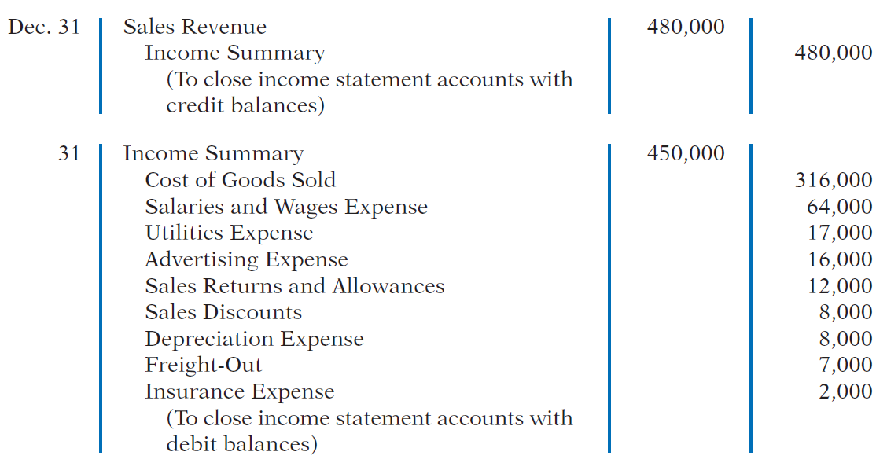
Closing Entries
LO 4

Slide 44
Closing Entries
LO 4

Slide 45
>
DO IT!
The trial balance of Celine’s Sports Wear Shop at December 31 shows Inventory €25,000, Sales Revenue €162,400, Sales Returns and Allowances €4,800, Sales Discounts €3,600, Cost of Goods Sold $110,000, Rent Revenue €6,000, Freight-Out €1,800, Rent Expense €8,800, and Salaries and Wages Expense €22,000. Prepare the closing entries for the above accounts.
Dec. 31
Sales Revenue 162,400
Rent Revenue 6,000
Income Summary 168,400
LO 4

Slide 46
The trial balance of Celine’s Sports Wear Shop at December 31 shows Inventory €25,000, Sales Revenue €162,400, Sales Returns and Allowances €4,800, Sales Discounts €3,600, Cost of Goods Sold €110,000, Rent Revenue €6,000, Freight-Out €1,800, Rent Expense €8,800, and Salaries and Wages Expense €22,000. Prepare the closing entries for the above accounts.
Dec. 31
Income Summary 151,000
Cost of Goods Sold 110,000
Sales Returns and Allowances 4,800
Sales Discounts 3,600
Freight-Out 1,800
Rent Expense 8,800
Salaries and Wages Expense 22,000
LO 4

Slide 47
Forms of Financial Statements
Learning Objective 5
Prepare an income statement for a merchandiser.
Income Statement
Primary source of information for evaluating a company’s performance.
Format is designed to differentiate between the various sources of income and expense.
LO 5

Slide 48
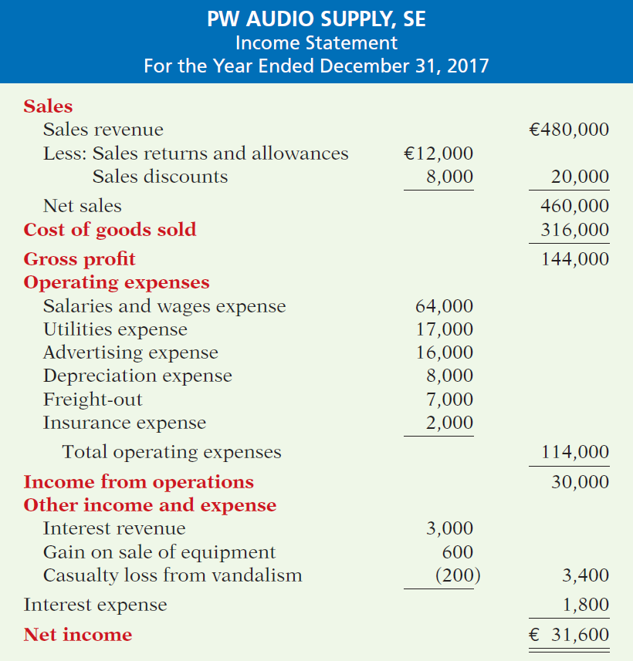
Income Statement
The income statement is a primary source of information for evaluating a company’s
performance.
Illustration 5-14
LO 5

Slide 49
Income Statement
Key Items:
Net sales
Illustration 5-14
LO 5

Slide 50
Income Statement
Key Items:
Net sales
Gross profit
Illustration 5-14
LO 5

Slide 51
Income Statement
Key Items:
Net sales
Gross profit
Illustration 5-11
Gross profit rate formula
and computation
Illustration 5-14
LO 5

Slide 52
Income Statement
Key Items:
Net sales
Gross profit
Operating expenses
Illustration 5-14
LO 5

Slide 53
Income Statement
Key Items:
Net sales
Gross profit
Operating expenses
Other income and expense
Illustration 5-14
LO 5

Slide 54
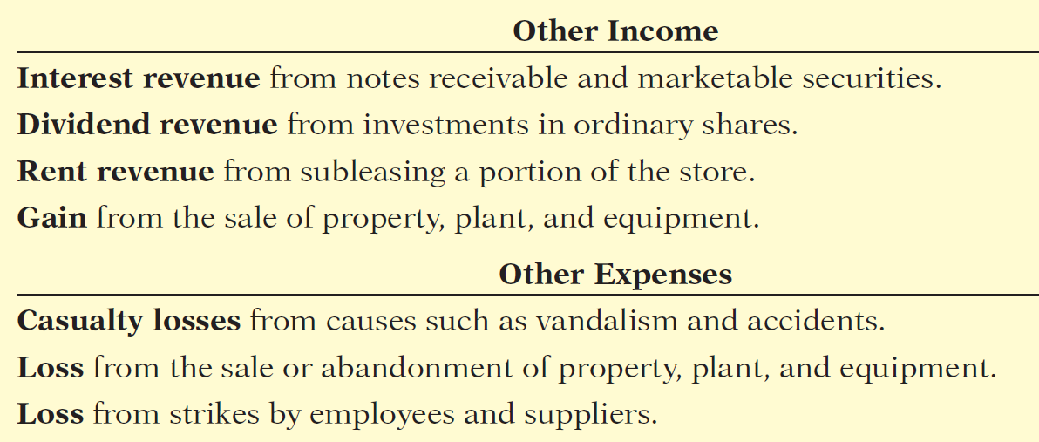
Income Statement
Key Items:
Net sales
Gross profit
Operating expenses
Other income and expense
Illustration 5-14
LO 5

Slide 55
Income Statement
Key Items:
Net sales
Gross profit
Operating expenses
Other income and expense
Interest expense
Illustration 5-14
LO 5

Slide 56
Income Statement
Key Items:
Net sales
Gross profit
Operating expenses
Other income and expense
Interest expense
Net income
Illustration 5-14
LO 5

Slide 57
Income Statement
Question
The income statement for a merchandiser shows each of the following features except:
gross profit.
cost of goods sold.
a sales section.
investing activities section.
LO 5

Slide 58
COMPREHENSIVE INCOME
Includes certain adjustments to pension plan assets, gains and losses on foreign currency translation, and unrealized gains and losses on certain types of investments.
Illustration 5-15
Separate statement of net
income and comprehensive
income
Reported in a combined statement of net income and comprehensive income, or in a separate schedule that reports only comprehensive income.
LO 5

Slide 59
ACCOUNTING ACROSS THE ORGANIZATION
Online Sales Stall in India
India is well known for its large pool of excellent software engineers. Therefore, it may come as a surprise that online merchandise sales are only starting to take hold in this country. The reason for the delay compared to many other countries is that, until recently, consistent Internet access was limited to a small portion of the Indian population. But, experts predict that by 2015 up to 200 million Indians will have Internet access. To take advantage of this, two software engineers started the online merchandising company Flipkart (IND). Their goal is “to be the Amazon. com of India.” Sales hit $20 million in a recent year, but the company faces many barriers to both growth and profitability. First, few Indians have credit cards, so many transactions must be done in cash. And, while the company has a book catalog of over 100 million titles, it is very difficult to deliver those books (or anything else) over India’s poorly maintained roads. As a consequence, even if Internet access improves rapidly, online merchandisers need to see improvements in the banking and transportation systems in India for sales to really take off.
Source: Amol Sharma, “Dot-Coms Begin to Blossom in India,” Wall Street Journal (April 12, 2011).
LO 5

Slide 60
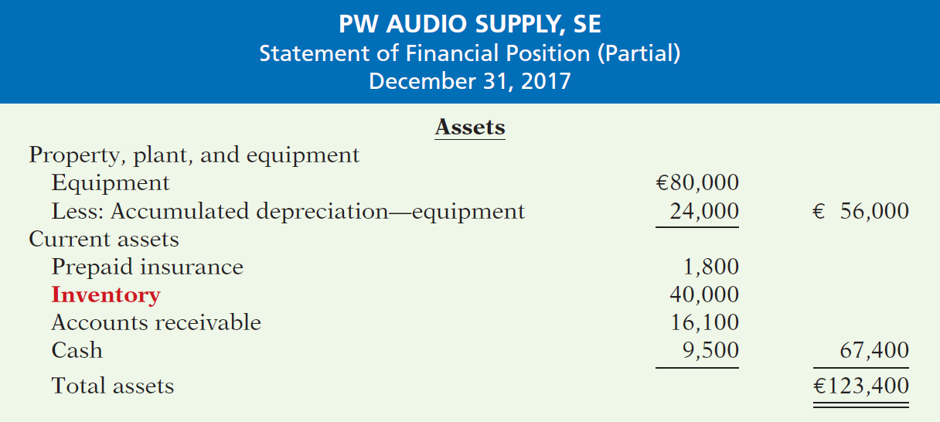
Inventory Presentation in the Classified Statement of Financial Position
Illustration 5-16
Assets section of a classified statement of financial position
LO 5

Slide 61
>
DO IT!
You are presented with the following list of accounts from the adjusted trial balance for merchandiser Gorman Company. Indicate in which financial statement and under what classification each of the following would be reported.
Financial Statement
Account
Classification
Accounts payable
SFP
Current liabilities
Accounts receivable
SFP
Current assets
Accumulated Depreciation-Buildings
SFP
Property, plant, and equipment
Accumulated Depreciation-Equipment
SFP
Property, plant, and equipment
Advertising Expense
IS
Operating expenses
Buildings
SFP
Property, plant, and equipment
Cash
SFP
Current assets
Depreciation Expense
IS
Operating expenses
Dividends
RES
Deduction section
LO 5

Slide 62
>
DO IT!
You are presented with the following list of accounts from the adjusted trial balance for merchandiser Gorman Company. Indicate in which financial statement and under what classification each of the following would be reported.
Financial Statement
Account
Classification
Equipment
SFP
Property, plant, and equipment
Freight-Out
IS
Operating expenses
Gain on Disposal of Plant Assets
IS
Other income and expense
Insurance Expense
IS
Operating expenses
Interest Expense
IS
Interest expense
Interest Payable
SFP
Current liabilities
Inventory
SFP
Current assets
Land
SFP
Property, plant, and equipment
Notes Payable (due in 3 years)
SFP
Non-current liabilities
LO 5

Slide 63
>
DO IT!
You are presented with the following list of accounts from the adjusted trial balance for merchandiser Gorman Company. Indicate in which financial statement and under what classification each of the following would be reported.
Financial Statement
Account
Classification
Property Taxes Payable
SFP
Current liabilities
Salaries and Wages Expense
IS
Operating expenses
Salaries and Wages Payable
SFP
Current liabilities
Sales Returns and Allowances
IS
Sales
Sales Revenue
IS
Sales
Share Capital—Ordinary
SFP
Equity
Utilities Expense
IS
Operating expenses
LO 5

Slide 64
APPENDIX 5A
Worksheet for a Merchandising Company
Learning Objective 6
Prepare a worksheet for a merchandising company.
Using a Worksheet
As indicated in Chapter 4, a worksheet enables
companies to prepare financial statements before they journalize and post adjusting entries. The steps in preparing a worksheet for a merchandising company are the same as for a service company. Illustration 5A-1 shows the worksheet for PW Audio Supply (excluding nonoperating items). The unique accounts for a merchandiser using a perpetual inventory system are in red.
LO 6

Slide 65
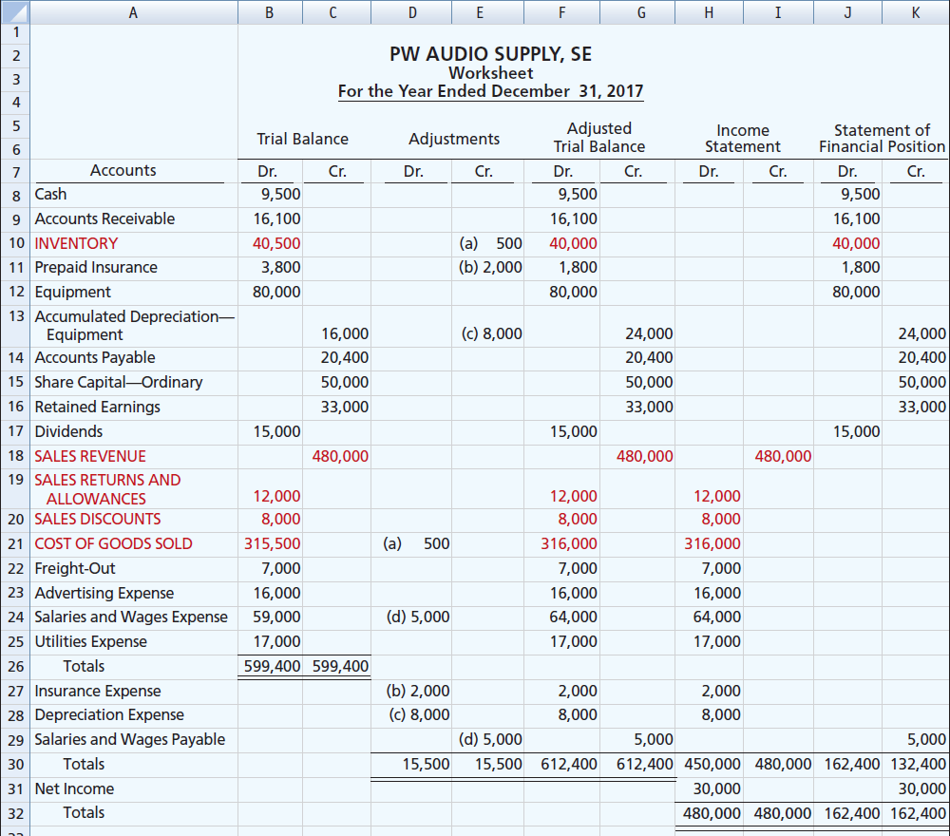
Illustration 5A-1
Worksheet for merchandising company
LO 6

Slide 66
APPENDIX 5B
Periodic Inventory System
Learning Objective 7
Explain the recording of purchases and sales of inventory under a periodic inventory system.
Determining Cost of Goods Sold Under a Periodic System
No running account of changes in
inventory.
Ending inventory determined by physical count.
Cost of goods sold not determined until the end of the period.
LO 7

Slide 67
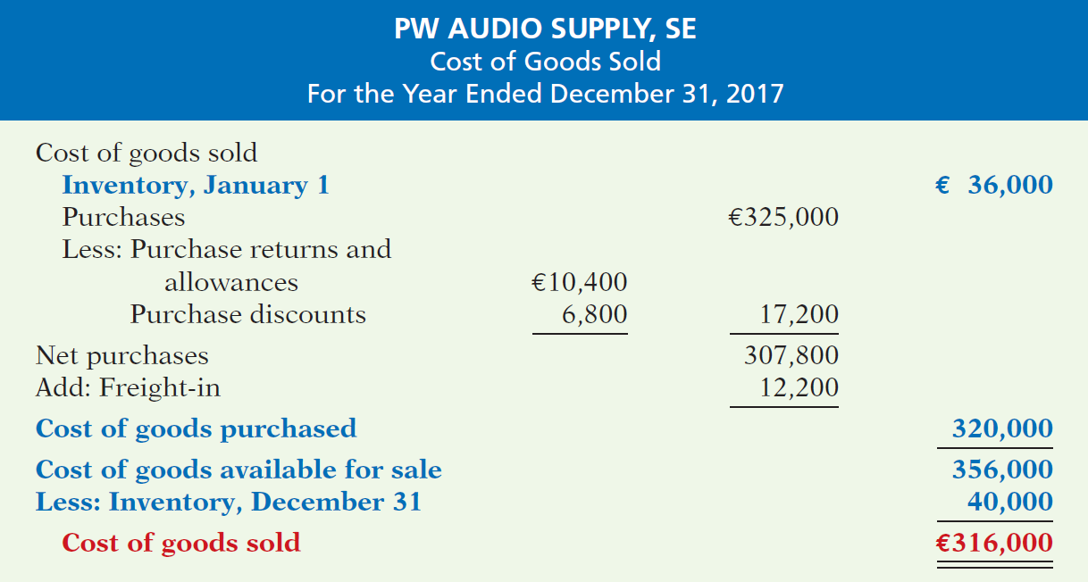
Determining Cost of Goods Sold Under a Periodic System
Illustration 5B-2
Cost of goods sold for a
merchandiser using a periodic
inventory system
Illustration 5B-2
LO 7

Slide 68
Recording Merchandise Transactions
Record revenues when sales are made.
Do not record cost of merchandise sold on the date of sale.
Physical inventory count determines:
Cost of merchandise on hand and
Cost of merchandise sold during the period.
Record purchases in Purchases account.
Purchase returns and allowances, Purchase discounts, and Freight costs are recorded in separate accounts.
LO 7

Slide 69
Recording Purchases of Merchandise
Illustration: On the basis of the sales invoice (Illustration 5-6) and receipt of the merchandise ordered from PW Audio Supply, Sauk Stereo records the €3,800 purchase as follows.
May 4
Purchases 3,800
Accounts Payable 3,800
LO 7

Slide 70
Recording Purchases of Merchandise
FREIGHT COSTS
Illustration: If Sauk pays Public Freight Company €150
for freight charges on its purchase from PW Audio Supply on May 6, the entry on Sauk’s books is:
May 6
Freight-In (Transportation-In) 150
Cash 150
LO 7

Slide 71
Recording Purchases of Merchandise
PURCHASE RETURNS AND ALLOWANCES
Illustration: Sauk Stereo returns €300 of goods to PW Audio Supply and prepares the following entry to recognize the return.
May 8
Accounts Payable 300
Purchase Returns and Allowances 300
LO 7

Slide 72
Recording Purchases of Merchandise
PURCHASE DISCOUNTS
Illustration: On May 14 Sauk Stereo pays the balance due on account to PW Audio Supply, taking the 2% cash discount allowed by PW Audio for payment within 10 days. Sauk
Stereo records the payment and discount as follows.
May 14
Accounts Payable 3,500
Purchase Discounts 70
Cash 3,430
LO 7

Slide 73
Recording Sales of Merchandise
Illustration: PW Audio Supply, records the sale of €3,800 of merchandise to Sauk Stereo on May 4 (sales invoice No. 731, Illustration 5-6) as follows.
May 4
Accounts Receivable 3,800
Sales Revenue 3,800
No entry is recorded for cost of goods sold at the time of the sale under a periodic system.
LO 7

Slide 74
Recording Sales of Merchandise
SALES RETURNS AND ALLOWANCES
Illustration: To record the returned goods received from Sauk Stereo on May 8, PW Audio Supply records the €300 sales return as follows.
May 8
Sales Returns and Allowances 300
Accounts Receivable 300
LO 7

Slide 75
Recording Sales of Merchandise
SALES DISCOUNTS
Illustration: On May 14, PW Audio Supply receives payment of €3,430 on account from Sauk Stereo. PW Audio honors the 2% cash discount and records the payment of Sauk’s account receivable in full as follows.
May 14
Cash 3,430
Sales Discounts 70
Accounts Receivable 3,500
LO 7

Slide 76
Recording Sales of Merchandise
COMPARISON OF ENTRIES
Illustration 5B-3
Comparison of entries for perpetual and periodic inventory systems
LO 7

Slide 77
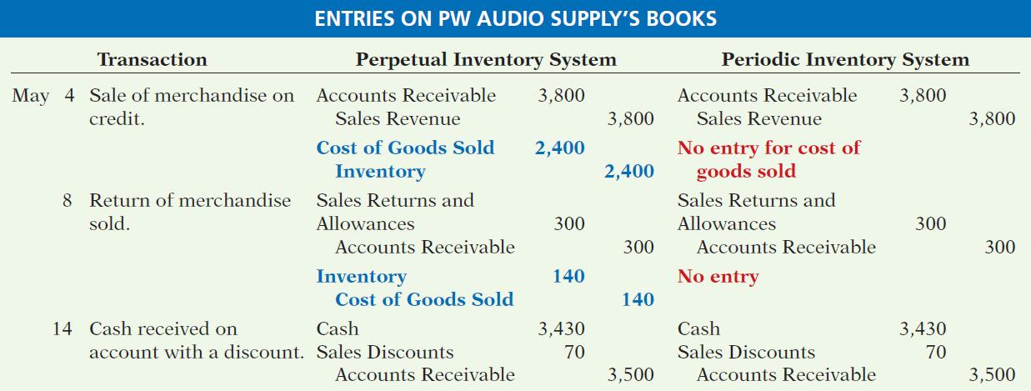
Recording Sales of Merchandise
COMPARISON OF ENTRIES
Illustration 5B-3
Comparison of entries for perpetual and periodic inventory systems
LO 7

Slide 78
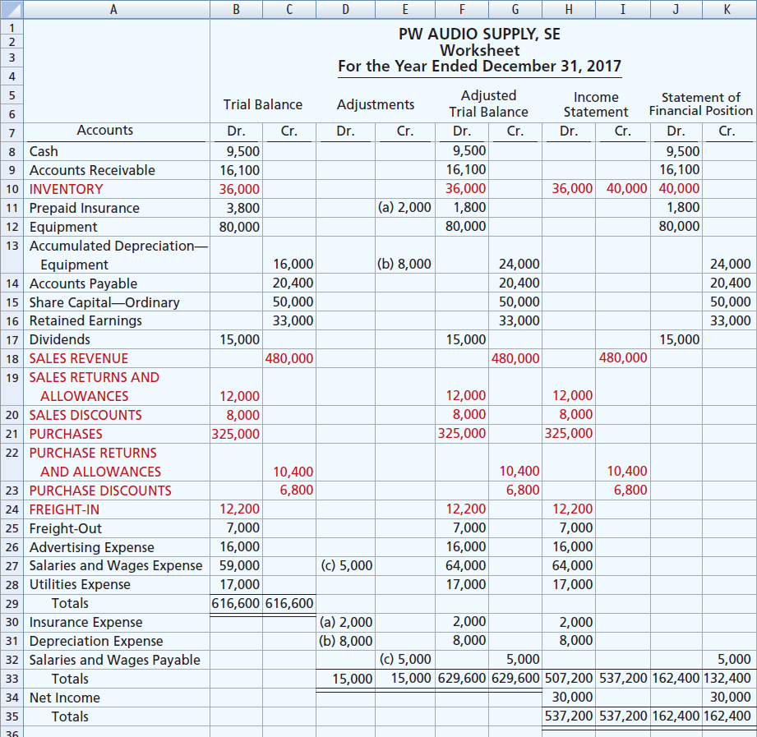
Illustration 5B-5
Worksheet for merchandising
company—periodic inventory system
LO 7

Slide 79
A Look at U.S. GAAP
Learning Objective 8
Compare the accounting for merchandising under IFRS and U.S. GAAP.
Key Points
Similarities
Under both GAAP and IFRS, a company can choose to use either a perpetual or a periodic system.
Inventories are defined by IFRS as held-for-sale in the ordinary course of business, in the process of production for such sale, or in the form of materials or supplies to be consumed in the production process or in the performing of services. The definition under GAAP is essentially the same.
Similar to GAAP, comprehensive income under IFRS includes unrealized gains and losses (such as those on non-trading securities) that are not included in the calculation of net income.
LO 8

Slide 80
A Look at U.S. GAAP
Key Points
Differences
Under GAAP, companies generally classify income statement items by function. Classification by function leads to descriptions like administration, distribution, and manufacturing. Under IFRS, companies must classify expenses by either nature or by function. Classification by nature leads to descriptions such as the following: salaries, depreciation expense, and utilities expense. If a company uses the functional-expense method on the income statement, disclosure by nature is required in the notes to the financial statements.
Presentation of the income statement under GAAP follows either a single-step or multiple-step format. IFRS does not mention a single-step or multiple-step approach.
LO 8

Slide 81
A Look at U.S. GAAP
Key Points
Differences
Under IFRS, revaluation of land, buildings, and intangible assets is permitted. The initial gains and losses resulting from this revaluation are reported as adjustments to equity, often referred to as other comprehensive income. The effect of this difference is that the use of IFRS instead of GAAP results in more transactions affecting equity (other comprehensive income) but not net income.
IFRS requires that two years of income statement information be presented, whereas GAAP requires three years.
LO 8

Slide 82
A Look at U.S. GAAP
Looking to the Future
The IASB and FASB are working on a project that would rework the structure of financial statements. Specifically, this project will address the issue of how to classify various items in the income statement. A main goal of this new approach is to provide information that better represents how businesses are run. In addition, this approach draws attention away from just one number—net income. It will adopt major groupings similar to those currently used by the statement of cash flows (operating, investing, and financing), so that numbers can be more readily traced across statements. For example, the amount of income that is generated by operations would be traceable to the assets and liabilities used to generate the income. Finally, this approach would also provide detail, beyond that currently seen in most statements (either GAAP or IFRS), by requiring that line items be presented both by function and by nature. The new financial statement format was heavily influenced by suggestions from financial analysts.
LO 8

Slide 83
A Look at U.S. GAAP
A Look at IFRS
GAAP Self-Test Questions
Which of the following would not be included in the definition of inventory under GAAP?
Photocopy paper held for sale by an office-supply store.
Stereo equipment held for sale by an electronics store.
Used office equipment held for sale by the human relations department of a plastics company.
All of the above would meet the definition.
LO 8

Slide 84
A Look at U.S. GAAP
A Look at IFRS
IFRS Self-Test Questions
Which of the following would not be a line item of a company reporting costs by nature?
Depreciation expense.
Interest expense.
Salaries and wages expense.
Manufacturing expense.
LO 8

Slide 85
A Look at U.S. GAAP
A Look at IFRS
IFRS Self-Test Questions
Which of the following statements is false?
GAAP specifically requires use of a multiple-step income statement.
Under GAAP, companies can use either a perpetual or periodic system.
The proposed new format for financial statements was heavily influenced by the suggestions of financial statement analysts.
The new income statement format will try to de-emphasize the focus on the “net income” line item.
LO 8

Slide 86
Copyright
“Copyright © 2016 John Wiley & Sons, Inc. All rights reserved. Reproduction or translation of this work beyond that permitted in Section 117 of the 1976 United States Copyright Act without the express written permission of the copyright owner is unlawful. Request for further information should be addressed to the Permissions Department, John Wiley & Sons, Inc. The purchaser may make back-up copies for his/her own use only and not for distribution or resale. The Publisher assumes no responsibility for errors, omissions, or damages, caused by the use of these programs or from the use of the information contained herein.”

