Slide 1
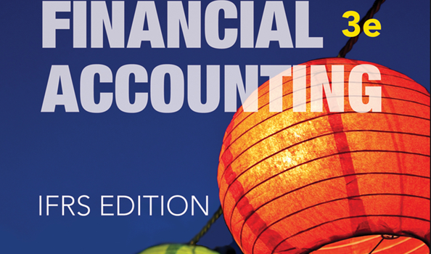
WILEY
IFRS EDITION
Prepared by
Coby Harmon
University of California, Santa Barbara
Westmont College

Slide 2
PREVIEW OF CHAPTER 12
Financial Accounting
IFRS 3rd Edition
Weygandt ● Kimmel ● Kieso

Slide 3
CHAPTER
12
Investments
LEARNING OBJECTIVES
After studying this chapter, you should be able to:
Discuss why corporations invest in debt and share securities.
Explain the accounting for debt investments.
Explain the accounting for share investments.
Describe the use of consolidated financial statements.
Indicate how debt and share investments are reported in financial statements.
Distinguish between short-term and long-term investments.

Slide 4
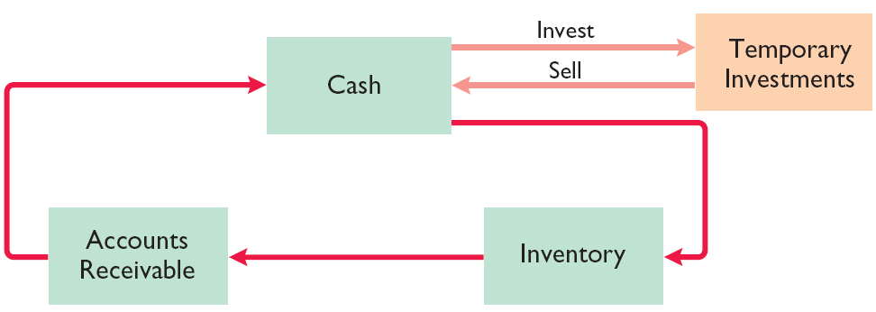
Why Corporations Invest
Learning Objective 1
Discuss why corporations invest in debt and share securities.
Corporations purchase investments in debt or share securities for one of three reasons.
Corporation may have excess cash.
To generate earnings from investment income.
For strategic reasons.
Illustration 12-1
Temporary investments and the operating cycle
LO 1

Slide 5
Why Corporations Invest
Question
Which of the following is not a primary reason why corporations invest in debt and equity securities?
They wish to gain control of a competitor.
They have excess cash.
They wish to move into a new line of business.
They are required to by law.
LO 2

Slide 6
Accounting for Debt Investments
Learning Objective 2
Explain the accounting for debt investments.
Investments in government and corporation bonds.
Entries are made to record
the acquisition,
the interest revenue, and
the sale.
Recording Acquisition of Bonds
Cost includes all expenditures necessary to acquire these investments, such as the price paid plus brokerage fees (commissions), if any.
LO 2

Slide 7
Recording Bond Interest
Calculate and record interest revenue based upon the
carrying value of the bond
times the interest rate
times the portion of the year the bond is outstanding.
LO 2

Slide 8
Recording Sale of Bonds
Credit the investment account for the cost of the bonds.
Record as a gain or loss
any difference between the net proceeds from the sale (sales price less brokerage fees) and
the cost of the bonds.
LO 2

Slide 9
Accounting for Debt Investments
Illustration: Kuhl NV acquires 50 Doan SA 8%, 10-year, €1,000 bonds on January 1, 2017, for €50,000. The entry to record the investment is:
Jan. 1
Debt Investments 50,000
Cash 50,000
LO 2

Slide 10
Accounting for Debt Investments
Kuhl NV acquires 50 Doan SA 8%, 10-year, €1,000 bonds on January 1, 2017, for €50,000. The bonds pay interest annually on January 1. If Kuhl NV’s fiscal year ends on December 31, prepare the entry to accrue interest earned by December 31.
Dec. 31
Interest Receivable 4,000
Interest Revenue 4,000
*
* (€50,000 x 8% = €4,000)
LO 2

Slide 11
Accounting for Debt Investments
Kuhl reports Interest Receivable as a current asset in the statement of financial position. It reports Interest Revenue under “Other income and expense” in the income statement. Kuhl reports receipt of the interest on January 1 as follows.
Jan. 1
Cash 4,000
Interest Receivable 4,000
LO 2

Slide 12
Accounting for Debt Investments
Assume that Kuhl NV receives net proceeds of €54,000 on the sale of the Doan SA bonds on January 1, 2018, after receiving the interest due. Prepare the entry to record the sale of the bonds.
Jan. 1
Cash 54,000
Debt Investments 50,000
Gain on Sale of Debt Investments 4,000
LO 2

Slide 13
Accounting for Debt Investments
Question
Hanes Company sells debt investments costing £26,000 for £28,000, plus accrued interest that has been recorded. In journalizing the sale, credits are to:
Debt Investments and Loss on Sale of Debt Investments.
Debt Investments, Gain on Sale of Debt Investments, and Interest Receivable.
Share Investments and Interest Receivable.
No correct answer is given.
LO 2

Slide 14
Investor Insight Hey, I Thought It Was Safe?
It is often stated that bond investments are safer than share investments. After all, with an investment in bonds, you are guaranteed return of principal and interest payments over the life of the bonds. However, here are some other factors you may want to consider:
In 2013, the value of bonds fell by 2% due to interest rate risk. That is, when interest rates rise, it makes the yields paid on existing bonds less attractive. As a result, the price of the existing bond you are holding falls.
While interest rates are currently low, it is likely that they will increase in the future. If you hold bonds, there is a real possibility that the value of your bonds will be reduced.
Credit risk also must be considered. Credit risk means that a company may not be able to pay back what it borrowed. Former bondholders in companies that declared bankruptcy saw their bond values drop substantially.
An advantage of a bond investment over shares is that if you hold it to maturity, you will receive your principal and also interest payments over the life of the bond. But if you have to sell your bond investment before maturity, you may be facing a roller coaster regarding its value.
LO 2

Slide 15
>
DO IT!
Waldo AG had the following transactions pertaining to debt investments.
Jan. 1, 2017 Purchased 30, €1,000 Hillary AG 10% bonds for €30,000. Interest is payable annually on January 1. Dec. 31, 2017 Accrued interest on Hillary AG bonds in 2017.
Jan. 1, 2018 Received interest on Hillary AG bonds.
Jan. 1, 2018 Sold 15 Hillary AG bonds for €14,600.
Dec. 31, 2018 Accrued interest on Hillary AG bonds in 2018.
Journalize the transactions.
Jan. 1, 2017
Debt Investments 30,000
Cash 30,000
LO 2

Slide 16
>
DO IT!
Waldo AG had the following transactions pertaining to debt investments.
Jan. 1, 2017 Purchased 30, €1,000 Hillary AG 10% bonds for €30,000. Interest is payable annually on January 1. Dec. 31, 2017 Accrued interest on Hillary AG bonds in 2017.
Jan. 1, 2018 Received interest on Hillary AG bonds.
Jan. 1, 2018 Sold 15 Hillary AG bonds for €14,600.
Dec. 31, 2018 Accrued interest on Hillary AG bonds in 2018.
Journalize the transactions.
Dec. 31, 2017
Interest Receivable 3,000
Interest Revenue (€30,000 × 10%) 3,000
LO 2

Slide 17
>
DO IT!
Waldo AG had the following transactions pertaining to debt investments.
Jan. 1, 2017 Purchased 30, €1,000 Hillary AG 10% bonds for €30,000. Interest is payable annually on January 1. Dec. 31, 2017 Accrued interest on Hillary AG bonds in 2017.
Jan. 1, 2018 Received interest on Hillary AG bonds.
Jan. 1, 2018 Sold 15 Hillary AG bonds for €14,600.
Dec. 31, 2018 Accrued interest on Hillary AG bonds in 2018.
Journalize the transactions.
Jan. 1, 2018
Cash 3,000
Interest Receivable 3,000
LO 2

Slide 18
>
DO IT!
Waldo AG had the following transactions pertaining to debt investments.
Jan. 1, 2017 Purchased 30, €1,000 Hillary AG 10% bonds for €30,000. Interest is payable annually on January 1. Dec. 31, 2017 Accrued interest on Hillary AG bonds in 2017.
Jan. 1, 2018 Received interest on Hillary AG bonds.
Jan. 1, 2018 Sold 15 Hillary AG bonds for €14,600.
Dec. 31, 2018 Accrued interest on Hillary AG bonds in 2018.
Journalize the transactions.
Jan. 1, 2018
Cash 14,600
Loss on Sale of Debt Investments 400
Debt Investments (€30,000 × 15/30) 15,000
LO 2

Slide 19
>
DO IT!
Waldo AG had the following transactions pertaining to debt investments.
Jan. 1, 2017 Purchased 30, €1,000 Hillary AG 10% bonds for €30,000. Interest is payable annually on January 1. Dec. 31, 2017 Accrued interest on Hillary AG bonds in 2017.
Jan. 1, 2018 Received interest on Hillary AG bonds.
Jan. 1, 2018 Sold 15 Hillary AG bonds for €14,600.
Dec. 31, 2018 Accrued interest on Hillary AG bonds in 2018.
Journalize the transactions.
Dec. 31, 2018
Interest Receivable 1,500
Interest Revenue (€15,000 × 10%) 1,500
LO 2

Slide 20
Accounting for Share Investments
Learning Objective 3
Explain the accounting for share investments.
Investor’s Ownership Interest in Investee’s Ordinary Shares
0 ------------------20% -------------- 50% -------------------- 100%
No significant influence on Investee
Significant influence on Investee
Control usually exists
Investment valued on parent’s books using Cost Method or Equity Method (investment eliminated in Consolidation)
Investment valued using Cost Method
Investment valued using Equity Method
The accounting depends on the extent of the investor’s influence over the operating and financial affairs of the issuing corporation (the Investee).
LO 3
Notes:
Fair Value – next slide
Equity Method -

Slide 21
Accounting for Share Investments
Holding of Less Than 20%
Companies use the cost method.
Investment is recorded at cost and revenue recognized only when cash dividends are received.
Cost includes all expenditures necessary to acquire these investments, such as the price paid plus any brokerage fees (commissions), if any.
LO 3

Slide 22
Holding of Less than 20%
RECORDING ACQUISITION OF SHARE INVESTMENTS
Illustration: On July 1, 2017, Lee Ltd. acquires 1,000 shares (10% ownership) of Beal Ltd. Lee pays HK$405 per share. The entry for the purchase is:
July 1
Share Investments 405,000
Cash 405,000
LO 3

Slide 23
Holding of Less than 20%
RECORDING DIVIDENDS
Illustration: During the time Lee owns the shares, it makes entries for any cash dividends received. If Lee receives a HK$20 per share dividend on December 31, the entry is:
Dec. 31
Cash 20,000
Dividend Revenue 20,000
LO 3

Slide 24
Holding of Less than 20%
RECORDING SALE OF SHARE
Illustration: Assume that Lee Corporation receives net proceeds of HK$395,000 on the sale of its Beal shares on February 10, 2018. Because the shares cost HK$405,000, Lee incurred a loss of HK$10,000. The entry to record the sale is:
Feb. 10
Cash 395,000
Loss on Sale of Share Investments 10,000
Share Investments 405,000
LO 3

Slide 25
Accounting for Share Investments
Holdings Between 20% and 50%
Equity Method: Record the investment at cost and subsequently adjusts the investment account each period for the
investor’s share of the associate’s net income and
dividends received by the investor.
If investor’s share of investee’s losses exceeds the carrying amount of the investment, the investor ordinarily should discontinue applying the equity method.
LO 3

Slide 26
Holdings Between 20% and 50%
Illustration: Milar plc acquires 30% of the ordinary shares of Beck plc for ₤120,000 on January 1, 2017. For 2017, Beck reports net income of ₤100,000 and paid dividends of ₤40,000. Prepare the entries for these transactions.
Jan. 1
Share Investments 120,000
Cash 120,000
Dec. 31
Share Investments (₤100,000 x 30%) 30,000
Revenue from Share Investments 30,000
Cash (₤40,000 x 30%) 12,000
Dec. 31
Share Investments 12,000
LO 3

Slide 27
Holdings Between 20% and 50%
Illustration: Milar plc acquires 30% of the ordinary shares of Beck plc for ₤120,000 on January 1, 2017. For 2017, Beck reports net income of ₤100,000 and paid dividends of ₤40,000. Prepare the entries for these transactions.
After Milar posts the transactions for the year, its investment and revenue accounts will show the following.
Illustration 12-4
Investment and revenue accounts after posting
LO 3

Slide 28
Holdings Between 20% and 50%
Question
Assume that Horicon NV acquired 25% of the ordinary shares of Sheboygan NV on January 1, 2017, for €300,000. During 2017, Sheboygan reported net income of €160,000 and paid total dividends of €60,000. If Horicon uses the equity method to account for its investment, the balance in the investment account on December 31, 2017, will be:
€300,000 c. €400,000.
€325,000. d. €340,000.
LO 3

Slide 29
Accounting for Stock Investments
Learning Objective 4
Describe the use of consolidated financial statements.
Holdings of More than 50%
Parent company - A company that owns more than 50% of the ordinary shares of another entity.
Subsidiary (affiliated) company - entity whose shares the parent company owns.
Parent generally prepares consolidated financial statements.
LO 4

Slide 30
Holdings of More than 50%
Consolidated statements indicate the magnitude and scope of operations of the companies under common control.
Illustration 12-5
Examples of consolidated companies and their subsidiaries
LO 4

Slide 31
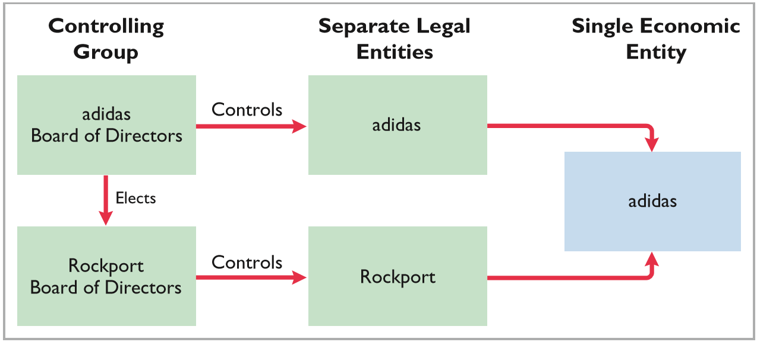
Accounting Across the Organization
Who’s in Control?
adidas (DEU) owns 100% of the shares of Rockport (USA). The ordinary shareholders of adidas elect the board of directors of the company, who, in turn, select the officers and managers of the company. adidas’s board of directors controls the property owned by the corporation, which includes the ordinary shares of Rockport. Thus, they are in a position to elect the board of directors of Rockport and, in effect, control its operations. These relationships are graphically illustrated below.
LO 4

Slide 32
>
DO IT!
Rho Jean Ltd. acquired 5% of the 400,000 ordinary shares of Stillwater Ltd. at a total cost of NT$60 per share on May 18, 2017. On August 30, Stillwater declared and paid a NT$750,000 dividend. On December 31, Stillwater reported net income of NT$2,440,000 for the year.
Prepare all necessary journal entries for 2017.
May 18
Share Investments (400,000 × 5% × NT$60) 1,200,000
Cash 1,200,000
Aug. 30
Cash 37,500
Dividend Revenue (NT$750,000 × 5%) 37,500
LO 4

Slide 33
>
DO IT!
Natal, Ltd. obtained significant influence over North Sails by buying 40% of North Sails’ 60,000 outstanding ordinary shares at a cost of NT$120 per share on January 1, 2017. On April 15, North Sails declared and paid a cash dividend of NT$450,000. On December 31, North Sails reported net income of NT$1,200,000 for the year.
Prepare all necessary journal entries for 2017.
Jan. 1
Share Investments (60,000 × 40% × NT$120) 2,880,000
Cash 2,880,000
Apr. 15
Cash 180,000
Share Investments (NT$450,000 × 40%) 180,000
Dec. 31
Share Investments (NT$1,200,000 × 40%) 480,000
Revenue from Share Investments 480,000
LO 4

Slide 34
Valuing and Reporting Investments
Learning Objective 5
Indicate how debt and share investments are reported in financial statements.
Categories of Securities
DEBT INVESTMENTS are classified into two categories:
Trading securities
Held-for-collection securities
SHARE INVESTMENTS are classified into two categories:
Trading securities
Non-trading securities
These guidelines apply to all debt securities and to those share investments in which the holdings are less than 20%.
LO 5

Slide 35
Valuing and Reporting Investments
Categories of Securities
Illustration 12-6
Valuation guidelines
LO 5

Slide 36
Categories of Securities
TRADING SECURITIES
Companies hold trading securities with the intention of selling them in a short period (generally less than a month).
Trading means frequent buying and selling.
Companies report trading securities at fair value, and report changes from cost as part of net income.
Classified as current asset.
LO 5

Slide 37
TRADING SECURITIES
Illustration: Investments of Pace SA are classified as trading securities on December 31, 2017.
Illustration 12-7
Valuation of trading securities
The adjusting entry for Pace is:
Dec. 31
Fair Value Adjustment—Trading 7,000
Unrealized Gain—Income 7,000
LO 5

Slide 38
TRADING SECURITIES
Illustration 12-8 shows the cost and fair values for investments that Pace classified as trading securities on December 31, 2018.
Illustration 12-8
Valuation of trading securities
The adjusting entry for Pace is:
Dec. 31
Unrealized Loss—Income 12,000
Fair Value Adjustment—Trading 12,000
LO 5

Slide 39
Categories of Securities
NON-TRADING SECURITIES
These securities can be classified as current assets or as non-current assets, depending on the intent of management.
Procedure for determining fair value and the unrealized gain or loss for these securities is the same as for trading securities.
Companies report securities at fair value, and report changes from cost as a component of equity.
LO 5

Slide 40
NON-TRADING SECURITIES
Illustration: Assume that Ingrao AG has two securities that it classifies as non-trading.
Illustration 12-9
Valuation of non-trading securities
The adjusting entry for Ingrao AG is:
Dec. 31
Unrealized Gain or Loss—Equity 9,537
Fair Value Adjustment—Non-Trading 9,537
LO 5

Slide 41
NON-TRADING SECURITIES
Illustration 12-10
Comprehensive income statement
Closing entry at December 31, 2017, to transfer the Unrealized Gain or Loss—Equity to Accumulated Other Comprehensive Income:
Accumulated Other Comprehensive Income 9,537
Unrealized Gain or Loss—Equity 9,537
LO 5

Slide 42
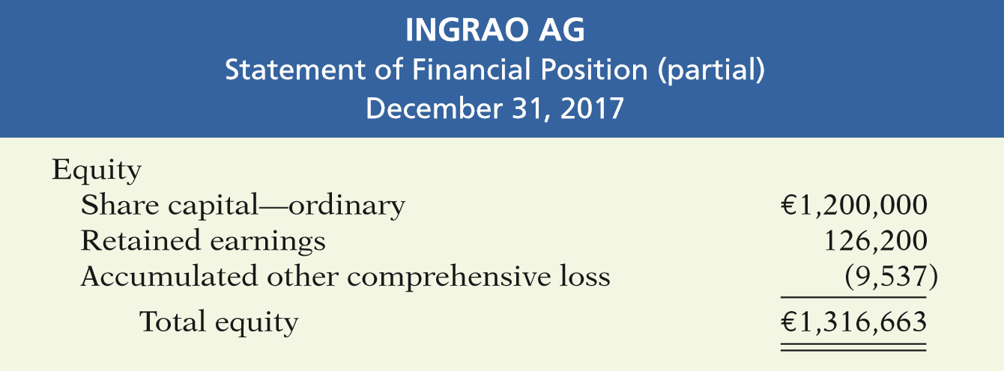
NON-TRADING SECURITIES
Illustration 12-11
Presentation of accumulated other comprehensive income in statement of financial position
LO 5

Slide 43
NON-TRADING SECURITIES
Ingrao’s non-trading securities on December 31, 2018, its second year of operations.
Illustration 12-12
Valuation of non-trading securities
It has a €9,537 credit balance from the previous year, so Ingrao must debit its Fair Value Adjustment—Non-Trading account by €11,174 (€9,537 + €1,637) to achieve a €1,637 debit balance.
Dec. 31
(2018)
Fair Value Adjustment—Non-Trading 11,174
Unrealized Gain or Loss—Equity 11,174
LO 5

Slide 44
NON-TRADING SECURITIES
Illustration 12-13
Comprehensive income statement
Closing entry at December 31, 2018, to transfer the Unrealized Gain or Loss—Equity to Accumulated Other Comprehensive Income:
Unrealized Gain or Loss—Equity 11,174
Accumulated Other Comprehensive Income 11,174
LO 5

Slide 45
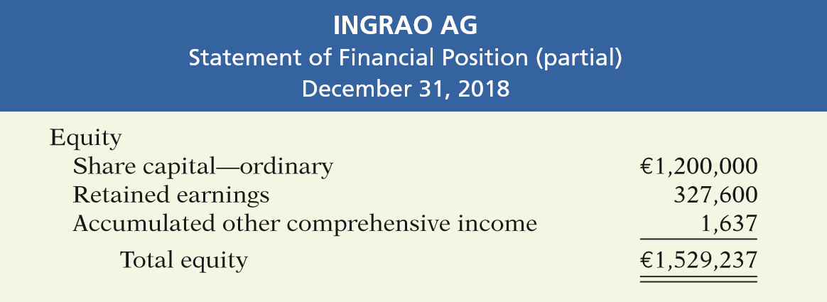
NON-TRADING SECURITIES
Illustration 12-14
Presentation of accumulated other comprehensive income in statement of financial position
LO 5

Slide 46
NON-TRADING SECURITIES
Question
In the statement of financial position, a debit balance in Unrealized Gain or Loss—Equity results in a(n):
increase to equity.
decrease to equity.
loss in the income statement.
loss in the retained earnings statement.
LO 5

Slide 47
>
DO IT!
Some of Chengdu Ltd.’s investment securities are classified as trading securities and some are classified as non-trading. The cost and fair value of each category at December 31, 2017, are shown as follows.
At December 31, 2016, the Fair Value Adjustment—Trading account had a debit balance of ¥92,000, and the Fair Value Adjustment—Non-Trading account had a credit balance of ¥57,500. Prepare the required journal entries for each group of securities for December 31, 2017.
Trading securities:
Unrealized Loss—Income (¥92,000 − ¥13,000) 79,000
Fair Value Adjustment—Trading 79,000
LO 5

Slide 48
>
DO IT!
Some of Chengdu Ltd.’s investment securities are classified as trading securities and some are classified as non-trading. The cost and fair value of each category at December 31, 2017, are shown as follows.
At December 31, 2016, the Fair Value Adjustment—Trading account had a debit balance of ¥92,000, and the Fair Value Adjustment—Non-Trading account had a credit balance of ¥57,500. Prepare the required journal entries for each group of securities for December 31, 2017.
Non-trading securities:
Fair Value Adjustment—Non-Trading 83,500
Unrealized Gain or Loss—Equity (¥57,500 + ¥26,000) 83,500
LO 5

Slide 49
Statement of Financial Position Presentation
Learning Objective 6
Distinguish between short-term and long-term investments.
SHORT-TERM INVESTMENTS
Also called marketable securities, are
securities held by a company that are
readily marketable and
intended to be converted into cash within the next year or operating cycle, whichever is longer.
Investments that do not meet both criteria are classified as long-term investments.
LO 6

Slide 50
SHORT-TERM INVESTMENTS
Illustration 12-15
Presentation of short-term investments
LO 6

Slide 51
Presentation of Realized and Unrealized Gain or Loss
In the income statement, companies report gains and losses in the non-operating activities section under the categories listed in Illustration 12-16.
Illustration 12-16
Non-operating items related to investments
LO 6

Slide 52
Presentation of Realized and Unrealized Gain or Loss
In the statement of financial position, companies report in the equity section accumulated other comprehensive income or loss.
Illustration 12-17
Accumulated other comprehensive loss
LO 6

Slide 53
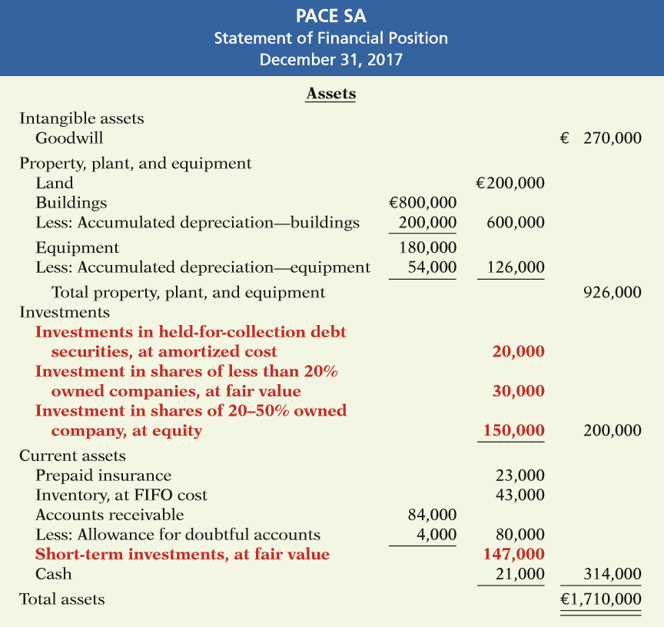
Illustration 12-18
Classified statement of financial position
LO 6

Slide 54
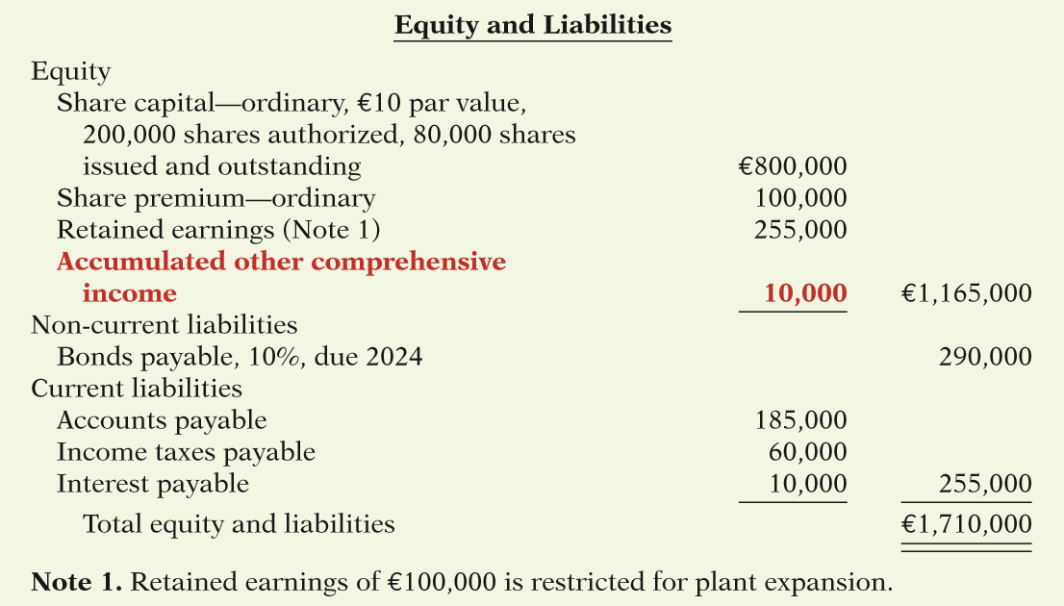
Illustration 12-18
Classified statement of financial position
LO 6

Slide 55
APPENDIX 12A
Consolidated Financial Statements
Learning Objective 7
Describe the form and content of consolidated financial statements as well as how to prepare them.
Consolidated Statement of Financial Position
Companies prepare consolidated statements of financial position from the individual statement of their affiliated companies.
Transactions between the affiliated companies are identified as intercompany transactions and are eliminated in consolidation.
LO 7

Slide 56
Consolidated Statement of Financial Position
Illustration: Assume that on January 1, 2017, Powers plc pays ₤150,000 in cash for 100% of Serto plc’s ordinary shares. Powers records the investment at cost.
The combined totals do not represent a consolidated statement of financial position, because there has been a double-counting of assets and equity in the amount of ₤150,000.
LO 7

Slide 57
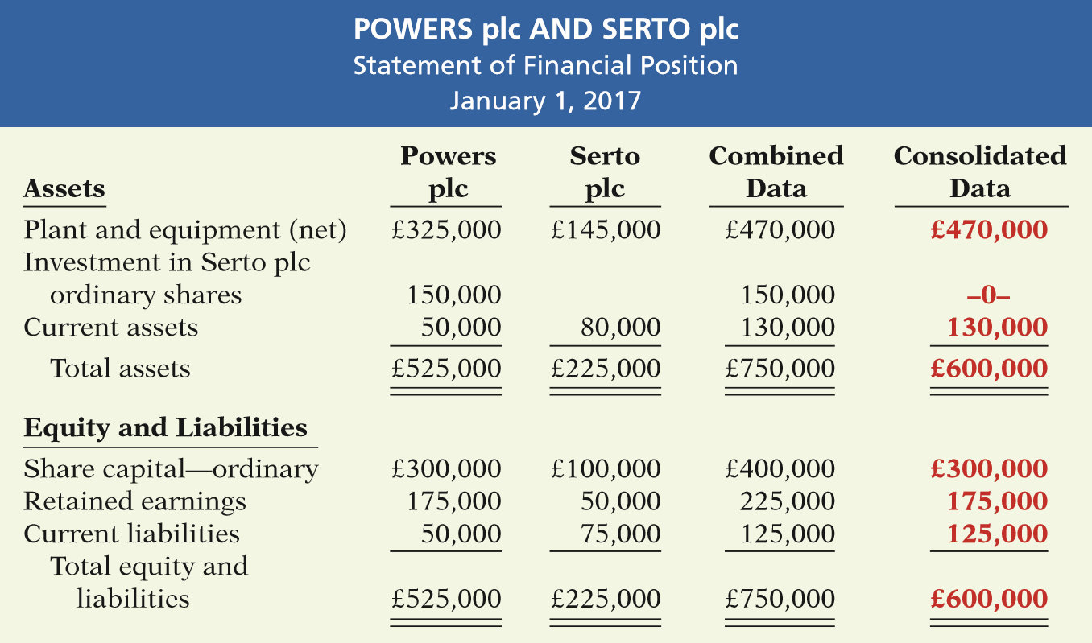
Consolidated Statement of Financial Position
Illustration 12A-1
Combined and consolidated data
LO 7

Slide 58
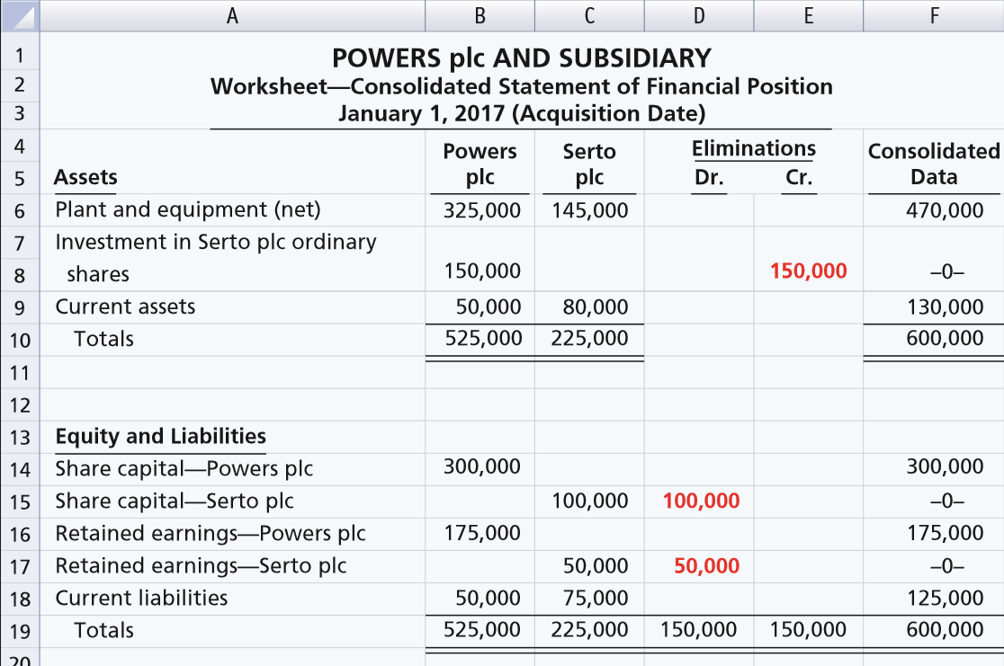
COST EQUAL TO BOOK VALUE
Illustration 12A-2
Worksheet—Cost equal to book value
LO 7

Slide 59
COST ABOVE BOOK VALUE
Illustration: Assume the same data used above, except that Powers plc pays ₤165,000 in cash for 100% of Serto’s ordinary shares. The excess of cost over book value is ₤15,000 (₤165,000 - ₤150,000).
LO 7

Slide 60
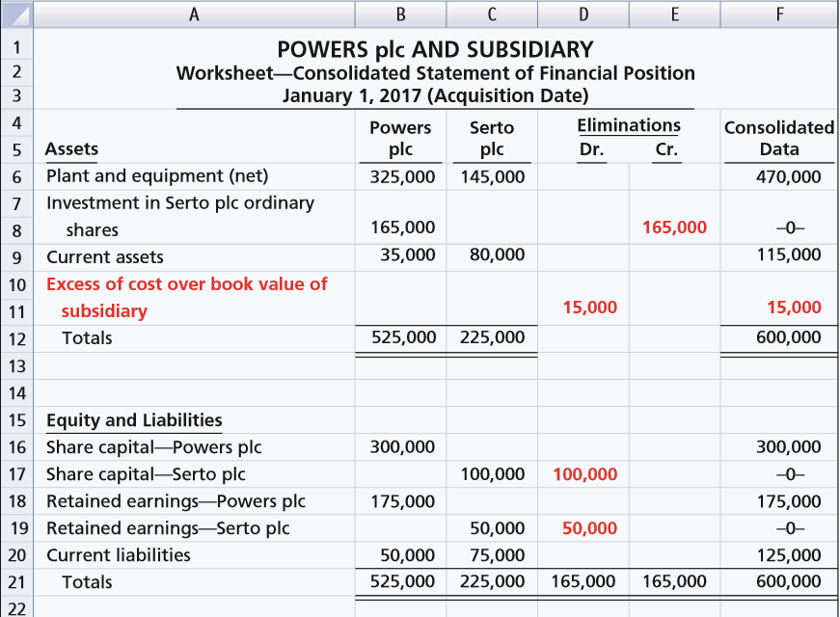
COST ABOVE BOOK VALUE
Illustration 12A-3
Worksheet—Cost above book value
LO 7

Slide 61
CONTENT OF A CONSOLIDATED STATEMENT OF FINANCIAL POSITION
Illustration: The prior worksheet shows an excess of cost over book value of ₤15,000. In the consolidated statement of financial position, Powers first allocates this amount to specific assets, such as inventory and plant equipment, if their fair market values on the acquisition date exceed their book values. Any remainder is considered to be goodwill. For Serto Company, assume that the fair market value of property and equipment is ₤155,000. Thus, Powers allocates ₤10,000 of the excess of cost over book value to property and equipment, and the remainder, ₤5,000, to goodwill.
LO 7

Slide 62
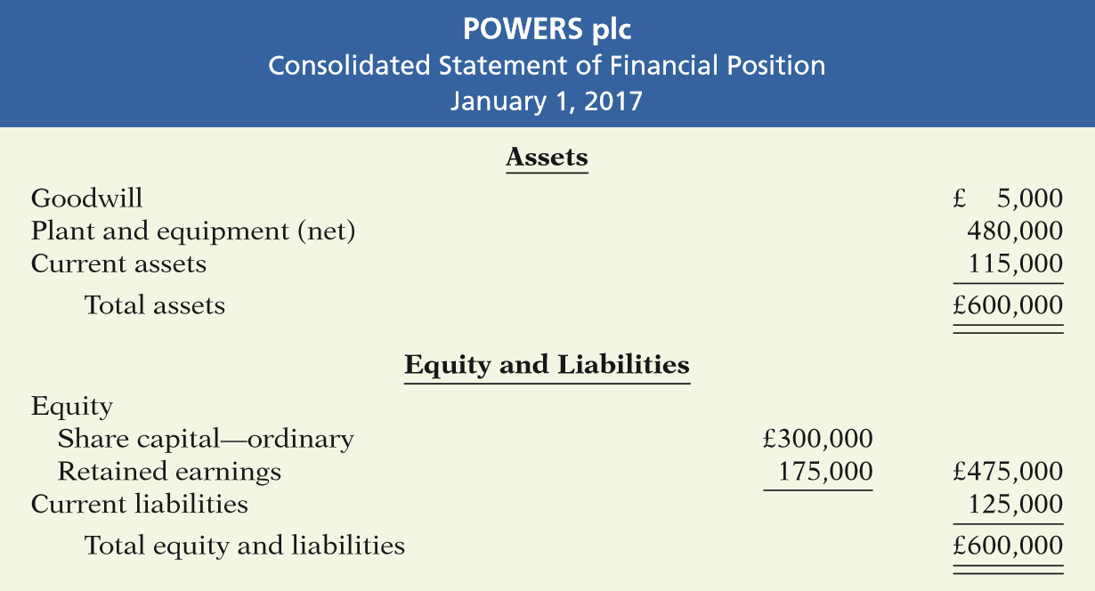
CONTENT OF A CONSOLIDATED STATEMENT OF FINANCIAL POSITION
Illustration 12A-4
Consolidated statement of financial position
LO 7

Slide 63
Consolidated Income Statement
Statement shows the results of operations of affiliated companies as though they are one economic unit.
All intercompany revenue and expense transactions must be eliminated.
A worksheet facilitates the preparation of consolidated income statements in the same manner as it does for the statement of financial position.
LO 7

Slide 64
A Look at U.S. GAAP
Learning Objective 8
Compare the accounting for investments under IFRS and U.S. GAAP.
Key Points
Similarities
Both IFRS and GAAP use the same criteria to determine whether the equity method of accounting should be used—that is, significant influence with a general guide of over 20% ownership. IFRS uses the term associate investment rather than equity investment to describe its investment under the equity method.
Under IFRS, both the investor and an associate company should follow the same accounting policies. As a result, in order to prepare financial information, adjustments are made to the associate’s policies to conform to the investor’s books. GAAP does not have that requirement.
Both IFRS and GAAP use held-for-collection (debt investments), trading (both debt and equity investments), and non-trading equity investment classifications. These classifications are based on the business model used to manage the investments and the type of security.
LO 8

Slide 65
A Look at U.S. GAAP
Key Points
Similarities
The accounting for trading investments is the same between GAAP and IFRS. Also, held-for-collection investments are accounted for at amortized cost. Gains and losses on non-trading equity investments (IFRS) are reported in other comprehensive income.
Unrealized gains and losses related to non-trading securities are reported in other comprehensive income under GAAP and IFRS. These gains and losses that accumulate are then reported in the statement of financial position.
LO 8

Slide 66
A Look at U.S. GAAP
Key Points
Differences
The basis for consolidation under IFRS is control. Under GAAP, a bipolar approach is used, which is a risk-and-reward model (often referred to as a variable-entity approach) and a voting-interest approach. However, under both systems, for consolidation to occur, the investor company must generally own 50% of another company.
Under GAAP, companies use Other Revenues and Gains or Other Expenses and Losses in its income statement presentation. Under IFRS, companies will generally classify these items as unusual items or financial items.
LO 8

Slide 67
A Look at U.S. GAAP
Looking to the Future
As indicated earlier, both the FASB and IASB have indicated (conceptually) that they believe that all financial instruments should be reported at fair value and that changes in fair value should be reported as part of net income. However, both the FASB and IASB have decided to permit amortized cost for debt investments held-for-collection. Hopefully, they will eventually arrive at fair value measurement for all financial instruments.
LO 8

Slide 68
A Look at U.S. GAAP
A Look at IFRS
GAAP Self-Test Questions
Under GAAP, the equity method of accounting for long-term investments in ordinary shares should be used when the investor has significant influence over an investee and owns:
between 20% and 50% of the investee’s ordinary shares.
30% or more of the investee’s ordinary shares.
more than 50% of the investee’s ordinary shares.
less than 20% of the investee’s ordinary shares.
LO 8

Slide 69
A Look at U.S. GAAP
A Look at IFRS
GAAP Self-Test Questions
Under GAAP, unrealized gains on non-trading share investments should:
be reported as other revenues and gains in the income statement as part of net income.
be reported as other gains on the income statement as part of net income.
not be reported on the income statement or statement of financial position.
be reported as other comprehensive income.
LO 8

Slide 70
A Look at U.S. GAAP
A Look at IFRS
GAAP Self-Test Questions
Under GAAP, the unrealized loss on trading investments should be reported:
as part of other comprehensive loss reducing net income.
on the income statement reducing net income.
as part of other comprehensive loss not affecting net income.
directly to equity bypassing the income statement.
LO 8

Slide 71
Copyright
“Copyright © 2016 John Wiley & Sons, Inc. All rights reserved. Reproduction or translation of this work beyond that permitted in Section 117 of the 1976 United States Copyright Act without the express written permission of the copyright owner is unlawful. Request for further information should be addressed to the Permissions Department, John Wiley & Sons, Inc. The purchaser may make back-up copies for his/her own use only and not for distribution or resale. The Publisher assumes no responsibility for errors, omissions, or damages, caused by the use of these programs or from the use of the information contained herein.”

