Slide 1


Corporate/Business Strategy and Strategic Planning Toolkit
Overview
Created by ex-McKinsey, Deloitte & BCG Strategy Consultants.

Slide 2


Introduction
This Strategy Toolkit was created by ex-McKinsey, Deloitte and BCG Strategy Consultants, after more than 5,000 hours of work. It is considered the world's best & most comprehensive Strategy Toolkit. It includes all the Frameworks, Best Practices and Templates required to define & implement a winning Corporate/Business Strategy and Strategic Plan for your organization.
Join the 200,000+ Executives, Consultants & Entrepreneurs who are already leveraging our Management Consulting Toolkits to improve the performance of their organization and boost their own career.
If you have any questions, send us an email at support@domontconsulting.com and one of our ex-McKinsey, Deloitte & BCG Management Consultants will get back to you within 2 business days.
Aurelien Domont
Management Consultant
Domont Consulting Managing Director

Slide 3
Problem: Most companies struggle to be good at both defining and executing their corporate/business strategy
Strategy/Execution matrix
Key takeaways
Companies that are in the green quadrant outperform their peers in terms of financial performance and total shareholder return.
But being good at both defining and executing a corporate/business strategy is challenging, with only a minority of companies able to do it.
As we often say in the corporate world, “Strategy without execution is a dream. And execution without a strategy is a nightmare!”
About 30% of companies have a good strategy but poor execution*
About 10% of companies have a good strategy and good execution*
Good
Strategy
About 30% of companies have a poor strategy and poor execution*
About 30% of companies have a poor strategy but good execution*
Poor
Poor
Good
Execution
Source: Based on the experience of our management consultants advising 200+ companies over the past 20 years

Slide 4












Solution: Our consulting firm created the Corporate/Business Strategy and Strategic Planning Toolkit to help you define and implement your strategy
What’s inside the Toolkit?
Who created the Toolkit?
The Toolkit was created by ex-McKinsey, Deloitte & BCG Strategy Consultants.
Best Practices
Frameworks
Number of professionals leveraging our Toolkits
Advice from
tier-1 Management Consultants
Tools
There are 200,000+ Executives, Consultants & Entrepreneurs leveraging our Toolkits to improve the performance of their organization
Real-life Examples
Templates
Trusted by small and large organizations
Video Training
Step-by-step Tutorials

Slide 5
Our Toolkit will help you fulfill multiple objectives
  The Corporate/Business Strategy and Strategic Planning Toolkit includes frameworks, tools, templates, tutorials, real-life examples, video training, and best practices to help you:
  Define and implement your corporate/business strategy and strategic plan with our 4-phase approach: (I) Internal and external analysis, (II) Strategy tools & frameworks to shape our strategy, (III) Strategy, (IV) Strategic plan
  (I) Carry out an internal and external analysis: (1) Internal analysis: Financial analysis, HR analysis, Marketing analysis, Customers analysis, Suppliers analysis, (2) Market Analysis: Target market, Market sizing with TAM, Market attractiveness with Porter’s 5 Forces, Environment analysis with PESTLE, (3) Competitor Analysis: Competitor identification, Benchmarking, Strategic group mapping, Competitor profiling, (4) SWOT summary
  (II) Shape your strategy with tools & frameworks commonly used by tier-one consulting firms: (1) Frameworks to answer common strategic questions: What caused the company’s profit to decrease?, Should we enter a new market?, Should we introduce a new product?, Should we acquire this company?, (2) BU/Product portfolio management tools: GE-McKinsey Matrix, BCG Growth-Share Matrix, (3) Corporate and growth strategy tools: 7 Degrees of Freedom for Growth, Ansoff Growth Matrix, Blue Ocean Strategy, McKinsey Seven-S, Porter’s Generic Corporate Strategies, Product Life Cycle, Value Chain Analysis, Value Driver Tree
  (III) Define your strategy: (1) Business model, (2) Mission, vision and values, (3) Strategy map including the strategic objectives to reach our vision, (4) Balanced scorecard including the key performance indicators linked to the strategic objectives, (5) Strategic pillars to reach our strategic objectives, (6) Potential strategic initiatives in each strategic pillar, (7) Business cases and financial models to help us prioritize our list of potential strategic initiatives, (8) Project prioritization
  (IV) Define and implement your strategic plan: (1) Guiding principles, (2) Strategic plan formulation: High-level strategic plan with the three horizons of growth , Detailed strategic plan, (3) Strategic plan implementation: Governance, Strategic objectives dashboard, Strategic pillars dashboard, Strategic initiatives dashboard, Objectives and key results (OKR), (4) Evaluation and lessons learnt

Slide 6




The Toolkit includes a 4-phase approach that we have built and refined over the past 20 years through constant trial and error
1
2
3
4
Internal and External Analysis
Strategy Tools & Frameworks to shape our Strategy
Strategy
Strategic Plan
Internal analysis
  Financial analysis
  HR analysis
  Marketing analysis
  Customers analysis
  Suppliers analysis
Market Analysis
  Target market
  Market sizing with TAM
  Market attractiveness with Porter’s 5 Forces
  Environment analysis with PESTLE
Competitor Analysis
  Competitor identification
  Benchmarking
  Strategic group mapping
  Competitor profiling
SWOT summary
Frameworks to answer common strategic questions
  What caused the company’s profit to decrease?
  Should we enter a new market?
  Should we introduce a new product?
  Should we acquire this company?
BU/Product portfolio management tools:
  GE-McKinsey Matrix
  BCG Growth-Share Matrix
Corporate and growth strategy tools
  7 Degrees of Freedom for Growth
  Ansoff Growth Matrix
  Blue Ocean Strategy
  McKinsey Seven-S
  Porter’s Generic Corporate Strategies
  Product Life Cycle
  Value Chain Analysis
  Value Driver Tree
Business model
Mission, vision and values
Strategy map including the strategic objectives to reach our vision
Balanced scorecard including the key performance indicators linked to the strategic objectives
Strategic pillars to reach our strategic objectives
Potential strategic initiatives in each strategic pillar
Business cases and financial models to help us prioritize our list of potential strategic initiatives
Project prioritization
Guiding principles
Strategic plan formulation
  High-level strategic plan with the three horizons of growth
  Detailed strategic plan
Strategic plan implementation
  Governance
  Strategic objectives dashboard
  Strategic pillars dashboard
  Strategic initiatives dashboard
  Objectives and key results (OKR)
Evaluation and lessons learnt

Slide 7



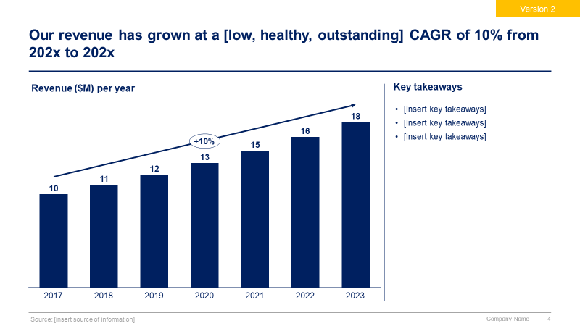
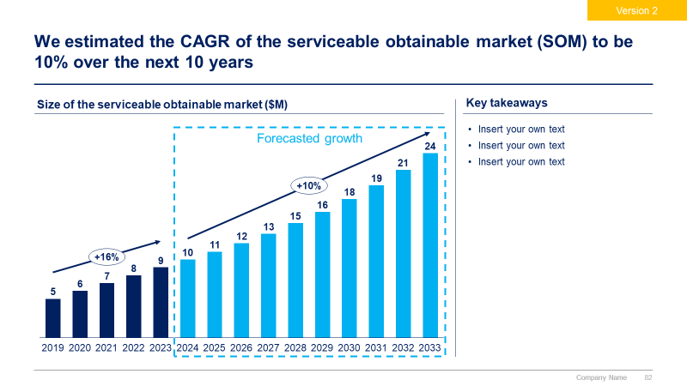
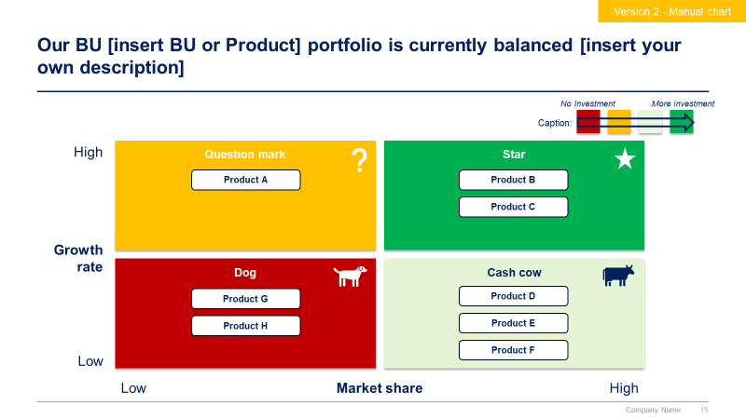
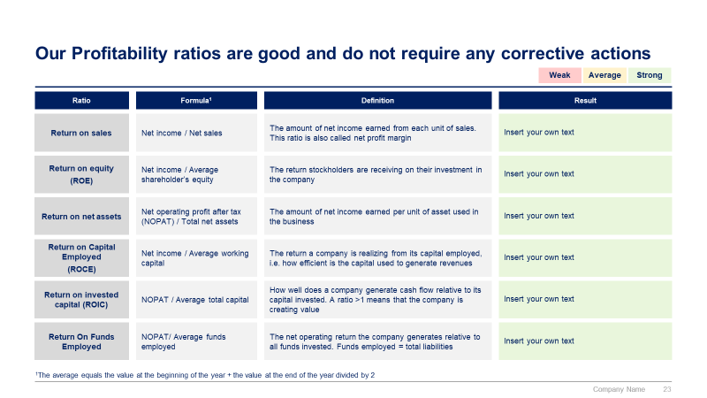
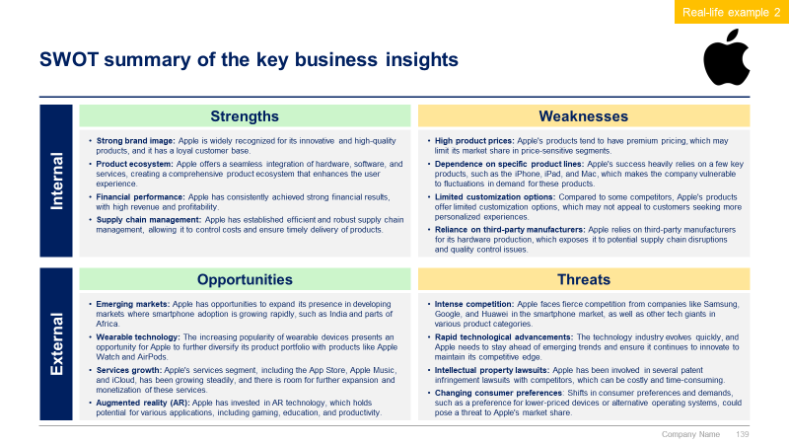
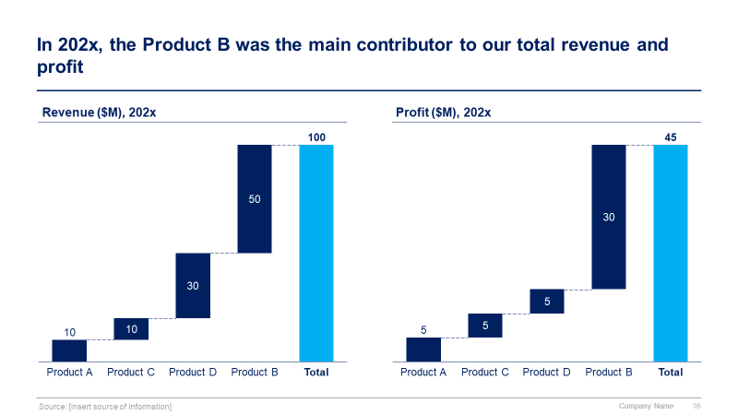
Phase 1 small preview
1
2
3
4
Internal and External Analysis
Strategy Tools & Frameworks to shape our Strategy
Strategy
Strategic Plan

Slide 8

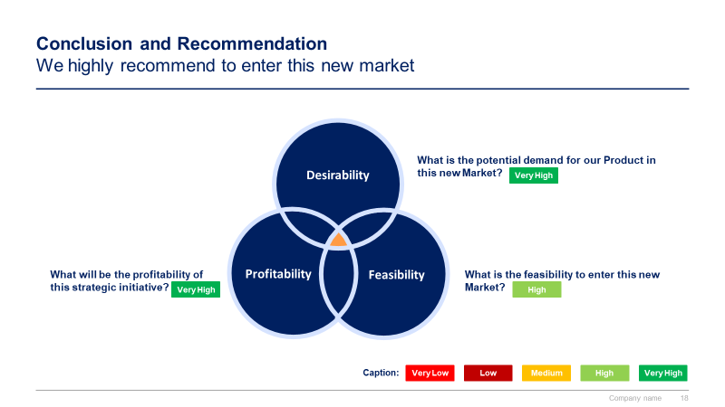
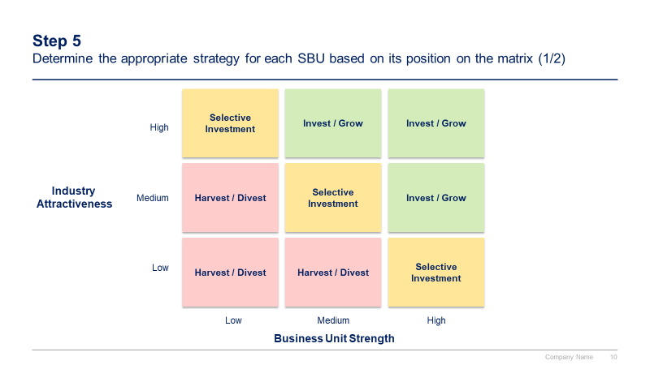
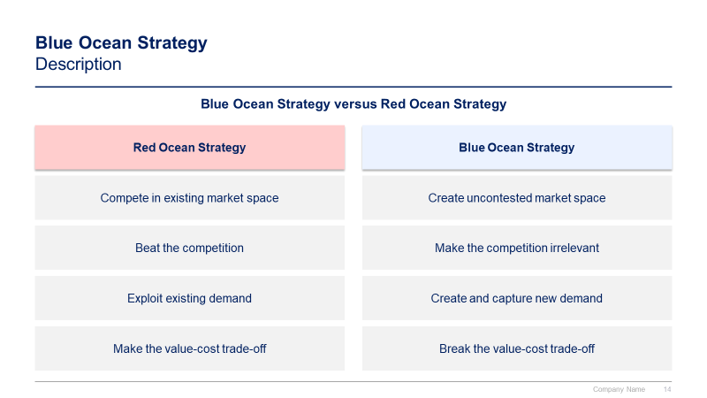
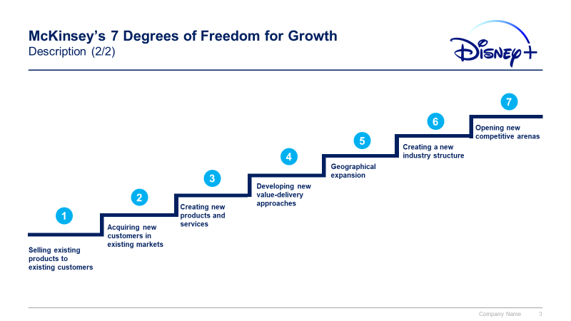
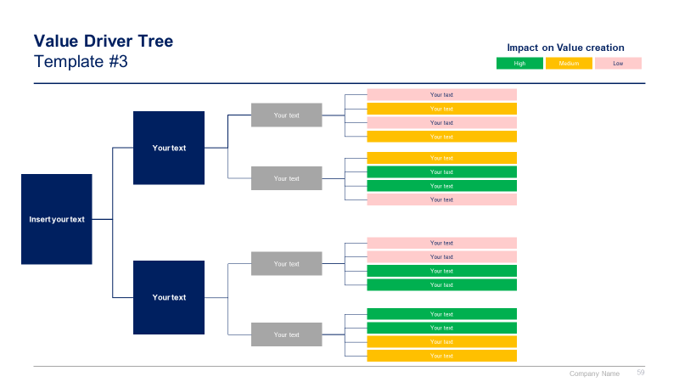
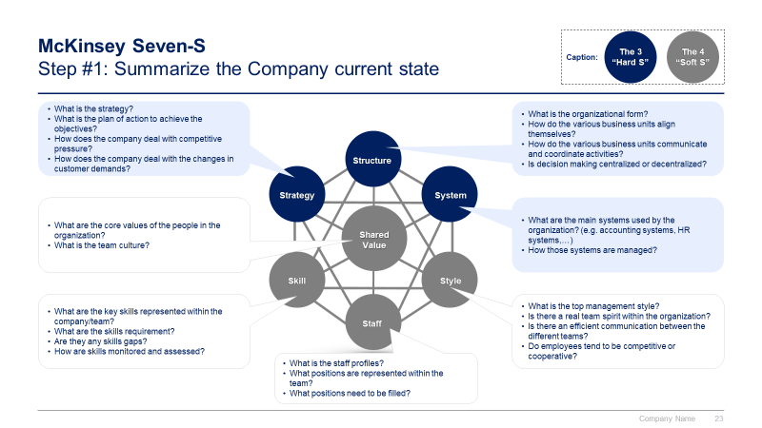
Phase 2 small preview
1
2
3
4
Internal and External Analysis
Strategy Tools & Frameworks to shape our Strategy
Strategy
Strategic Plan

Slide 9
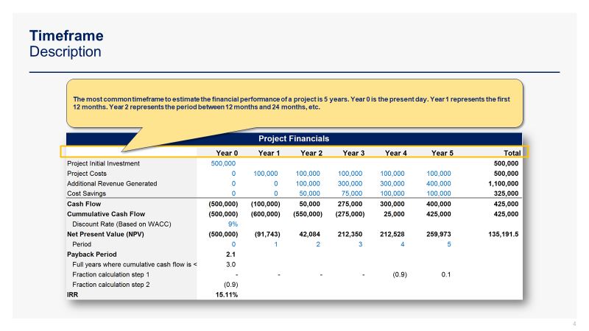
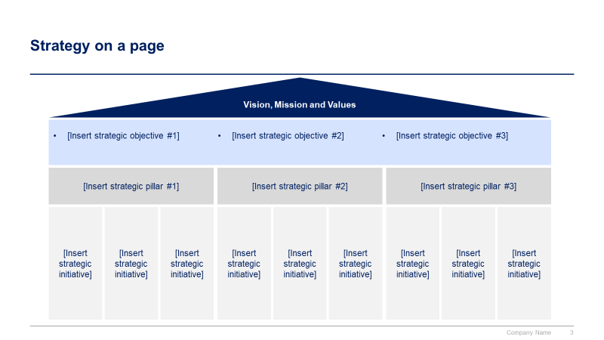
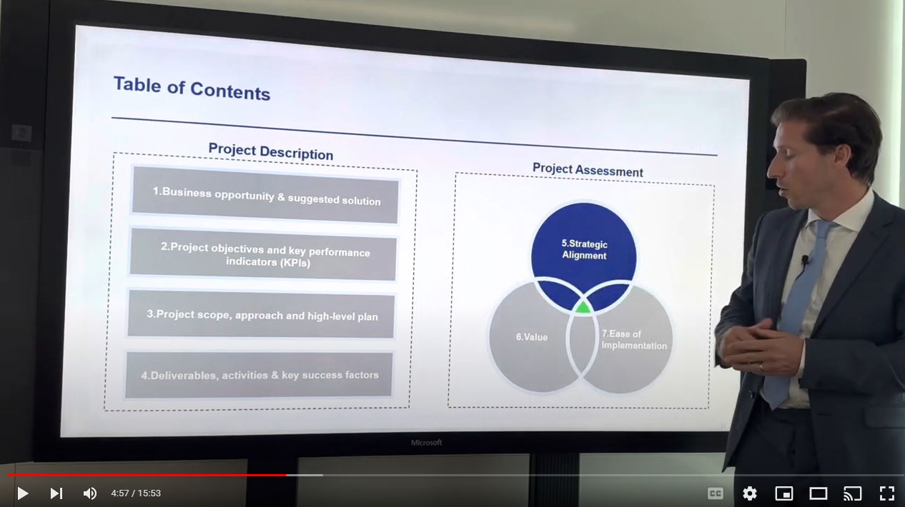
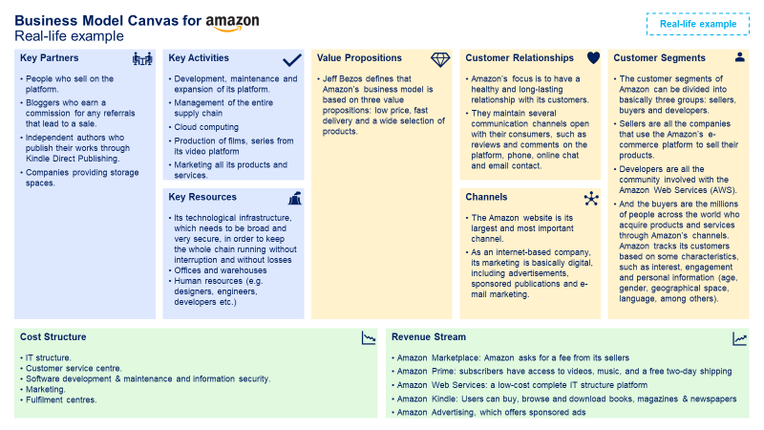
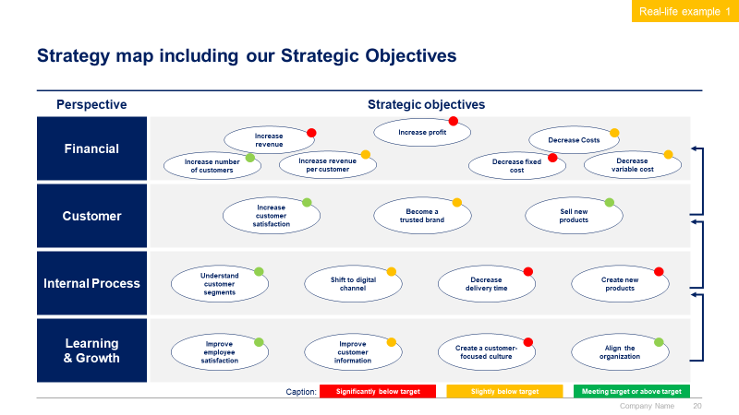
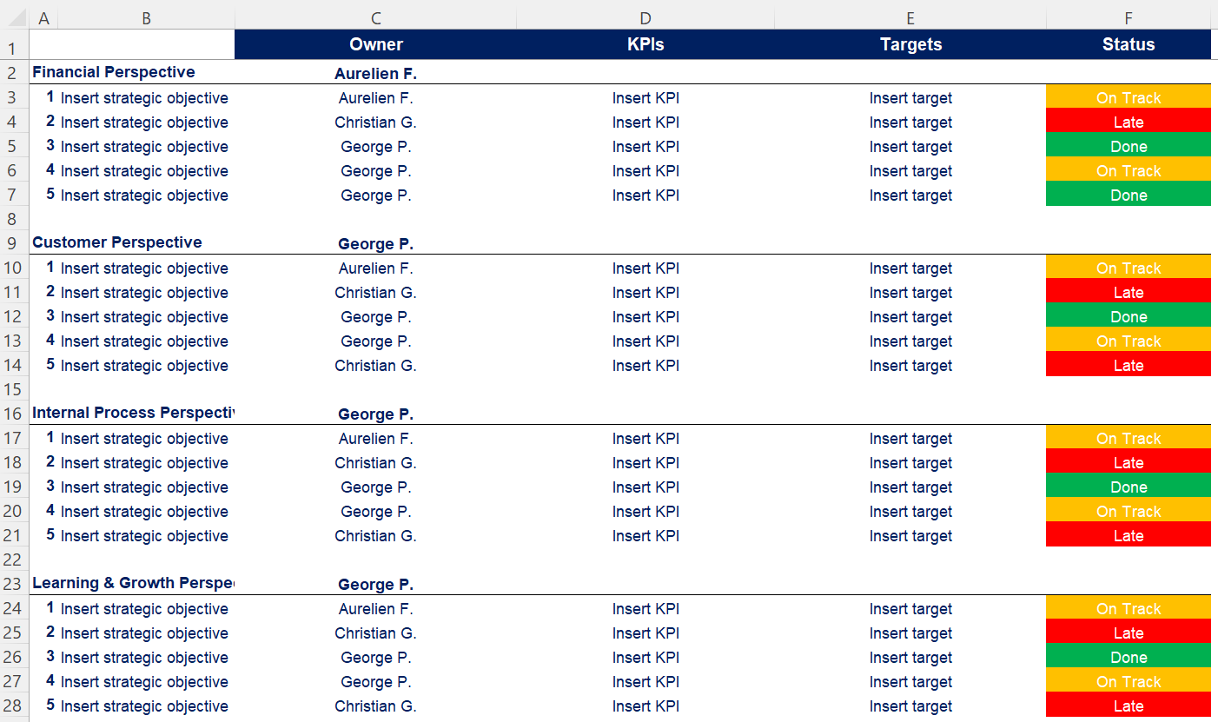
Phase 3 small preview
1
2
3
4
Internal and External Analysis
Strategy Tools & Frameworks to shape our Strategy
Strategy
Strategic Plan

Slide 10
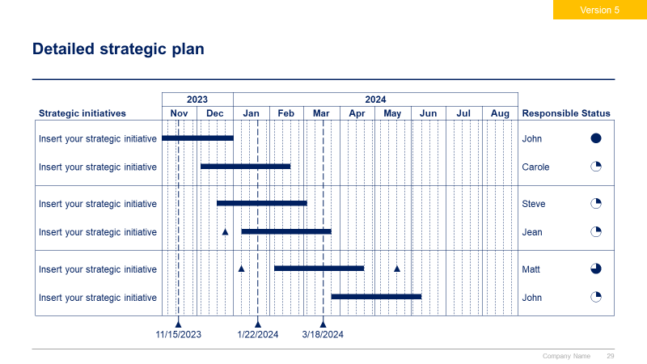
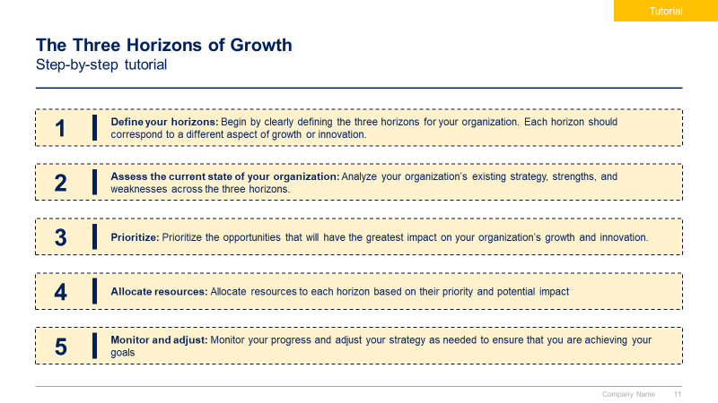
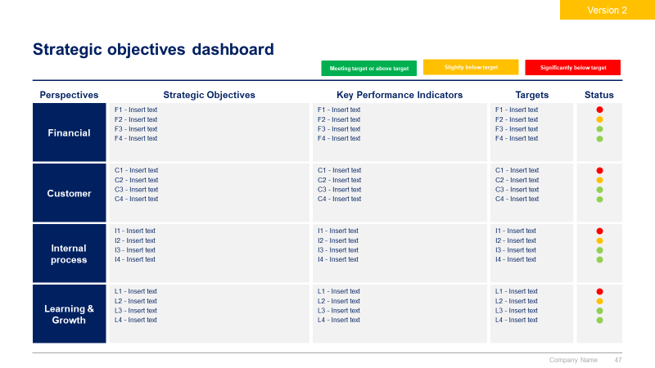
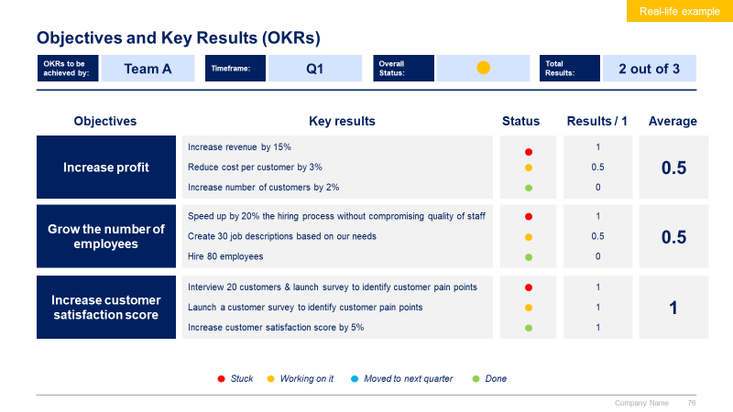
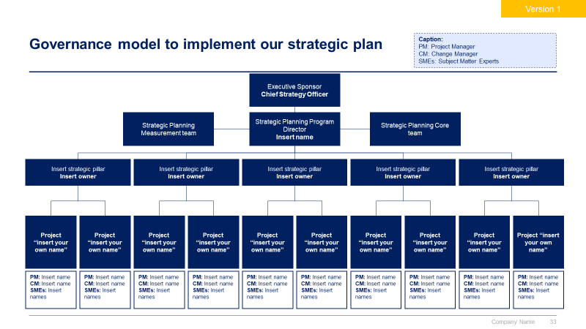
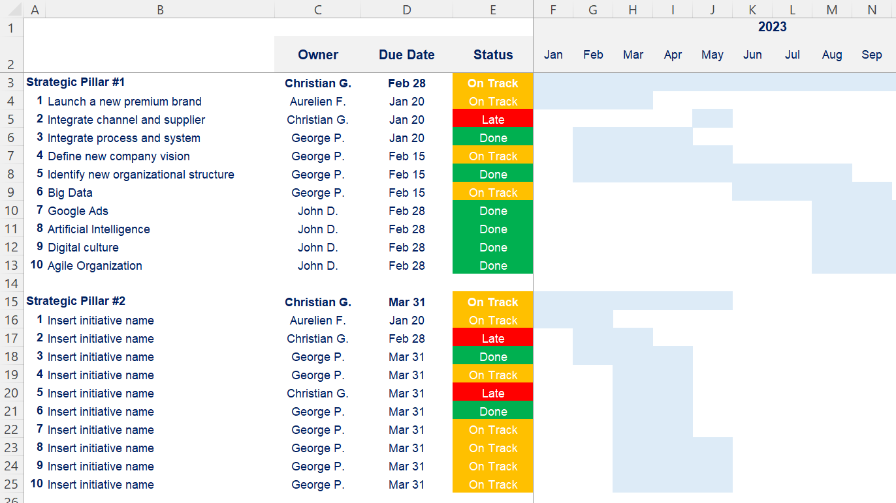
Phase 4 small preview
1
2
3
4
Internal and External Analysis
Strategy Tools & Frameworks to shape our Strategy
Strategy
Strategic Plan

Slide 11
We decided to use the BCG matrix to help us better understand our current BU [if needed, replace BU by product] portfolio (1/2)
Additional free sample
The BCG Growth-Share Matrix, also known as the Boston Consulting Group Matrix, is a portfolio management tool that helps companies decide how to prioritize their different businesses. The matrix is split into four quadrants, each with its own unique symbol that represents a certain degree of profitability: question marks, stars, pets (often represented by a dog), and cash cows. By assigning each business to one of these four categories, executives could then decide where to focus their resources and capital to generate the most value, as well as where to cut their losses.
The matrix was created in 1968 by Bruce Henderson, the founder of BCG. It was built on the logic that market leadership results in sustainable superior returns. Ultimately, the market leader obtains a self-reinforcing cost advantage that competitors find difficult to replicate. These high growth rates then signal which markets have the most growth potential.
Each of the four quadrants represents a specific combination of relative market share and market growth rate:
Low Growth, High Share: Companies should milk these “cash cows” for cash to reinvest.
High Growth, High Share: Companies should significantly invest in these “stars” as they have high future potential.
High Growth, Low Share: Companies should invest in or discard these “question marks,” depending on their chances of becoming stars.
Low Share, Low Growth: Companies should liquidate, divest, or reposition these “pets.”
The matrix reveals two factors that companies should consider when deciding where to invest: company competitiveness and market attractiveness, with relative market share and growth rate as the underlying drivers of these factors.
The BCG Growth-Share Matrix is still central in business school teachings on business strategy and has been used by about half of all Fortune 500 companies.

Slide 12



We decided to use the BCG matrix to help us better understand our current BU [if needed, replace BU by product] portfolio (2/2)
Additional free sample
No Investment
More investment
Caption:
High
Question mark
Description: High growth but neutral or negative cash flow (expensive growth)
Strategy: See if ROI can be improved
Star
Description: Growing earnings, positive or neutral cash flow
Strategy: Invest in growth
Growth
rate
Dog
Description: Small market share in low growth market, requires much capital to continue
Strategy: Divest or close
Cash cow
Description: Stable earnings and solid cash flow, low growth business
Strategy: Milk for remaining value
Low
Low
Market share
High

Slide 13
Our BU [insert BU or Product] portfolio is currently balanced [insert your own description]
Additional free sample
No Investment
More investment
Caption:
High
Question mark
Star
Product A
Product B
Product C
Growth
rate
Dog
Cash cow
Product G
Product D
Product H
Product E
Product F
Low
Low
Market share
High

Slide 14
Our BU [insert BU or Product] portfolio is currently balanced [insert your own description]
Additional free sample including an
Excel-based matrix
Growth rate (201x-202x)
Size = Annual revenue ($M) in 202x
BU2
BU1
BU3
BU4
BU6
BU5
Market share (202x)

Slide 15




The Toolkit includes multiple PowerPoint slides, Excel sheets and Video training that you can download on your device immediately after purchase
500 editable PowerPoint slides*
40 Excel sheets*
28 minutes of Video training
Overview and Approach
Internal and External Analysis
Strategy Tools & Frameworks to shape our Strategy
Strategy
Strategic Plan
*Please note that the number of Powerpoint slides and Excel sheets listed is the number of unique slides and sheets. For example, a Powerpoint slide that has been duplicated to facilitate our clients’ understanding only counts for one slide

Slide 16
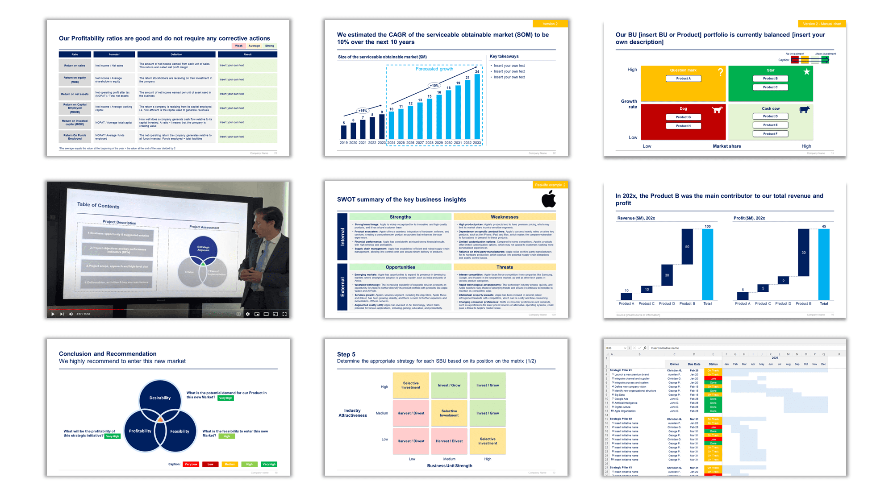
This was just a small preview. Check our entire Corporate/Business Strategy and Strategic Planning Toolkit by clicking here or on the image below
https://www.domontconsulting.com/products/strategic-plan-template?variant=12475735769170

Slide 17









Our Management Consulting Toolkits include 9 key benefits
Improve the growth & efficiency of your organization by leveraging Management Consulting Toolkits created by ex-McKinsey, Deloitte & BCG Consultants.
Make a great investment for your career & organization. It cost us US$8M+ over the past 10 years to create all our Toolkits. Get them for a fraction of this cost.
Get a competitive advantage. It’s like hiring Management Consultants to create all the practical Frameworks, Tools & Templates you need.
Get the job done quicker and never start from scratch again with our ready-made and fully editable Frameworks, Tools & Templates in Powerpoint & Excel.
Don't reinvent the wheel. We have already worked 30,000+ hours over the past 10 years to create all the Management Consulting Toolkits you need.
Improve the capabilities of your organization by learning how the Fortune 100 and Global Consulting Firms do it.
Decrease your costs. Hiring tier-1 Consultants for a project would cost you $300k+. Way more expensive than our Toolkits, which will last you a lifetime!
Become your organization’s subject matter expert and impress your stakeholders with world-class approaches to resolve common business problems.
Get free support and advice from our ex-McKinsey, Deloitte & BCG Management Consultants.

Slide 18
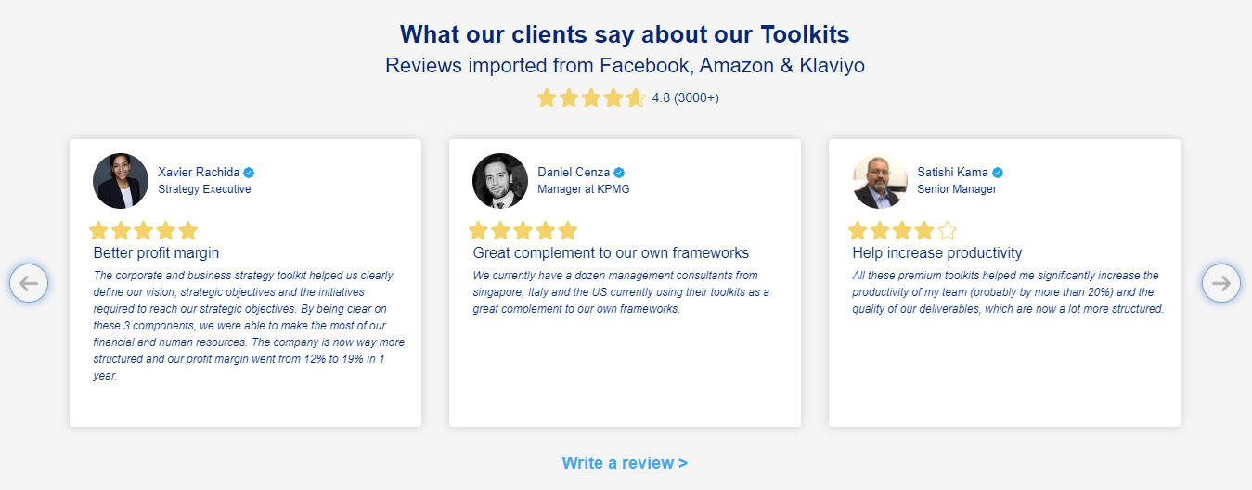
What our clients say about our Toolkits
Click here to see more reviews >

Slide 19

Join 200,000+ Executives, Consultants & Entrepreneurs leveraging our Toolkits to improve the performance of their organization
Trusted by small and large organizations
Customer satisfaction
4.8
Number of countries leveraging our Toolkits
160+
Number of professionals leveraging our Toolkits
200,000+
Daily rate of our ex-McKinsey, Deloitte and BCG Management Consultants
$3k-$4k

Slide 20

Interested in more than 1 Toolkit? Access all our Toolkits for half the price with our Gold Access
Gold Access
Click here to learn more

Slide 21


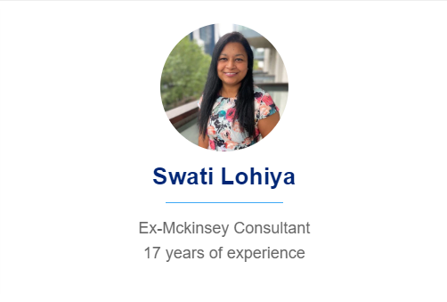



Need additional help? Send us a brief and we’ll find you the right talent from our network of 500+ tier-1 Management Consultants
Click here to send us a Project Brief

Slide 22
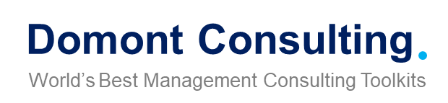
This was just a small preview.
www.domontconsulting.com

