Slide 1


Stakeholder Engagement Strategy
Tutorial & Template
High
Maintain Confidence
Collaborate
Insert Stakeholder Group name or Stakeholder name
Insert Stakeholder Group name or Stakeholder name
Insert Stakeholder Group name or Stakeholder name
Insert Stakeholder Group name or Stakeholder name
Insert Stakeholder Group name or Stakeholder name
Insert Stakeholder Group name or Stakeholder name
Insert Stakeholder Group name or Stakeholder name
Insert Stakeholder Group name or Stakeholder name
Stakeholder’s Influence
Extent to which this group or person’s buy-in is needed to move forward
Monitor and Respond
Keep Informed
Insert Stakeholder Group name or Stakeholder name
Insert Stakeholder Group name or Stakeholder name
Insert Stakeholder Group name or Stakeholder name
Insert Stakeholder Group name or Stakeholder name
Insert Stakeholder Group name or Stakeholder name
Insert Stakeholder Group name or Stakeholder name
Insert Stakeholder Group name or Stakeholder name
Insert Stakeholder Group name or Stakeholder name
Low
Impact on Stakeholder
Extent to which the project will impact this group/person
High

Slide 2
Stakeholder Engagement Strategy
Overview
In the context of a project, a stakeholder engagement strategy outlines how we will engage with our stakeholders to achieve our project objectives.
A stakeholder engagement strategy can easily be defined by following these 4 steps:
1
List the stakeholders who can influence the project or be impacted by it
2
Map the stakeholders by leveraging our 2-by-2 matrix
3
Develop an engagement strategy for each stakeholder
4
Develop an engagement detailed plan for each stakeholder

Slide 3
Step 1: List the stakeholders who can influence the project or be impacted by it
Stakeholders | Stakeholder’s Influence | Impact on Stakeholder
Insert Stakeholder Group name or Stakeholder name | High | High
e.g. Senior executives, managers, customer, team, shareholders, government | Low | Low
e.g. Suppliers, the press, the public, prospective customers, trade associations | High | High
Insert Stakeholder Group name or Stakeholder name | Low | Low
Insert Stakeholder Group name or Stakeholder name
Insert Stakeholder Group name or Stakeholder name
Insert Stakeholder Group name or Stakeholder name
Insert Stakeholder Group name or Stakeholder name
Insert Stakeholder Group name or Stakeholder name
Insert Stakeholder Group name or Stakeholder name
Insert Stakeholder Group name or Stakeholder name
Insert Stakeholder Group name or Stakeholder name
Insert Stakeholder Group name or Stakeholder name
Insert Stakeholder Group name or Stakeholder name
Insert Stakeholder Group name or Stakeholder name
Insert Stakeholder Group name or Stakeholder name

Slide 4
Step 2: Map the stakeholders by leveraging our 2-by-2 matrix (1/3)
Our high-level Stakeholder Matrix will help you manage your Stakeholders effectively by mapping your stakeholders into 4 different quadrants:
Monitor and Respond
Keep Informed
Collaborate
Maintain Confidence
To identify in which quadrant your stakeholder belongs, you simply need to rate them based on the following 2 dimensions:
Stakeholder’s Influence (Extent to which this group or person’s buy-in is needed to move forward)
Impact to Stakeholder (Extent to which the project will impact this group/person)

Slide 5
Step 2: Map the stakeholders by leveraging our 2-by-2 matrix (2/3)
Insert name
Who must be in contact with each stakeholder?
Insert name
Insert name
High
Maintain Confidence
Collaborate
Insert Stakeholder Group name or Stakeholder name
Insert Stakeholder Group name or Stakeholder name
Insert Stakeholder Group name or Stakeholder name
Insert Stakeholder Group name or Stakeholder name
Insert Stakeholder Group name or Stakeholder name
Insert Stakeholder Group name or Stakeholder name
Insert Stakeholder Group name or Stakeholder name
Insert Stakeholder Group name or Stakeholder name
Stakeholder’s Influence
Extent to which this group or person’s buy-in is needed to move forward
Monitor and Respond
Keep Informed
Insert Stakeholder Group name or Stakeholder name
Insert Stakeholder Group name or Stakeholder name
Insert Stakeholder Group name or Stakeholder name
Insert Stakeholder Group name or Stakeholder name
Insert Stakeholder Group name or Stakeholder name
Insert Stakeholder Group name or Stakeholder name
Insert Stakeholder Group name or Stakeholder name
Insert Stakeholder Group name or Stakeholder name
Low
Impact on Stakeholder
Extent to which the project will impact this group/person
High

Slide 6
Step 2: Map the stakeholders by leveraging our 2-by-2 matrix (3/3)
John
Who must be in contact with each stakeholder?
Jean
Raphael
High
Maintain Confidence
Collaborate
Executive Committee
Senior Management
Managers
Customers of product A
Shareholders
Trade Associations
Insert Stakeholder Group name or Stakeholder name
Insert Stakeholder Group name or Stakeholder name
Stakeholder’s Influence
Extent to which this group or person’s buy-in is needed to move forward
Monitor and Respond
Keep Informed
Press
Government
Customers of product B
Suppliers
Government
Insert Stakeholder Group name or Stakeholder name
Insert Stakeholder Group name or Stakeholder name
Insert Stakeholder Group name or Stakeholder name
Low
Impact on Stakeholder
Extent to which the project will impact this group/person
High

Slide 7
Step 3: Develop an engagement strategy for each stakeholder
John
Who must be in contact with each stakeholder?
Jean
Raphael
High
Maintain Confidence
Collaborate
Put enough work in with these stakeholders to keep them satisfied, but not so much that they become bored with your message.
Fully engage and collaborate with these stakeholders, and make the greatest efforts to satisfy them.
Stakeholder’s Influence
Extent to which this group or person’s buy-in is needed to move forward
Monitor and Respond
Keep Informed
Adequately inform these stakeholders, and talk to them to ensure that no major issues are arising. People in this category can often be very helpful with the detail of your project.
Monitor these stakeholders, but don’t bore them with excessive communication.
Low
Impact on Stakeholder
Extent to which the project will impact this group/person
High

Slide 8
Step 3: Develop an engagement strategy for each stakeholder
John
Who must be in contact with each stakeholder?
Jean
Raphael
High
Maintain Confidence
Collaborate
Put enough work in with these stakeholders to keep them satisfied, but not so much that they become bored with your message.
Fully engage and collaborate with these stakeholders, and make the greatest efforts to satisfy them.
Stakeholder’s Influence
Extent to which this group or person’s buy-in is needed to move forward
Feel free to customize each strategy based on the specificities of your situation
Keep Informed
Monitor and Respond
Adequately inform these stakeholders, and talk to them to ensure that no major issues are arising. People in this category can often be very helpful with the detail of your project.
Monitor these stakeholders, but don’t bore them with excessive communication.
Low
Impact on Stakeholder
Extent to which the project will impact this group/person
High

Slide 9

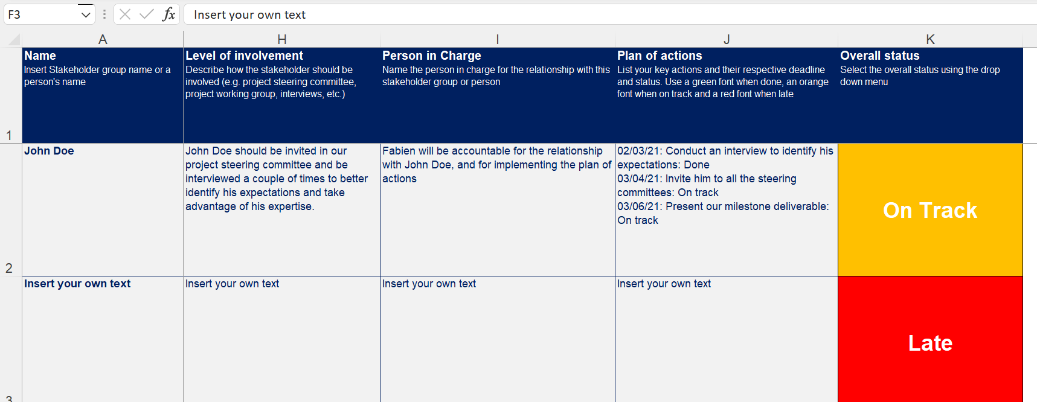
Step 4: Develop an engagement detailed plan for each stakeholder

Slide 10












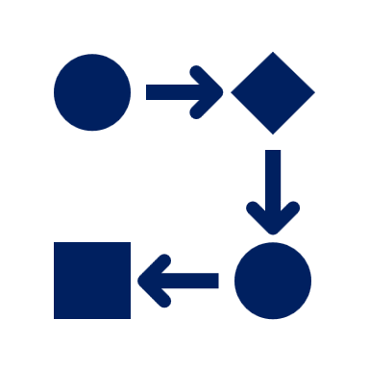





Need more help? Our ex-McKinsey, Deloitte & BCG Consultants have created 19 Management Consulting Toolkits available at www.domontconsulting.com
1. Corporate & Business Strategy Toolkit
2. Management Consulting Toolkit
3. Operating Model & Organization Design Toolkit
4. Digital Transformation Toolkit
5. Change & Project Management Toolkit
6. Strategic Planning Toolkit
7. Human Resources & Talent Management Toolkit
8. Mergers & Acquisitions Toolkit
9. Post Merger Integration Toolkit
10. Sales, Marketing & Communication Strategy Toolkit
11. Business Plan & Entrepreneurship Toolkit
12. Supply Chain Strategy Toolkit
13. Lean 6 Sigma Toolkit
14. Risk Management Toolkit
15. Leadership Development Toolkit
16. Financial Modeling, Planning & Analysis Toolkit
17. Customer Experience Strategy & Design Thinking Toolkit
18. Data Analytics Strategy Toolkit
19. Warren Buffet Value Investing Strategy Toolkit
Need another Toolkit?
Let us know by sending an email at support@domontconsulting.com

Slide 11
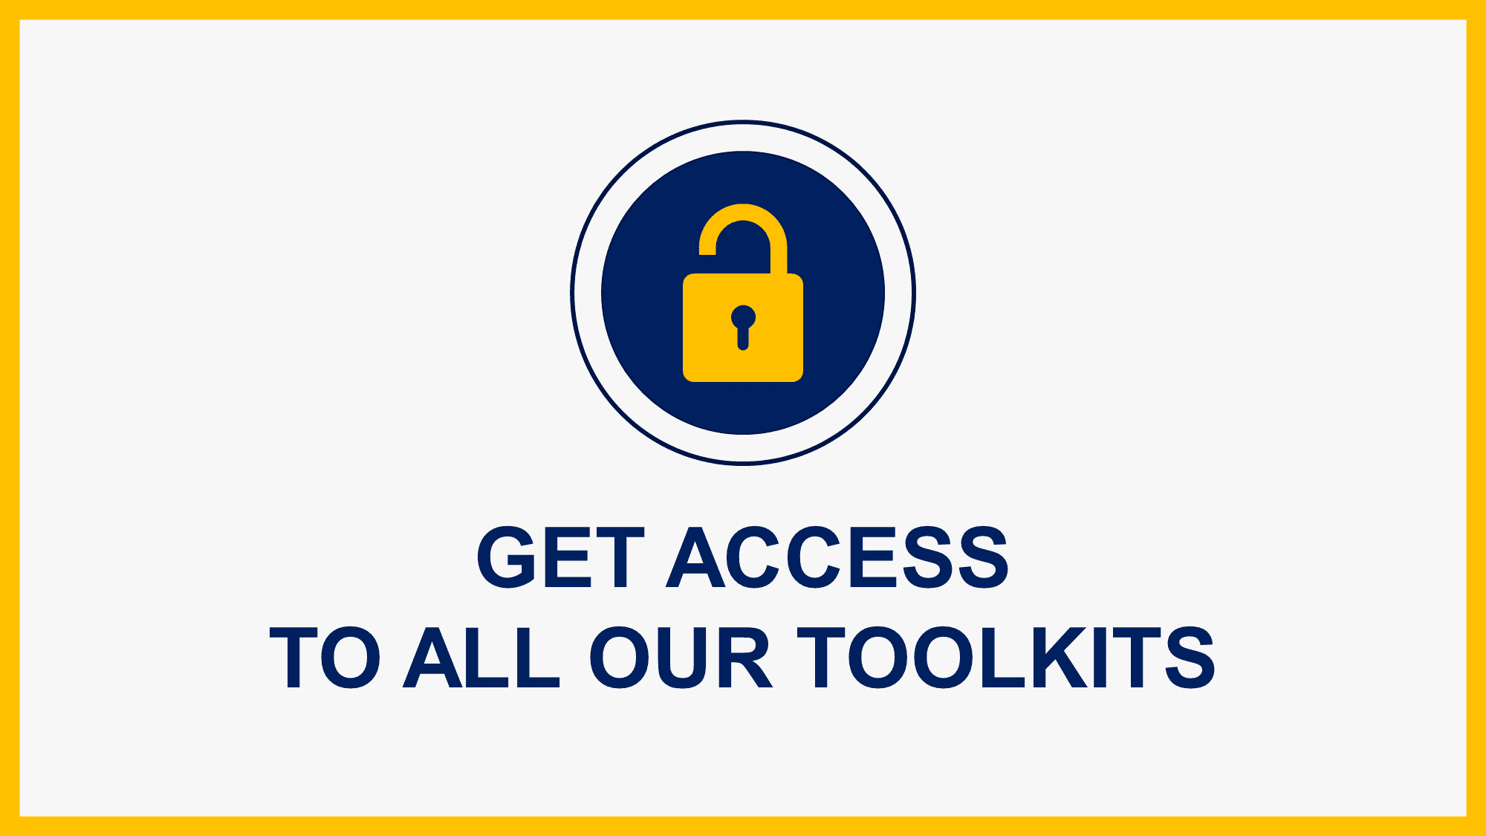
Interested in more than 1 Toolkit?
Access all our Toolkits for half the price with our Gold Access
Gold Access
Click here to learn more

Slide 12
Thanks for your attention!
www.domontconsulting.com

