Slide 1
Leveling Up: Exploring Accessibility in Video Games
Will Knoll
Solutions Engineer, Gamer, All-Around Fun Guy

Slide 2
Leveling Up: Exploring Accessibility in Video Games
Today, we'll delve into the strategies developers use to make gaming inclusive for players of all abilities.
Learn about tangible design principles, real game examples, and essential features like customizable controls and subtitles.
Gain insights into how accessibility is reshaping the gaming industry for a more inclusive future where gaming is truly for everyone.

Slide 3
Topics
Introduction to Accessibility in Video Games
Disability Considerations
Inclusive Design and User-Centered Approach
Current Ecosystem

Slide 4
Who Are You?
Solutions Engineer at TPGi.
Audit scoping, product demos, recommendations, etc.
Spent most of my career as a web developer.
Started coding tiny sites in Notepad.
Evolved to writing frontend code, backend code, deployment automation, web services, SQL…
Been playing video games since Atari.
And why are you giving this talk?

Slide 5
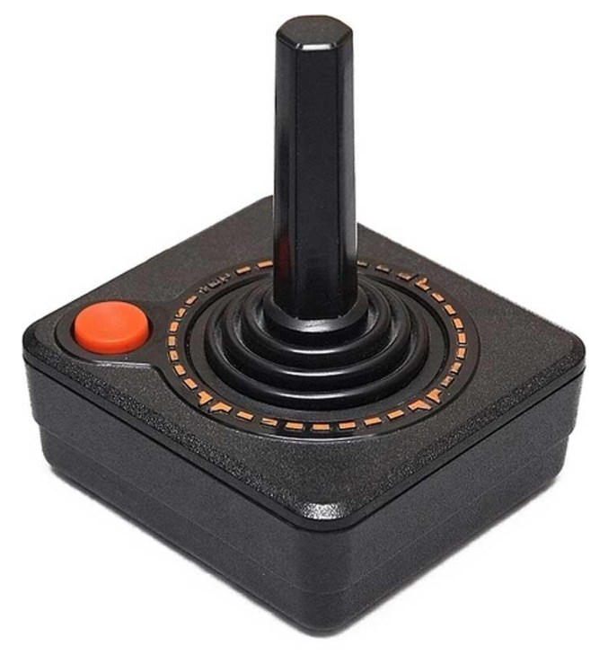
Personal Interest
Accessibility features help me as well.
Left-handed
Captions
Game Difficulty
Family history with motor disabilities.
Teenager with a red/green color deficiency.
Notes:
Obviously, left-handedness isn’t a disability, however, I benefit from game features that also have important accessibility impact.
The first gaming system I owned was the classic Atari. The controllers had a single button and joystick. I played it turned around, but you can’t do that with today’s controllers. That’s where custom hardware or software accessibility options come into play.

Slide 6
Down the Rabbit Hole
“Gaming” is an extremely broad topic-- there’s a lot we could talk about here
We’ll touch on the high points

Slide 7
Introduction to Accessibility in Video Games

Slide 8
Accessibility in the context of gaming
Design and adaptation of video games to be playable and enjoyable by as wide an audience as possible, including people with disabilities.
Considering various needs and implementing features that accommodate different forms of physical, cognitive, neurological, and sensory impairments.
Notes:
Accessibility in gaming refers to the design and implementation of features and practices that enable individuals with diverse abilities to participate fully in video game experiences.
This includes considerations for players with visual, auditory, motor, cognitive, or other impairments.
Accessible gaming involves creating interfaces, controls, and content that cater to a broad range of needs, ensuring that everyone, regardless of their abilities, can enjoy and engage with video games on an equal basis.

Slide 9
Importance of making games accessible to all players
Wider Audience Reach -- +15% of world population
Legal Compliance
Social Responsibility
Improved User Experience Overall
An average person spends 34 minutes per day playing games
Innovation and Creativity
Positive Brand Image
Notes:
Wider Audience Reach: By making games accessible, developers can reach a broader audience, including the millions of people worldwide with disabilities. This not only expands the market potential but also fosters a more inclusive gaming community.
Legal Compliance: In many regions, there are laws and regulations, like the Americans with Disabilities Act (ADA) and Communications and Video Accessibility Act (CVAA) in the U.S., requiring digital content, including games, to be accessible. Designing with accessibility in mind helps companies avoid legal pitfalls and fines.
Social Responsibility: Ensuring everyone can enjoy gaming is a matter of equity and fairness. Games often reflect society's values, and including accessibility demonstrates a commitment to diversity and inclusion.
Improved User Experience: Features designed for accessibility often benefit all players, not just those with disabilities. For instance, subtitles can help in noisy environments, and customizable controls can improve comfort for all users.
Innovation and Creativity: Thinking about accessibility can lead to innovative design solutions and new game mechanics, enhancing the gaming experience for everyone.
Positive Brand Image: Companies that prioritize accessibility are often viewed more favorably, enhancing their reputation and customer loyalty.
In essence, incorporating accessibility in game design not only makes good business sense but also contributes to a more inclusive and equitable society.

Slide 10
Communications and Video Accessibility Act
Passed in 2010 to improve accessibility in telecommunications and advanced communication services and is governed by the FCC.
The CVAA was expanded in 2019 to include video games.
Text and video chat
Subtitles and text-to-speech
Customizable control schemes
Menus, guides, and instructions
Compatibility with assistive technologies
Requires procedures for effectively resolving accessibility complaints
Notes:
Governed by the FCC.
“expanded in 2019” is somewhat of a misnomer. Video games were granted exceptions for several years so that they could catch up with the technical requirements. Those exceptions expired on Dec. 31, 2018.

Slide 11
Disabilities that affect gaming
Sensory
Physical
Cognitive
Neurological
(There is a lot of overlap)
Notes:
Any disability can potentially have a negative effect on one’s gaming experience. These are the primary categories.
Sensory – Visual and Auditory
Physical – Motor and Mobility Cognitive – Dyslexia, Learning, Attention
Neurological – Epilepsy, memory, sometimes motor (Parkinson’s, MS)
Psychiatric and Mental Health can also come into play (PTSD, etc.) but that is more related to content.

Slide 12
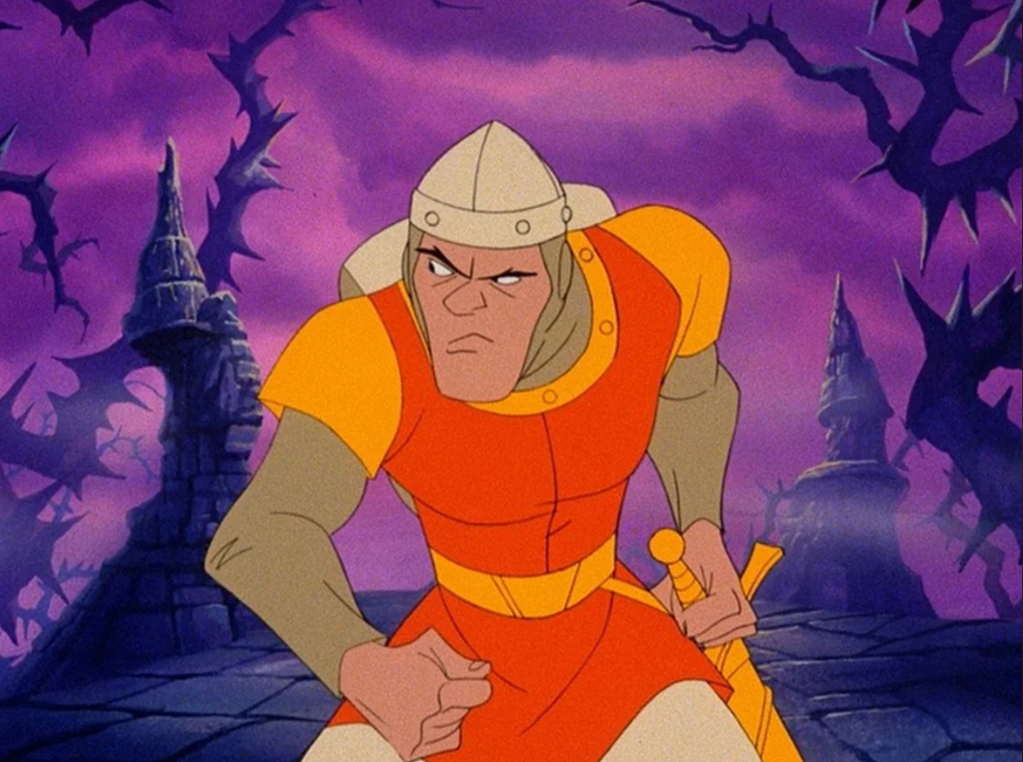
Back in the Day
Notes:
Dirk the Daring -- Dragon’s Lair is a poster child for inaccessibility and the grandfather of the Quicktime Event (QTE), where certain actions must be performed in the game within a very limited amount of time. Timing and Reflex Requirements
No subtitles or captioning
Visual complexity
No difficulty adjustment
No alternative control schemes
Cognitive overload (fast-paced and unpredictable) No practice or learning mode

Slide 13
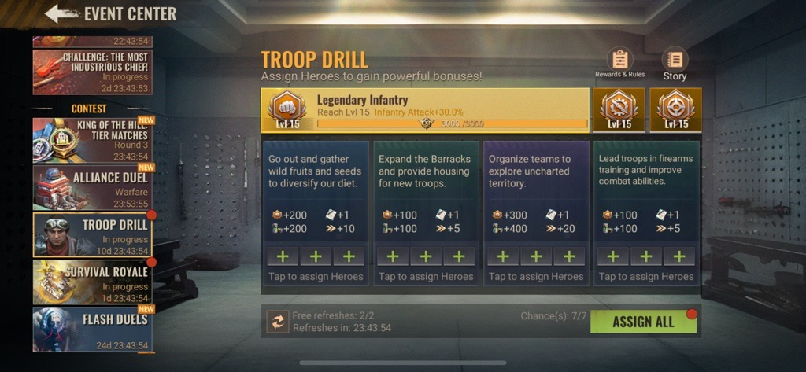
Visual Accessibility
Notes:
Zombie game with ridiculously small text, poor contrast, and poor color choices

Slide 14
Visual Accessibility
High contrast visuals, scalable fonts, and colorblind-friendly options.
Subtitle options and text-to-speech functionalities.
Audio narration.
Screen magnification.
Design considerations for players with visual impairments
Notes:
Audio narration – Games need to have an option for audio narration of visuals and actions being taken. This allows blind and visually impaired players to access your game.

Slide 15
Auditory Accessibility
Provide options for adjustable sound levels.
Music / SFX balance
Left / Right volume control
Closed captions and audio cues for important game events.
Subtitles and translations for non-native speakers.
Design considerations for players with auditory impairments
Notes:
Captioning: All speaking and narration should include full captions/subtitles, with options to adjust the size of the text and the background. In addition, there should be the option to show speaker names. Captioning is a mode of access for Deaf and Hard of Hearing players.

Slide 16
Motor and Mobility Accessibility
Customizable controls, key mapping, and sensitivity adjustment.
Alternative input methods for players with limited mobility.
Avoiding reliance on fast reflexes or complex button combinations.
Design considerations for players with motor and mobility impairments

Slide 17
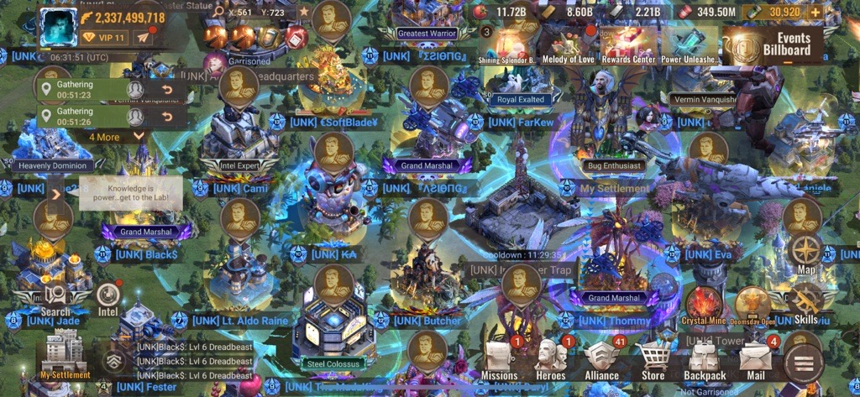
Cognitive Accessibility

Slide 18
Cognitive Accessibility
Clear UI design reduces cognitive load.
Options for adjustable difficulty levels.
Offer tutorials, hints, and the ability to skip difficult puzzles or sections of gameplay.
Use consistent rules and mechanics.
Design considerations for players with cognitive impairments
Notes:
Avoid sudden changes in gameplay or unexpected surprises. Many games slowly introduce additional mechanics.

Slide 19
Neurological Accessibility
Options to modify or disable potentially problematic visual effects (like flashing lights or fast-moving patterns).
Include content warnings for game elements that might affect players sensitive to intense sound effects, or themes that could trigger adverse reactions.
Provide tools that allow players to control their level of social interaction.
Design considerations for players with neurological impairments
Notes:
options to modify or disable potentially problematic visual effects (like flashing lights or fast-moving patterns) that can trigger seizures or discomfort in people with photosensitive epilepsy or other sensory sensitivities
Don’t make assumptions. “They know they’re playing a horror game, so they should know what to expect.”

Slide 20
Inclusive Design and User-Centered Approach

Slide 21
Engage with diverse users early and often
Involve players from diverse backgrounds, including those with various disabilities, in the design and testing processes from the earliest stages.
Regular feedback and iterative testing with a broad range of users help identify accessibility barriers and opportunities for improvement.

Slide 22
Adopt universal design principles
Apply universal design principles to create games that are inherently accessible to as many people as possible without the need for adaptation or specialized design.
This includes offering multiple ways to receive information (visual, auditory, tactile feedback) and interact with the game (varied control options, customizable interfaces).

Slide 23
Ensure flexibility in UI and controls
Design games with customizable user interfaces and control schemes that can be adjusted to meet individual needs and preferences.
This includes options for remapping controls, adjusting sensitivity settings, and enabling various assistive features like subtitles, text-to-speech, and colorblind modes.

Slide 24
Incorporate accessibility guidelines and standards
Follow established accessibility guidelines and standards, such as the Web Content Accessibility Guidelines (WCAG) for digital content and the CVAA requirements for communications and video programming.
Use these guidelines as a baseline for designing accessible game elements, from menus and tutorials to gameplay and online interactions.

Slide 25
Foster an inclusive gaming community
Promote a positive and inclusive gaming community by implementing features that support respectful interactions and provide tools for managing communication preferences.
This can include moderation tools, content filters, and options for players to customize their social experience to feel safe and welcomed.

Slide 26
Collaboration and Advocacy
Collaboration between developers, players, and advocacy groups such as AbleGamers.
CanIPlayThat.com
Major companies publishing best practices.
Gaming Accessibility Conference (April 22nd & 23rd)

Slide 27
Current Ecosystem

Slide 28
Where are we now?
Notes:
Spider-Man 2 is a great example for leading game accessibility.

Slide 29
Accessibility Options and Visibility
Hearing Preset
Enables subtitles and captions.
Motion Sensitivity Preset
Slows controls, adds centering dot, disables camera shake, disables motion blur.
Motor Preset
Toggles various modes for aiming and tricks, toggles hold button for repeated button presses, enables QTE Autocomplete, increases time for dodge, etc.
Vision Preset
Enables screen reader, audio descriptions, increases prompt and icon size, various game assists.
Beginning cut scene shows an ASL interpreter in a classroom.

Slide 30
Other Feature Examples
Change the color of items
Story Mode
Settings, settings, settings!
Notes:
If your game has the ability to make minute changes to your character’s nose (and other things…Cyberpunk), surely you can implement settings that improve accessibility.

Slide 31
Xbox Adaptive Controller
Notes:
More of a “controller hub”

Slide 32
PlayStation Access Controller
Notes:
Fully functional controller with modular design and tactile buttons

Slide 33
Nintendo Flex Controller
Notes:
Similar to Xbox Adaptive Controller, more of a “controller hub”

Slide 34
Stickless

Slide 35
Quadstick
Notes:
RockyNoHands uses the quadstick

Slide 36
Additional Resources

Slide 37
Additional Resources
International Game Developers Association
https://igda-gasig.org/what-and-why/demystifying-cvaa
Can I Play That
https://caniplaythat.com
Able Gamers
https://ablegamers.org
Gaming Accessibility Conference
https://www.gaconf.com/conference
Xbox Accessibility Guidance
https://learn.microsoft.com/en-us/gaming/accessibility
Game Accessibility Guidelines
https://gameaccessibilityguidelines.com

Slide 38
Additional Resources
https://www.playstation.com/en-us/accessibility/
https://www.theverge.com/2023/4/3/23668538/sony-playstation-store-accessibility-tags-ps5
https://access-ability.uk/2024/01/05/video-games-need-accessibility-standards-2024/

Slide 39
Thank You!
Will Knoll
wknoll@tpgi.com

