Slide 1
B2B on Shopify
Partner Guide

Slide 2
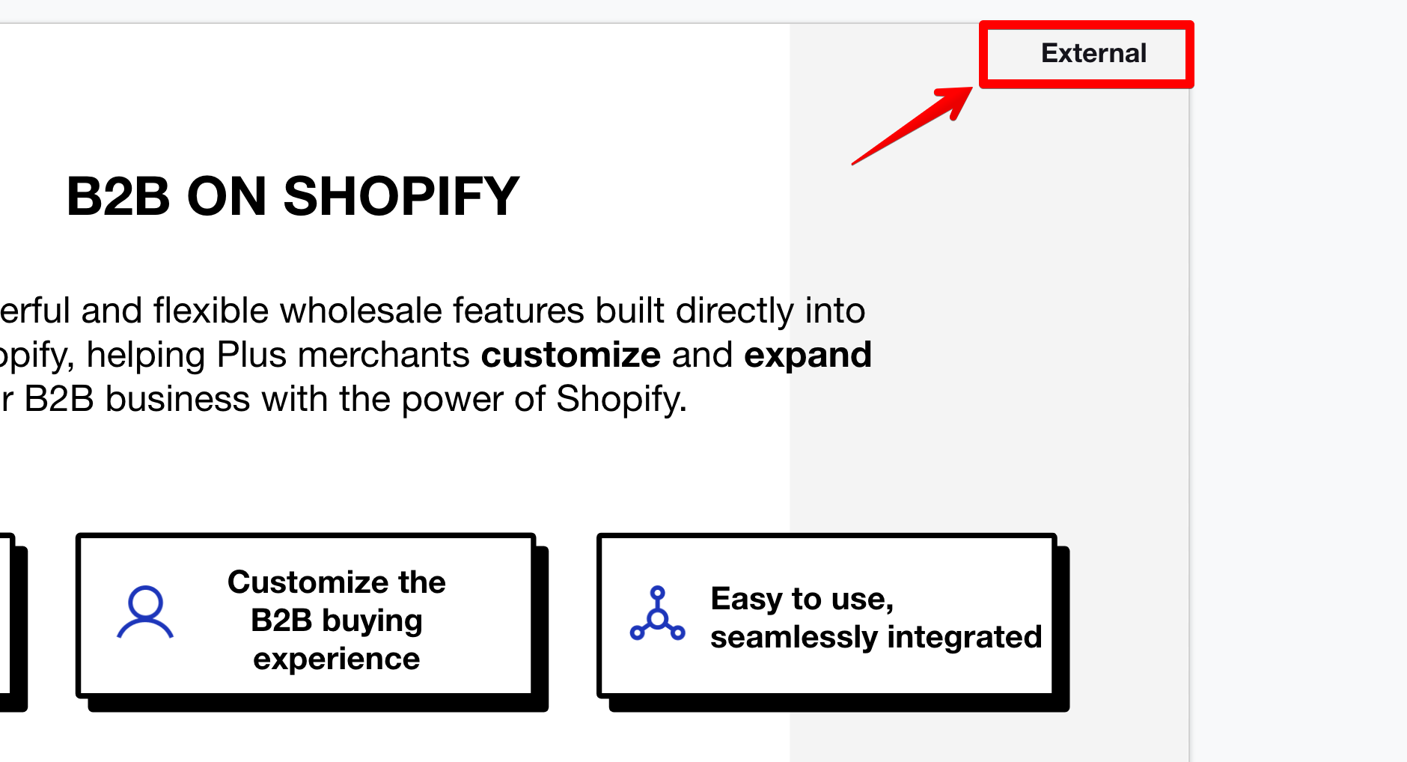
Note:
This Guide is intended as an informational resource for Shopify Partners.
Any slides marked “External” in the top right corner may be used in presentations with your clients and prospects.

Slide 3
Context
1/ Merchant challenge
2/ Opportunity & landscape
3/ Product
4/ Shopify advantage
5/ Case study

Slide 4
Merchant Challenge
Low customization and flexibility
📈
Stagnant growth, slow innovation, offline sales, rising CAC, low conversion and LTV
MERCHANT CHALLENGE
Merchants know that B2B is a huge opportunity to scale their growth and reach new markets, but they struggle with…
🫠
Low efficiency and high costs
Multiple platforms, archaic technology, manual processes, expensive legacy solutions, 3rd party apps

Slide 5



External
Shopify Plus | Accelerate growth
B2B ON SHOPIFY
A suite of powerful and flexible wholesale features built directly into the core of Shopify, helping Plus merchants customize and expand their B2B business with the power of Shopify.
Sell B2B and DTC from one place
Customize the B2B buying experience
Easy to use,
seamlessly integrated
Notes:
Speaking points:
B2B on Shopify is a powerful suite of wholesale features built directly into the platform and included for all Plus merchants.
Shopify’s DTC platform is world renowned for its ability to fully customize the buying experience with the easiest to use admin. We saw the need for an equally powerful and customizable B2B solution built into the core.
Sell B2B and DTC from one place
Grow and run your B2B business with the power and simplicity of Shopify’s all-in-one platform.
Leverage Shopify’s world renowned customizable platform for your B2B business.
Run both sides of your business from one platform and one admin.
Choose between a single storefront for DTC and B2B or a dedicated store for your wholesale business
You no longer need to pay for third party apps or leave the platform to use powerful, intuitive B2B features such as company profiles, payment terms, and price lists.
Pain points solved → managing multiple platforms, duplicate costs, inventory discrepancies
Customize the B2B buying experience
Tailor the buying experience for each company with personalized product publishing and pricing, quantity purchasing rules and more.
Increase AOV and LTV by offering a world class DTC-like buying experience for B2B that is adaptive and agile to buyer needs.
We’ve built the new B2B feature set directly into the heart of Shopify to give you access to our most customizable features
This enables you to deliver an incredible buying experience for your B2B customers without expensive tools, complex workarounds, apps or coding.
Shopify’s powerful customization enables you to give savvy buyers a modern and seamless experience.
Pain points solved → satisfying younger buyers looking for a DTC like experience
Easy to use, seamlessly integrated
Launch quickly and easily integrate existing back-end systems to increase efficiency.
Spend less time managing multiple platforms with Shopify’s flexible integrations, open APIs, and automated order processing.
An easy to use platform and seamless integrations will create more efficiency and time and cost savings to your business
Connect to your ERP to remove the need for manual data entry and integrate all of your essential business data to Shopify (coming mid 2023)
Pain points solved → reduced headcount and labor, reduced costs, increase growth velocity and efficiency
Differentiation:
Shopify is the world’s leading DTC commerce solution and we’ve harnessed our global reach and power of customization for wholesale selling.
Shopify’s B2B solution is built directly into the core platform without apps, separate selling channels and complex code.
Shopify offers the fastest migration and easiest admin with the power of 4,000 engineers to give you the flexibility you need.

Slide 6
Positioning
B2B ON SHOPIFY
A suite of powerful and flexible wholesale features built directly into the core of Shopify, helping Plus merchants customize and expand their B2B business with the power of Shopify.
Sell B2B and DTC from one place
Customize the B2B buying experience
Easy to use,
seamlessly integrated
Grow and run your B2B business with the power and simplicity of Shopify’s all-in-one platform.
Leverage Shopify’s world renowned customizable platform for your B2B business.
Tailor the buying experience for each company with personalized product publishing and pricing, quantity purchasing rules and more.
Increase AOV and LTV by offering a world class DTC-like buying experience for B2B that is adaptive and agile to buyer needs.
Launch quickly and easily integrate existing back-end systems to increase efficiency.
Spend less time managing multiple platforms with Shopify’s flexible integrations, open APIs, and automated order processing.
Differentiation:
Shopify is the world’s leading DTC commerce solution and we’ve harnessed our global reach and power of customization for wholesale selling.
Shopify’s B2B solution is built directly into the core platform without apps, separate selling channels and complex code.
Shopify offers the fastest migration and easiest admin with the power of 4,000 engineers to give you the flexibility you need.

Slide 7
B2B is Shopify’s biggest growth lever with an estimated $1T GMV TAM by 2026.
Investment
Market interest
B2B opens up a new channel for merchants, attracting larger merchants to help us move up market and win the Enterprise.
Our target market is ready for B2B on Shopify
80%
90%
$1.5B
Plus merchants selling B2B off platform would prefer to sell on Shopify.
Plus merchants would replatform their existing B2B business to Shopify
Targeted B2B GMV in 2023

Slide 8



Target Customer Profile
B2B on Shopify is built for scalable growth.
Business model
Primary: B2B + DTC hybrid model with existing operations
Secondary: Solely B2B operations
Verticals
Aligned with Shopify’s top industries (apparel, beauty, food and bev, home goods)
Business sells to independent retailers (i.e. non EDI orders)
Business sells products by quantity, not weight
Region
Global availability
Stronger fit in english speaking regions in North America, EMEA, AIPAC
Business size
Exclusive to Plus + CCS
Primary: Mid-market / Large ($1M - $100M)
Secondary: Strategic / Enterprise ($100M+)

Slide 9


B2B Opportunity
Expand your B2B business.
Existing B2B business online
Shopify advantage: All in one platform for B2B and DTC
Opportunity: Centralized platform to increase back-end efficiency and provide a world class custom buying experience.
Hesitations: Replatforming, Shopify’s ability to handle complex businesses
Existing B2B business offline
Shopify advantage: Efficiency and scale
Opportunity: Access to customized buying experience, self-serve purchasing, and automated back-end operations to reduce time and costs
Hesitations: Fear of change, cost, complexity, support
Expanding into B2B
Shopify advantage: Growth and scale on a single platform
Opportunity: B2B is a huge opportunity to reach new customers and revenue streams with lower CAC costs than DTC
Hesitations: Simplicity and ease

Slide 10
Market Landscape
1/ B2B trends
2/ Landscape + competitors
3/ Product market fit
4/ Shopify merchants

Slide 11
External
Market Trends
B2B Commerce Trends
Revamped B2B Commerce
-52% buyers frustrated with online buying experience for wholesale
-87% would pay more for a Merchant with an excellent commerce experience
DTC-like Buying Experience
Buyers expect easy to use purchasing that is personalized
Multiple payment options
Merchants expect flexibility and efficient fulfillment
Millennials In Power
73% involved in buying process
75% of workplace by 2025
Younger buyers expect self-serve purchasing and engaging online experiences
Digital-first B2B
83% buyers prefer purchasing through digital commerce v. sales rep led
65% buyers who self-purchase complete higher quality deals than sales rep led purchases
*Sources: Gartner Social Media Best Practices, Shopify Plus The B2B Ecommerce Trends and Statistics to Follow in 2023, Finances Online 2022 B2B trends, Wunderman Thomspon The B2B Future Shopper Report 2021, Avionos 2021 B2B Buyer Report, McKinsey B2B sales: Omnichannel everywhere, every time 2021
Notes:
Speaking Points:
Revamped B2B Commerce:
Challenge: Poor Online Buying Experience
Conventional, long-established B2B companies struggle w/ UX design and agility
52% B2B are frustrated w/ their online buying experiences
DTC - like Buying Experience
Challenge: Buyers expect modern experience
These digital natives are responsible for the shift of traditional B2B industry to more like B2C
Why does this matter? Millennials want an easy to use, seamless, digitized, self-driving experience
They expect speed and quick delivery - improving omnichannel fulfillment
Millennials in Power
Challenge: Buyers are more savvy and expect easy purchasing
73% are involved in buying process
By by 2025 - will make up 75% of workforce
Gen Z is a fast follow. By 2026 they’ll have min $44B buying power and are 55% more likely to go into business than Millennials (Forbes).
Digital-first B2B
Challenge: stagnant growth using manual processes

Slide 12
External
Market Trends
Shopify Advantage
Revamped B2B Commerce
Shopify makes it easy to move your business online with highly customizable experiences that increase order value and streamline your operations.
DTC-like Buying Experience
Shopify is the world leader in DTC commerce and excels in creating personalized experiences and easy self-purchasing. We have harnessed this power for B2B buyers.
Millennials In Power
Shopify is highly agile and innovative, helping merchants easily adapt to new buying behaviors. With the power of over 4K engineers, Shopify can help you create personalized experiences for any buyer.
Digital-first B2B
As the world leader in commerce, Shopify makes it easy to offer purchasing options that fit your buyer’s needs across all channels and markets.
Notes:
Speaking Points:
Revamped B2B Commerce / DTC - like Buying Experience
“Among the biggest changes going into 2023 that B2B ecommerce decision-makers will keep an eye on is what McKinsey calls NeXT commerce, which the consulting firm defines as “an approach to ecommerce that needs a big upgrade grounded in a commitment to become indispensable to the customer through an exponentially deeper level of engagement online and offline.” (source)
While many B2B businesses still see ecommerce as “just another channel” they’ll need to adjust their mindset and plans to remain ahead of their competitors. Merchants will need to offer an ecommerce experience that is personalized and consistent across all channels to meet customer expectations and continue building relationships.
Offering an online ordering experience is not enough anymore, it’s table stakes.
Shopify is well suited for this trend as a DTC-first platform that has extensive experience in creating exceptional, intuitive buying experiences. We should highlight our comprehensive list of out-of-the-box features and available APIs that will allow merchants to easily build highly customized buying experiences for all of their customers from a single platform.
We see evidence for this trend all of the time on merchant calls, for merchants both large and small.
Digital - first B2B
This is an ongoing trend we’ve seen for a while with no signs of slowing down. I believe we will not have to convince merchants to go online if they’re not already, the real challenge is convincing merchants that Shopify is the best platform to support their future growth in B2B and to deliver an exceptional buying experience to their customers.
“Eighty-three percent of B2B buyers say they prefer ordering or paying through digital commerce, according to Gartner, Inc. A Gartner survey of 725 B2B buyers from November through December 2021 found that digital commerce has rapidly become the norm and the preferred way to complete B2B purchases.” (source)
“When buyers report their purchase process was primarily led by sales reps (as opposed to self-navigated), they make lower-quality purchase decisions. Only 24% of B2B buyers in primarily sales rep-led purchases completed a high-quality deal, versus 65% of B2B buyers who self-navigated the purchase process. Today’s chief sales officers (CSOs) often feel torn trying to solve these problems by either retraining reps to win over digitally inclined buyers or cutting out sellers entirely to go all-in on digital sales. A new approach is needed that combines digital and human engagements to help buyers feel more confident in their decisions and drives high-quality deals. Ultimately, digital and sales rep underperformance have a common root cause: ineffective customer learning.” (source)

Slide 13








Market Landscape
B2B Market Landscape.
HYBRID eCOMMERCE
ERP / CRM
PURE B2B
🛡️ SHOPIFY WEAKNESS
Access to complex B2B features (e.g. sales rep order flows, ACH payment portal)
Strong partner ecosystems
🥊 SHOPIFY ADVANTAGE
Many complex features are 3rd party via integration to BundleB2B (BigCommerce)
Many complex features are developer built and costly (Magento)
On-premise, long implementation (Magento)
🛡️ SHOPIFY WEAKNESS
Powerful ERP and CRM platforms
Fully integrated ERP and CRM platform with commerce
🥊 SHOPIFY ADVANTAGE
Highly focused on back office and admin operations versus eCommerce
B2B is low priority
User experience, both for merchants and customers, is clunky and slow
🛡️ SHOPIFY WEAKNESS
Complex B2B feature set
Greater mobile capabilities
Strong apparel partnerships (NuOrder)
🥊 SHOPIFY ADVANTAGE
No ability to support DTC eCommerce
Poor support experience
Limited experience/reputation (Zoey)
Notes:
Speaking Points:
How does Shopify Win Against Existing Solution?
vs. Manual
Ability to streamline a merchant’s business, saving them time and resources, so that they can scale and grow their business by focusing on strategic projects and acquiring new merchants
Meets buyer expectations of a modern, innovative ecommerce experience
vs. SaaS Hybrid (other than Shopify)
Belief that Shopify is the most innovative, intuitive platform for B2B and DTC
Desire to offer customizable buying experiences with first-party, out-of-the-box features and APIs
Larges partner ecosystem offering custom solutions and flexibility
vs. Cloud Hosted
Ability to offer lower total cost of ownership, shorter time to value, and support/maintenance maintained by Shopify
Desire to use an intuitive, simple admin that can be used by any member of the team, no coding experience required
Optimized for performance
vs. Pure B2B
Ability to support their DTC and B2B business on one platform, or one store
B2B is included in the cost of Plus (if already Plus merchant)
User experience, modern commerce expertise
vs. Pure Headless
Desire for a true ecommerce partnership - Shopify provides best-in-class customer support and ecommerce expertise to help you grow and scale your business
Offer highly customizable buying experiences to all of your customers without requiring extensive development work
vs. Legacy, Custom-Built
Commerce expertise
Meets buyer expectations of a modern, innovative ecommerce experience
No maintenance or update costs
vs. Marketplace
Desire to build deeper brand loyalty and awareness with their customers, no need to compete against other merchants during the ordering process
Can be used in conjunction with direct ecommerce models
vs. 3P Apps
Desire to use first-party features, included in the cost of the Plus subscription, that are supported and maintained by Shopify

Slide 14


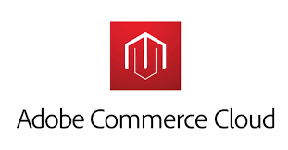


Market Landscape
Top B2B Competitors.
🛡️ PROTECT AGAINST
More B2B features via apps (ACH, headless support, PO numbers)
SHOPIFY ADVANTAGE
Fully integrated B2B v. add on apps, 3rd party features
Speed of innovation
Higher capacity for complexity, extensibility, and flexibility
Largest app and partner ecosystem
More flexible storefront themes
🛡️ PROTECT AGAINST
Access to complex B2B features (e.g. sales rep order flows, ACH payment portal)
Powerful ERP / CRM integrations
SHOPIFY ADVANTAGE
Fully integrated B2B built by Shopify v. acquired platforms that are disjointed
Better / easier customization
Agility and faster innovation
Little/no reliance on developers
Low maintenance costs
Faster time to launch
🛡️ PROTECT AGAINST
Access to complex B2B features (e.g. sales rep order flows, ACH payment portal)
“Endless” customization ($$)
SHOPIFY ADVANTAGE
Better / easier customizable buyer experience leads to increased conversion and LTV
Agility and faster innovation
Little/no reliance on developers
Low cost / faster to launch
Notes:
Speaking Points:
How do we position ourselves against Adobe Commerce?
TL;DR - As the recognized leader in the DTC ecommerce space, we know how to create exceptional buying experiences that delight customers and allow merchants to focus on growing their business. We’re bringing the same level of customization and flexibility to B2B so you can create highly customized buying experiences for all of your customers from a single platform and an intuitive, user-friendly admin.
Shopify advantage - buyer experience, agility, ease of customization, fast innovation, little/no reliance on developers, low maintenance costs
Supporting messages:
Minimize time to value by using our effortless, intuitive admin and first-party features to manage both sides of your business, no coding required.
With our suite of B2B APIs you can create custom solutions that meet the needs of your business and your customers.
Grow your B2B business by using a platform that empowers your customers to help themselves and streamlines back office tasks.
How do we position ourselves against Salesforce?
TL;DR - B2B buying expectations are changing, and in order to remain competitive merchants need to offer the same level of personalization and flexibility to their B2B customers as they do for DTC. Bringing your B2B business to Shopify means you can offer all of your customers a highly customized buying experience from a single store or platform that connects seamlessly with the rest of your business.
Shopify advantage - agility, fast innovation, app ecosystem, site design, ease of customization, costs
Supporting messages:
As the experts in commerce, we know how to make selling online easy and efficient. Simplify your order process by empowering customers to self-serve and automating back office tasks.
B2B buying experiences shouldn’t be an afterthought. Convert more wholesale buyers and create repeat customers with Shopify’s customized DTC-like buying experiences, optimized for B2B.
Tap into the power of Shopify’s app and partner ecosystem for custom solutions for the most complex business needs.
How do we position ourselves against BigCommerce?
TL;DR - Grow and run your B2B and DTC business from one place with the power and simplicity of Shopify’s all-in-one platform. No third party apps required.
Shopify advantage: speed of innovation, capacity for complexity, app ecosystem, extensibility, flexibility and customization options
Supporting messages:
Leverage the full power of Shopify’s platform, including Functions, themes, discounts, 3P apps, and more to build highly customized buying experiences for all of customers without ever leaving the platform.
Tap into the power of Shopify’s app and partner ecosystem for custom solutions for the most complex business needs.
We’ve streamlined the selling process for millions of merchants by creating tools that empower your customers to self-serve and simplify back office tasks.
Shopify
From the Magic Quadrant report:
Within the “Strengths” section: “Shopify’s newly launched Online Store 2.0 provides a notable upgrade for customization and business-user-friendly editing. Hydrogen, which was offered in developer preview form in November 2021 and officially launched in June 2022, is a front-end web development framework and SDK that provides more flexibility for merchants wanting to build custom Shopify storefronts. Shopify also offers Shopify Flow, a platform to automate tasks and processes within stores and across apps. These added capabilities improve Shopify’s ability to meet the complex requirements of large businesses.”
Within the “Cautions” section: “Most of Shopify’s merchants are very small businesses with subscription plans that cost less than $50 a month. The Shopify Plus customer base accounts for less than 1% of Shopify’s total merchants. Enterprise buyers with annual GMVs larger than $50 million, especially in non-retail industries, should seek references from customers of similar size.”
Within the “Cautions” section: “Shopify enables merchants to set up wholesale channels, but its suitability for B2B digital commerce use cases remains untested. Merchants and other businesses looking for more complex B2B functionality should explore other vendors. Shopify launched a B2B offering in June 2022, which was not evaluated for this Magic Quadrant.”
Adobe Commerce (formerly Magento)
From the Magic Quadrant report:
Within the “Cautions” section: “Although Adobe continues to upgrade its B2B offering, some functionality is still missing. Examples are the ability to prevent order quantity from exceeding customer budget allocation, the ability for order approvers to combine multiple requests to achieve volume discounts, and a native configure, price and quote (CPQ) offering.”
Note that we do not have solutions for any of the above today, except for draft orders as a solution for quotes.
Salesforce Commerce Cloud
From the Magic Quadrant report:
Within the “Cautions” section: “Salesforce requires clients to purchase additional components for some basic commerce functions. For example, the OMS module is required for some physical-store connection functionality, such as product picking for BOPIS orders. Additionally, B2B customers seeking the ability to respond to quotes need to purchase the Salesforce Sales Cloud.
Within the “Cautions” section: “Salesforce B2B Commerce customers must purchase user licenses for buyers on the platform, in addition to paying for the platform on a per order or GMV percentage basis. This is a pricing lever not used by most B2B-focused vendors in this Magic Quadrant.”
Seems to now offer a “B2B2C” option that lets merchants sell DTC from the same admin as their B2B store (previously there was no connection between the two sides). “Side by side on the same platform”. Made for B2B merchants who want to expand into DTC. The customer interface looks very outdated, compared to even a basic Shopify theme.
Marketing video

Slide 15



Product Market Fit
B2B on Shopify has reached market parity with high release velocity.
2,000 Plus merchants using B2B on Shopify
SHOP NOW
$120M B2B orders within first 6 months of GA release
Shopify has decades of experience in ecommerce and we have supercharged B2B development to reach market parity by Q1 2023.
Over a dozen new features released to make Shopify in line with top competitors.
SHOP NOW
Annual growth projections 200%
SHOP NOW

Slide 16
B2B Feature Parity
 | B2B on Shopify | Big Commerce | SalesForce | Adobe Commerce | Bottom Line
Integrated natively | 🟢 | 🔴 | 🟢 | 🟢 | Only B2B on Shopify will allow merchants to utilize the full power of our platform and our custom buying experience for both B2B and DTC
Price Lists | 🟢 | 🟢 | 🟢 | 🟢 | B2B on Shopify uses direct assignment (vs tags) which is easier to maintain, is supported via the API, and allows for both percentage off and fixed prices in the same price list
Payment Terms | 🟢 | 🟢 | 🟢 | 🟢 | B2B on Shopify will allow merchants to assign Companies a payment term that will be automatically included on all orders
Custom Product Publishing | 🟢 | 🟢 | 🟢 | 🟢 | Set customized product catalogs for each buyer and location to personalize the buying experience and increase conversion.
Quantity Price Breaks | 🟢 (via Scripts) | 🟢 | 🟢 | 🟢 | Issue automatic discounts as buyers purchase higher quantities. Increased functionality coming in H2 2023
Quantity Rules | 🟢 (Feb 2023) | 🟢 (no multiple rule) | 🟢 | 🟢 (via 3P app) | Flexible and customizable for any business need - set min/max or quantity amounts that are specific for each product.
Vaulted Credit Cards | 🟢 (Feb 2023) | 🟢 | 🟢 | 🟢 | Merchants and buyers can streamline the order process with less friction by vaulting credit cards.
Discounts | 🟢 | 🟢 | 🟢 | 🟢 | Discounts are already possible on the platform and will be able to be contextualized for B2B v. DTC customers by the end of Q1 2023.
ERP Integrations | 🟢 | 🟢 | 🟢 | 🟢 | Out of the box ERP integrations will begin rolling out in Q1 2023 with the release of our stable APIs. Accumatica will be first to market with Netsuite and Microsoft. Currently available with APIs

Slide 17






External
Shopify Merchants
B2B Merchants on Shopify.
Notes:
Speaking Notes:
Shopify Merchants selling B2B
Many of Shopify’s top merchants have moved their B2B business on to Shopify.
Merchants across all industries are successfully onboarding the new feature set and processing millions of dollars of orders to wholesale customers.
Each business has its own unique use case and is able to leverage Shopify’s flexibility to create a premium wholesale buying experience.
Shopify’s biggest merchants have migrated their B2B business to Shopify across many different verticals.
They are frustrated with other solutions and the lack of flexibility and customization available. Also - these merchants are already familiar with Shopify’s amazing admin and customized buying experience so it was a no-brainer for them to run their B2B business alongside DTC.
Apparel and accessories → Spanx, Pura Vida, Rothy’s, Steve Madden, Barstool Sports
Health and beauty → Paula’s Choice, Dermalogica, Supergoop
Food and beverage → Remy Cointreau, Jeni’s Ice Cream
Home and garden → Brooklinen
Furniture → ILKA
Office supplies → Staples
Healthcare → Filtrous
Brooklinen:
Previously, the Brooklinen team was manually entering all orders into NetSuite, creating an inefficient process with a poor customer experience that cost their internal team countless hours on back office tasks
Decided to use B2B on Shopify because they could manage their entire business from a single platform from a simple, intuitive admin.
Launching their new B2B store in Q1 2023, with a merchant case study launching at Editions to help us bring on more Plus merchants
Dermalogica:
Previously, the Dermalogica CA team used a custom-built, legacy platform for B2B that was outdated and clunky for customers to use, resulting in customer dissatisfaction and a poor user experience.
Joined B2B on Shopify during our beta and it’s just about ready to launch their pilot program
While this is only for their Canadian arm right now, they intend to use B2B on Shopify for their global wholesale operations
Filtrous:
Filtrous will leverage the new B2B on Shopify to automate and improve the buyer experience for their customers, as well as future-proof to meet the needs of changing B2B buyer expectations such as the Millennial and Gen-Z-driven need for a D2C-like buying experience.
Currently on BigCommerce, Filtrous found that too many customizations were required, resulting in things constantly breaking on their site.
With a list of complex requirements around POs, complex shipping rules, and tiered pricing, they've decided to invest in Shopify for the long
term to help them create a frictionless buying and fulfillment experience, increase speed, and build a strong foundation for international expansion, and are excited to be a future case study demonstrating the strength of B2B on Shopify.

Slide 18
Shopify Merchants
B2B Merchants on Shopify.
Beauty and wellness
Improved buying experience after switching from a custom-built legacy platform
Medical supplies
Improved customization and flexibility after switching from BigCommerce
Home furnishing
Improved efficiency and customer experience after switching from manual order entry.
Beauty and wellness
Improved customization and branding after migrating from Plus wholesale channel
Notes:
**please do not share with other Merchants - contains merchant GMV data

Slide 19
Product
1/ Key Features
2/ Demos
3/ Roadmap

Slide 20
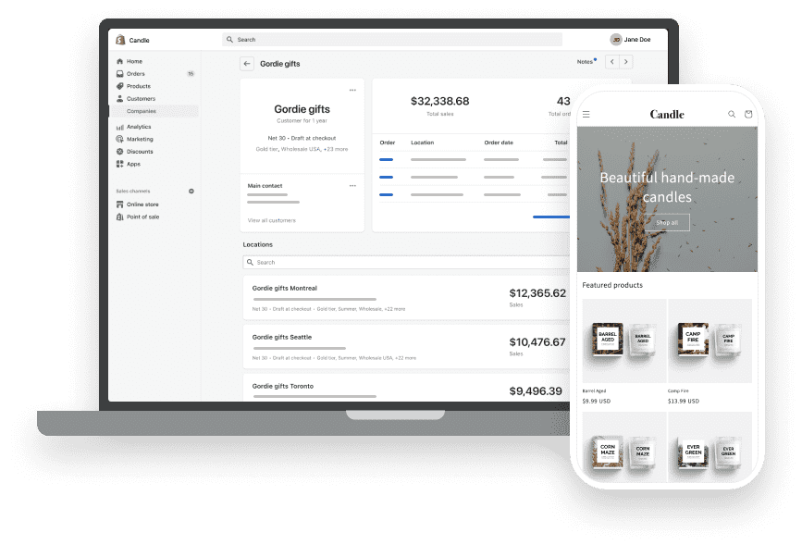
External
In the box
Company profiles
Custom product publishing + pricing
Quantity purchasing rules
Payment terms and discounts
Vaulted credit cards
Checkout to draft
Custom store themes and branding
Easy reorders
Self-serve portal
B2B APIs
B2B on Shopify
As a merchant, help me run and grow my B2B business so that I can achieve scalable growth through custom buying experiences and streamlined operations.
BUILT FOR:
HIGH GROWTH MERCHANTS
PRICING AND PACKAGING:
PLUS & CCS
AVAILABILITY:
GLOBAL
Feature descriptions
Notes:
Speaking Points:
Building a best-in-class B2B experience that can be easily and efficiently managed requires a suite of foundational features which we’ve built into the new B2B on Shopify.
Features are available directly in the admin - no need for additional tools, tags, coding or apps
Company Profiles
Company profiles are the foundation of B2B on Shopify.
The company profile can represent multiple buyers and locations, each personalized with payment terms, price lists, tax exemptions, and user permissions.
Merchants are able to satisfy more complex use cases with flexibility by associating multiple customers with the same company or company location.
Company profiles increase a businesses flexibility by being able to choose a permission level for each buyer - “admin” or “ordering only”
Custom Product Publishing
Merchants will have the ability to segment which buyers see a given product or variant, creating a more customized wholesale buying experience.
Benefit: Strengthen relationships with customers; Customized buying experience; Automatically curated product assortments; Less time managing order process
Quantity purchasing rules
B2B merchants can set minimum, multiple, and maximum quantity constraints for each product. They can also set specific increment logic and sell products in case packs. It can also be customized per company location to make a more personalized buying experience.
Benefit: Spend less time managing the order process; Streamlined backend processes and inventory fulfillment; Increase order value
Price Lists
Price lists are a fundamental part of customizable B2B commerce.
They enable merchants to create a truly customized buying experience for each wholesale customer by setting fixed-prices or percentage off prices for all of their products.
Each price list can be assigned to an individual business customer or location.
They can easily modify the currency and exchange rate for international buyers and enforce rules around when a given price applies.
The buyer sees exactly what price they will be paying while in the online store.
It is easy and seamless for merchants to set and update price lists without using tags, coding, or additional apps.
Price lists make the selling process more efficient because merchants no longer need to send individual discount codes to their buyers.
Net Payment Terms
Net payment terms allow merchants to further customize the buying process for each customer while also increasing their efficiency through automation.
Payment terms can be assigned to each company location and they will be automatically included on any orders created by the customer or merchant.
Payment terms support wholesale business practices because the buyer can place an order and not pay right away. They can receive an invoice to pay or use the self-serve portal to pay on their own when the payment is due.
The following net payment terms are available: Net 7, Net 15, Net 30, Net 45, Net 60, Net 90
Merchants and buyers have clear visibility into the payment due date and can track, pay and collect payment on orders as they become due in the admin.
Merchants also have the flexibility to set a custom payment due date for payments that do not fall into the interval options.
Vaulted credit cards (Feb 2023)
Buyers can now securely save their credit card information at checkout, enabling a quicker and more seamless checkout experience.
Benefit: Less time spent on admin tasks and collecting payment for merchants; higher percentage of on time payments because of stored payment; increased conversion; increased cash flow for merchants, streamlined payment processing
Checkout to draft
Wholesale buyers can complete a self-serve checkout and the resulting order is sent to the Merchant as a draft order to review and approve before finalizing. Merchants can choose to enable this feature by specific company location.
Benefit: Greater order accuracy; increased efficiency for merchants (if previously using the PWC); greater control and visibility over checkout process; streamlined checkout and ordering for trusted buyers
Custom Store Themes
Shopify is well known for its custom buying experience and B2B is not an exception.
B2B merchants can customize their online store theme with liquid support for a personalized wholesale buying experience.
As buyers become more sophisticated, B2B merchants are increasingly focused on custom branding and design in their online store.
Many wholesale merchants want their brand image to come across correctly to their business buyers as well as DTC buyers.
This includes designs specific to wholesale such as seasonal brand guides or specific merchandising for brick and mortar stores.
Easy reordering
Wholesale buyers can easily and quickly place an order based on a previous order.
Benefit: Increased efficiency for customers; increased conversion given the ease of ordering; higher order volume; less time spent accepting manual orders from customers.
B2B Checkout
Shopify Checkout helps merchants of all sizes deliver the internet's most reliable and best converting checkout experience for every buyer by providing the power, speed, and flexibility to satisfy their unique business needs.
B2B Checkout allows you to customize and streamline the checkout experience for your wholesale buyers with pre-populated business contact information, net payment terms, payment methods, and wholesale discounts.
Functions for B2B checkout
Merchants can now access APIs for Business Customers to create custom logic in checkout for discounts, payments and shipping. This can be contextualized in blended storefronts.
Benefit: Customized checkout experience increases conversion; Efficient and streamlined checkout experience with custom logic built in
Self Serve Portal
As wholesale buyers are becoming more savvy, the self-serve portal allows them to purchase, pay and edit their account on their own much like they would with DTC.
The self-serve portal also adds security for the merchant, ensuring that only buyers who have been authenticated can see specific wholesale products and prices.
Buyers can view and filter order history, pay unpaid orders, and select the company location they’re buying for.
B2B APIs
We are releasing the stable version of the business customer API to enable app developers to update their primitives and better serve B2B merchants. This will give more flexibility and customization options to merchants by using apps to satisfy unique use cases.
Benefit: Partners and developers can create better B2B workstreams and integrations to serve complex B2B businesses with custom solutions

Slide 21
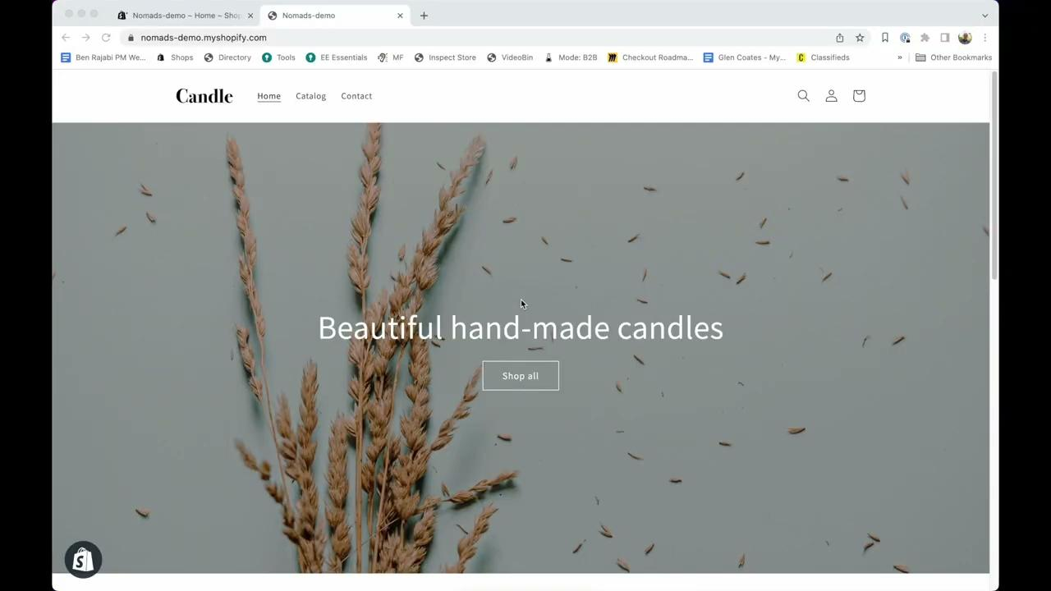
External
DEMO
Product overview
View here.
Notes:
**note - UX/UI for Catalogs has been updated as of Feb 2023

Slide 22
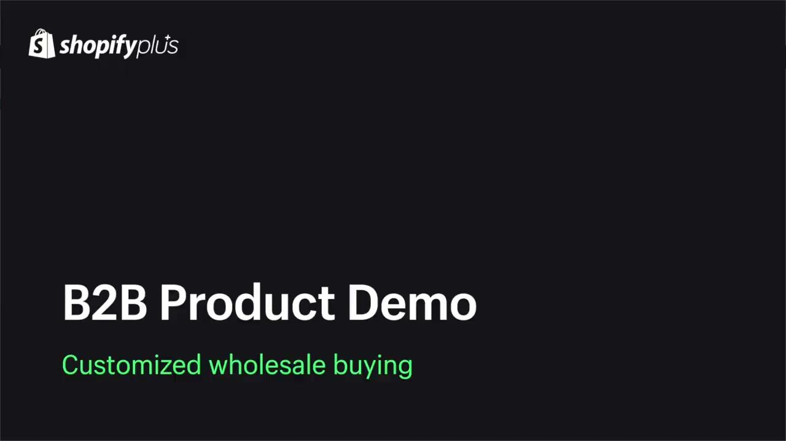
External
DEMO
Customized wholesale
buying
View here.
Notes:
Demo featuring Catalogs - custom product publishing and pricing, quantity rules, buyer experience

Slide 23
External
Product Roadmap
B2B on Shopify
2023
Jan / Feb
March / April
H2
Payment reminders
Custom product publishing
Quantity rules
B2B APIs
Payment and delivery customizations (via Functions)
Easy reorders
Vaulted credit cards
Flexible shipping address
PO numbers
Headless support
Catalogs API
Quantity price breaks
ACH payments
Sales rep support (v1)
B2B storefront themes
Discount functions
ERP integrations (out of the box)
Notes:
Speaking points:
B2B is central to our product development roadmap and a key part of our platform investment. We have very high release velocity and have reached market parity with top competitors as of Q1 2023
PO numbers → Ability for merchants and buyers to insert PO numbers or connect orders to an existing PO number during the ordering process. Will also support integration with ERPs.
ERP integration → Shopify is partnering with the top ERPs to create flexible integrations for B2B operations. This will help businesses create a centralized platform for all ecommerce with data flowing seamlessly between systems.
Discount Functions → Merchants now have a whole new way to incentivize and promote B2B sales that’s never been possible in a blended B2B and DTC store. You now have the ability to customize discounts by specifically targeting B2B buyers or excluding them from discounts all together. Previously, Merchants could only apply discounts to both B2B and DTC buyers or not apply discounts at all.
Benefit: increased customer satisfaction; increased conversion due to shipping and payment personalization; less time spent managing order process because of automation; customized buying experience
Quantity price breaks → Buyers can receive discounted pricing as they purchase higher quantities of a given product.

Slide 24
Challenges → Solutions
1/ Accelerate growth
2/ Increase LTV
3/ Drive efficiency

Slide 25
External
Accelerate growth
Large scale growth for complex businesses with B2B on Shopify.
Shopify Plus makes it easy to expand by managing your B2B and DTC business from one place
SHOP NOW
Built on Shopify’s powerful and integrated platform to create large scale growth and flexibility
Expand your reach across new markets with lower CAC costs.
Avoid stagnant growth and expensive upgrades that come with legacy B2B solutions.
SHOP NOW
Shopify allows you to expand and quickly innovate without additional tools, costs, and time. It’s all included in your Plus subscription.
SHOP NOW
Notes:
Speaking Points:
Accelerate Growth
What’s at risk:
Large scale growth for serious, complex businesses
Solution →
Built on Shopify’s powerful and integrated platform with flexible B2B APIs and integrations that you can use to create large scale growth
Streamline your B2B operations and manage your entire business in one place when you integrate your existing back-end systems.
Tailor the buying experience for each customer with custom product catalogs and pricing, volume purchasing rules, payment terms, payment and shipping customizations, and more - all from one place
It is harder than ever to expand your reach with rising CAC costs
Solution →
B2B on Shopify makes it easy to expand into new markets internationally and across new customer channels by managing your B2B and DTC business from one place
Shopify allows you to expand into new markets with B2B without additional tools, subscription costs, additional headcount and time to onboard a new platform - it’s all in one place and included in your Plus subscription.
Stagnant growth from using legacy solutions and archaic technology with slow, complicated and expensive upgrades
Solution →
Shopify has the most agile and innovative ecommerce platform with 4,000 engineers helping you build the custom solution you need quickly and easily
Shopify gives you the ability to unlock performance and agility for wholesale with flexible integrations, open APIs, and automated order processing.

Slide 26
External
Increase order value
Shopify is the leading commerce solution for optimized buyer conversion with B2B built directly into its core platform.
Customize the wholesale buying experience with tools optimized for flexibility.
SHOP NOW
Shopify offers the largest ecosystem of apps and partners for more plug and play flexibility.
SHOP NOW
B2B buyers expect easy and personalized experiences, much like DTC.
Avoid using separate selling channels and apps that limit your ability to customize.
Shopify makes it easy to create scalable personalized buying experiences for B2B with custom product catalogs and pricing, themes, and open APIs.
SHOP NOW
Notes:
Speaking points:
Increase order value
What’s at risk:
Decreased customer conversion due to limited flexibility for your wholesale business
Solution →
Shopify built a robust B2B solution directly in its core platform, allowing businesses to customize the entire design and buyer experience leading to optimized conversation. Competitors use separate selling channels and 3rd party apps to run B2B, limiting their ability to customize.
Ecosystem - Shopify offers the largest ecosystem of partners, apps and agencies to give you plug and play options for increase flexibility and composibility
Open APIs - Shopify has robust and open B2B APIs to allow you to create custom solutions, workflows and branding to make your B2B site specific to your business and drive conversion. Increased agility and innovation.
B2B buyers expect an easy and personalized buying experience (much like DTC)
Solution →
Shopify is the leading ecommerce platform for optimized buyer conversion and has used these learnings when building B2B.
B2B on Shopify makes it easy and scalable to create personalized buying experiences with custom product catalogs and pricing, payment terms, custom storefront themes and open APIs
Only Shopify offers the best checkout experience in the world with the highest conversion rates. It is also available to B2B buyers with automated payment and shipping personalizations and workflows to decrease friction and increase conversion.

Slide 27
External
Drive efficiency
Shopify makes it easy to launch your B2B business with the fastest speed to market and easiest admin.
Reduce costs and time by managing B2B and DTC from a single platform with B2B on Shopify.
SHOP NOW
Streamline your existing back-end operations with robust integrations and automated workflows.
SHOP NOW
Get up and running quickly without disrupting your business or existing systems.
Avoid added time, costs, and errors associated with manual order processing.
Self-serve B2B purchasing allows teams more time to build relationships and grow the business.
SHOP NOW
Notes:
Speaking points:
Drive Efficiency
What’s at risk:
Low efficiency by managing multiple platforms for DTC and B2B
Solution →
All in one ecommerce platform where you can manage both sides of your business from a single admin without developers, code or apps.
Your operations and data are centralized in one place with robust integrations giving you a singular view of your business operations to avoid inventory discrepencies (ERPs)
Shopify makes it possible to reduce your costs with only one subscription cost and reduced developer and web maintenance costs by managing a single platform.
Shopify gives you one system to work in which offers a better customer experience through flexible workflows
Only Shopify built power B2B features on their core ecommerce foundations to create a centralized model with access to all of Shopify’s powerful features instead of add-on integrations like other platforms.
Manual order processing increases human error, costs and overhead while decreasing productivity
Solution →
Self-serve portal allows buyers to complete orders without the need for hands on support from sales reps
Automated workflows for your back-end operations allows sales reps to spend more time building relationships instead of processing orders and doing repetitive tasks
Friction in the ordering process decreases conversion
Solution →
Automated processes make ordering easy, fast and personalized for B2B buyers
Migrating to a new ecommerce platform can be difficult and slow, causing disruptions in your business
Solution →
Shopify makes it easy and quick to launch your B2B business with the faster speed to market compared to legacy platforms
Only Shopify offers the easiest to use admin and integrations to allow your team to get up and running in no time
Only Shopify has the largest ecosystem that offers businesses plug and play solutions and gives you the flexibility you need to operate specific workflows on Shopify.

Slide 28
Case Studies
1/ Brooklinen
2/ Dermalogica
3/ Filtrous

Slide 29
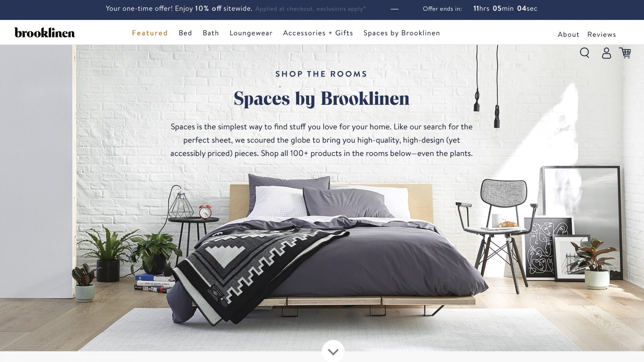
Brooklinen
External
Industry
Home furnishing / hospitality
Use Case
B2B, growth and scale
Case Study
Link to blog and video HERE
Story
As their B2B business started to grow, they knew they needed to migrate their operations from manual to online. Brooklinen knows Shopify is the best place for their B2B business because they have helped them grow their DTC to $200M with customized buying journeys and automated workflows.
Notes:
Speaking points:
Previously, the Brooklinen team was manually entering all orders into NetSuite, creating an inefficient process with a poor customer experience that cost their internal team countless hours on back office tasks
Decided to use B2B on Shopify because they could manage their entire business from a single platform from a simple, intuitive admin.
Brooklinen immediately saw increased efficiency and more time for their team to engage with customers instead of processing orders
They are already big believers in Shopify from their DTC success and want that same experience for B2B
Launching their new B2B store in Q1 2023, with a merchant case study launching at Editions to help us bring on more Plus merchants

Slide 30
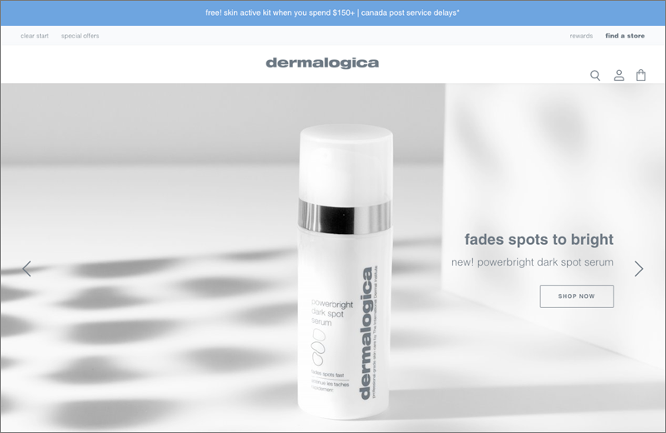
Dermalogica
Industry
Health and beauty
Use Case
B2B, custom solutions
Story
Before moving their B2B business to Shopify, they used a separate 3rd party platform that lacked the customization and flexibility they needed. With Shopify, Dermalogica has created custom solutions that elevate their brand and tailor to their buyers.

Slide 31




Filtrous
Industry
Medical supplies
Use Case
B2B, customization
Story
Before moving their B2B business to Shopify, Filtrous struggled with the lack of customization and innovation with BigCommerce. They looked to disrupt their antiquated industry with a more modern buyer experience and automated back-end. Filtrous understands the needs of younger buyers looking for a DTC-like buying experience for B2B and knows Shopify can help them adapt and be more agile.

Slide 32
Appendix
1/ Resources
2/ B2B + Shopify solutions
3/ Competitor deep dive
4/ Features
Notes:
TO DO:
Add link to resources, guru, forum channel, learning course
Add product demo clips
Add competitor deep dive slides (from Jonathan)

Slide 33
B2B + SHOPIFY SOLUTIONS
B2B is built directly into the core of Shopify and is compatible with most of Shopify’s features and solutions available to Plus merchants.
Shopify Checkout
Shopify Markets
Commerce Components (Enterprise)
B2B is compatible with Checkout One
Subscriptions, BOPIS, accelerated checkouts, and wallets are not supported
Delivery, shipping and payment customizations available via Functions
Markets and B2B are compatible (not Markets Pro)
Prices set by Markets will be overwritten by B2B price lists
B2B price lists support multi-currency
B2B is not current compatible with Markets Pro (coming in H2 2023)
B2B is one of the core components included in CCS
CCS pricing includes the use of the B2B component
B2B is not currently supporting headless storefronts (coming Q2 2023)
Notes:
See full list of compatibility and limitations HERE
POS - B2B is not currently supporting Shopify POS at this time
Subscriptions - B2B is not currently supporting subscriptions at this time

Slide 34
B2B features are turned on by default for Plus merchants
Available directly in the Plus admin under Customers. B2B customer must use new customer accounts to log into store.
Choose between two store formats - blended and dedicated
GETTING STARTED
Depends on Merchant’s business model and level of customization and flexibility needed for B2B
Considerations when onboarding
Upload existing companies and customers
Add companies in bulk using Matrixify. PWC merchants can use a migration tool starting Q2 2023

Slide 35
Competitor Deep Dive
Notes:
ADD: slides / talk track from Jonathan

Slide 36
 | B2B on Shopify | Big Commerce | SalesForce Commerce Cloud | Magento | Bottom Line
Integrated natively | 🟢 | 🔴 | 🟢 | 🟢 | Only B2B on Shopify will allow merchants to utilize the full power of our platform and our custom buying experience for both B2B and DTC.
Business buyer profile (Companies) | 🟢 | 🟢 | 🟢 | 🟢 | This is a table stake feature among B2B platforms but Shopify allows your to customize the input and output to back-end systems using APIs and integrations.
Price Lists | 🟢 | 🟢 | 🟢 | 🟢 | B2B on Shopify uses direct assignment (vs tags) which is easier to maintain, is supported via the API, and allows for both percentage off and fixed prices in the same price list.
Payment terms | 🟢 | 🟢 | 🟢 | 🟢 | B2B on Shopify will allow merchants to assign Companies a payment term that will be automatically included on all orders.
Customer-specific product publishing | 🟢 | 🟢 | 🟢 | 🟢 | Set customized product catalogs for each buyer and location to personalize the buying experience and increase conversion.
Quantity price breaks | 🟢 (via Scripts) | 🟢 | 🟢 | 🟢 | Issue automatic discounts as buyers purchase higher quantities.
Quantity rules | 🟢 (Feb 2023) | 🟢 (no multiple rule) | 🟢 | 🟢 (via 3P app) | Flexible and customizable for any business need - set min/max or quantity amounts that are specific for each product.
Vaulted credit cards | 🟢 (Feb 2023) | 🟢 | 🟢 | 🟢 | Merchants and buyers can streamline the order process with less friction by vaulting credit cards.
ACH payments | 🟡 (Q3 2023) | 🟢 (US only, via 3P app) | 🟢 (via 3P app) | 🟢 (via 3P app) | ACH payments can be done off platform for B2B orders but we are bringing ACH to Shopify Payments in 2023 for an easier buying experience and better conversion.
Headless support | 🟡 (Q2 2023) | 🟢 | 🟢 | 🟢 | Storefront and self-serve APIs specific to B2B to support headless stores.
Discounts | 🟢 | 🟢 | 🟢 | 🟢 | Discounts are already possible on the platform and will be able to be contextualized for B2B v. DTC customers by the end of Q1 2023.
ERP Integrations | 🟢 | 🟢 | 🟢 | 🟢 | ERP integrations will begin rolling out in Q1 2023 with the release of our stable APIs. Accumatica will be first to market with Netsuite and Microsoft.
PO Numbers | 🟡 (March 2023) | 🟢 (via 3P app) | 🟢 | 🟢 | The execution of PO numbers is still in debate which will dictate speed to market.

Slide 37
Features

Slide 38
PRODUCT OVERVIEW
B2B on Shopify includes a holistic suite of features with the full power of Shopify.
Companies a new customer record that will represent the business buyer. It will surface fields such as contact permissions, payment terms, price lists, catalogs assignment, tax ID, and enable merchants to associate multiple contacts and locations with a given company.
Price Lists allow merchants to set customer-specific prices via fixed prices or a percentage off of retail prices for all of the products they sell.
Payment Terms allow merchants to automate the process of assigning payment terms to orders or draft orders, and remove the manual work required today. Merchants will be able to track, sort, and collect on orders as they become due within the admin, with the ability to charge a business customers' vaulted credit card at a later date.
B2B Checkout allow buyers to add a vaulted card at checkout and view their assigned payment terms, payment methods, and wholesale discounts at time of purchase.
Customer Accounts allow customers to manage their account with ease and select the company location they're buying on behalf of, edit buyer information, and view and filter order history
Notes:
Building a best-in-class B2B experience that can be easily and efficiently managed requires a suite of foundational features which we’ve built into the new B2B on Shopify.
Company Profiles
Company profiles are the foundation of B2B on Shopify.
The company profile can represent multiple buyers and locations, each personalized with payment terms, price lists, tax exemptions, and user permissions.
Merchants are able to satisfy more complex use cases with flexibility by associating multiple customers with the same company or company location.
Company profiles increase a businesses flexibility by being able to choose a permission level for each buyer - “admin” or “ordering only”
Price Lists
Price lists are a fundamental part of customizable B2B commerce.
They enable merchants to create a truly customized buying experience for each wholesale customer by setting fixed-prices or percentage off prices for all of their products.
Each price list can be assigned to an individual business customer or location.
They can easily modify the currency and exchange rate for international buyers and enforce rules around when a given price applies.
The buyer sees exactly what price they will be paying while in the online store.
It is easy and seamless for merchants to set and update price lists without using tags, coding, or additional apps.
Price lists make the selling process more efficient because merchants no longer need to send individual discount codes to their buyers.
Net Payment Terms
Net payment terms allow merchants to further customize the buying process for each customer while also increasing their efficiency through automation.
Payment terms can be assigned to each company location and they will be automatically included on any orders created by the customer or merchant.
Payment terms support wholesale business practices because the buyer can place an order and not pay right away. They can receive an invoice to pay or use the self-serve portal to pay on their own when the payment is due.
The following net payment terms are available: Net 7, Net 15, Net 30, Net 45, Net 60, Net 90
Merchants and buyers have clear visibility into the payment due date and can track, pay and collect payment on orders as they become due in the admin.
Merchants also have the flexibility to set a custom payment due date for payments that do not fall into the interval options.
Custom Store Themes
Shopify is well known for its custom buying experience and B2B is not an exception.
B2B merchants can customize their online store theme with liquid support for a personalized wholesale buying experience.
As buyers become more sophisticated, B2B merchants are increasingly focused on custom branding and design in their online store.
Many wholesale merchants want their brand image to come across correctly to their business buyers as well as DTC buyers.
This includes designs specific to wholesale such as seasonal brand guides or specific merchandising for brick and mortar stores.
B2B Checkout
Shopify Checkout helps merchants of all sizes deliver the internet's most reliable and best converting checkout experience for every buyer by providing the power, speed, and flexibility to satisfy their unique business needs.
B2B Checkout allows you to customize and streamline the checkout experience for your wholesale buyers with pre-populated business contact information, net payment terms, payment methods, and wholesale discounts.
Self Serve Portal
As wholesale buyers are becoming more savvy, the self-serve portal allows them to purchase, pay and edit their account on their own much like they would with DTC.
The self-serve portal also adds security for the merchant, ensuring that only buyers who have been authenticated can see specific wholesale products and prices.
Buyers can view and filter order history, pay unpaid orders, and select the company location they’re buying for.

Slide 39
Q1 2023
Customize the B2B buying experience
Custom Product Publishing
Segment which buyers see a given product or variant, creating a more customized wholesale buying experience with curated product selections.
Quantity Purchasing Rules
Set min, max, multiple variant purchasing rules that increase average order value and simplify the fulfillment process. Set increment logic and sell products in case packs, customized by company location
Payment and Shipping Customizations
Access APIs to create custom logic in checkout for discounts, payments and shipping using Shopify Functions. This can be contextualized in blended storefronts.
Branding Customization
Keep branding and design consistent across your checkout and entire site to build brand loyalty and awareness for wholesale buyers.
Custom Themes and Templates
Use Liquid to delight your customers with a store theme and email templates that include personalized company information.
Metafields for B2B Buyers
Streamline back office tasks and build better relationships with your customers using custom data fields like companies and locations in the admin.

Slide 40
Q1 2023
Streamline your payment process
Vaulted Credit Cards
Let customers securely store credit cards at checkout or within customer accounts to streamline payments and order process.
Payment Reminders
Use standard payment reminders or set up a custom workflow using Shopify Flow to remind customers via email of upcoming payments as they’re due.
Due on Fulfillment Payment Options
Manage orders and reconcile payments by offering consistent or one-time “due on fulfillment” payment terms.
Invoices for Draft Orders
Create draft orders on behalf of your customers then easily collect payment by sending invoices directly from the admin.
B2B Discounts (March 2023)
Customize discounts by specifically targeting B2B buyers within a blended store. This allows you to separate your discount strategy between B2B and DTC buyers or apply not discounts at all
PO Numbers (March 2023)
Buyers will be able to enter a PO number at checkout and it will be surfaced on the thank you page, order status, draft orders, orders, self-serve, emails, invoices and packing slips.

Slide 41
Q1 2023
Easy self-serve for your business customers
Checkout to Draft
Increase efficiency by automatically approving customer orders. Or choose to gain more control and visibility over your checkout process by receiving orders as a draft, letting you review and approve them before finalizing.
Easy Re-orders
Make it easier to order frequently purchased items and sell more by duplicating previous orders.
B2B Welcome Email
Wholesale buyers now receive a dedicated email after they are entered as a business customer inviting them to visit your B2B site.
Flexible Shipping Address
Buyers can enter a 1-time use shipping address at checkout, which is critical for dropshipping businesses.

Slide 42
Q1 2023
Build custom solutions with B2B APIs
B2B APIs (Jan 2023)
Use our suite of B2B APIs to create the custom solutions your wholesale model needs, such as collection order notes, packaging and/or delivery instructions at checkout or even building B2B loyalty program.
B2B Compatible Apps (Jan 2023)
Customize your experience with B2B - compatible apps from the app store.

